Slide 1
Training as Part of Lean Change Management
Jeremiah Genest– Sanofi
ASQ Lean Conference – Session T13 – March 5, 2019

Slide 2
The views and opinions expressed in the following PowerPoint slides are those of the individual presenter and should not be attributed to any company with which the presenter is now or has been employed or affiliated.

Slide 3
Learning Objectives
In this session you will:
  Develop a learning plan for a change
  Apply a risk based approach to identifying training.
  Explain how lean changes interact with an organization's learning management system

Slide 4
Current State Future State
Identify the current processes
Process
Process
How are your processes changing?
Identify the current technology.
The means.
Technology
Technology
How is the technology changing?
Identify what do people do now
Identify what is important to people now
People
People
What will people do differently?
Notes:
To identify training we first need to understand the change. Walk the participants through the three major aspects of a change and how training impacts each
Specific – The CCR Request needs to be accurate and leave no doubt as to what the CCR will achieve.
Measurable – How will the system owner know when the project is complete.
Achievable – Make the CCRas small as possible after all it is easier to eat an elephant one bite at a time. It is far easier to manage a few smaller CCRs than one big one.
Realistic – Make the CCR easy to deliver, if it is over complicated then it is likely to hit problems and run over budget, be delivered late or of poor quality.
Timely – Does the CCR have to be complete by a certain date? If so put it in the scope that the project has to be complete by that date.

Slide 5
Change is…
Propose
  Current and Future State
Evaluate
  Assemble the Team
  Develop Change Plan
  Obtain Approvals
Effectiveness Review
  Evaluate Effectiveness
Plan
Act
Evaluate impact and effectiveness of training
Review - Effectiveness Review
Propose and Evaluate
Identify a training
strategy
Close
  Ensure Change Plan executed
  Escalate unaddressed risks
Review - Close
Implement
Check
Do
Implement
  Execute Change Plan
  Escalate risks and delays
Confirm training
Develop and provide training
Notes:
Propose, we look at the current state, identify our challenge and the problems we strive to address. Compare to the PDCA lifecycle

Slide 6
People
Time taken to accept the change depends on the input required
Exterior
Refusal - Rejection
Commitment
Integration
Change
Shock
“ I'll go for it ”
“ It's not true
It's not possible
I can't believe it ”
Denial
Commitment
Anger
Fear
“ If I try hard, can I make things the way they used to be ? »
Negotiation (protection strategies)
Exploration
Discovery of meaning
“ I see things differently ”
Time
“ Nothing works with me ”
“ It's not what I had planned but I'll manage ”
Sadness
Acceptance
Resistance
Exploration
Interior
Source: Elizabeth Kübler-Ross
| 6
Notes:
1 - Title: Time required to mourn the death of an idealised existence
2 - The K-R curve shows the emotional dimension of change
+ the role of time and the importance of implementing the right measures at the right time
The ultimate goal of change management is to drive organizational results and outcomes by engaging employees and inspiring their adoption of a new way of working. Whether it is a process, system, job role or organizational structure change (or all of the above), a project is only successful if individual employees change their daily behaviors and start doing their jobs in a new way. This is the essence of change management.
Giving employees a significant part to play in the transition process facilitates new beginnings in five ways:
It gives employees new insight into the real problems being faced by the organization as it comes out of past and redefines itself. When employees understand the problems, they are in the business for solutions.
By sharing these problems, you align yourself and your employees on one side and the problems on the other. The polarity is not between you and them; you are allies, not adversaries. If relationships has been frayed by change, this is a chance to rebuild them.
Giving employees a part brings their firsthand knowledge to bear on solving problems. Joint decisions are not necessarily better than unilateral ones, but including employees makes their knowledge available to the decision maker, whoever that may be.
The knowledge thus provided is more than the facts about the problem – it also includes facts about the self-interest of the various parties in the situation. Outcomes work bet if they serve the self-interest of those involved. Without that knowledge, the results are likely to be solutions that, however technically or economically satisfactory, run afoul of human respect.
Finally, everyone who plays a part is implicitly implicated in the outcome. That is, after all, how democracy works: you vote, and your vote is an implicit promise to abide by the results. Although actual votes are rare in organizations, this essential strength of democracy is still attainable and advantageous. As in the political arena, it is more important that people accept the solution, whatever it is, than that it is the ideal solution. In most cases, excellence is about seven parts commitment and three parts strategy.

Slide 7
Change Management & Human Performance
Strategy – Communicate the why
Internalization – What behavioral change do we expect?
Focus – Have we appropriately directed people’s attention to the change?
DELTA Training AND training for a New Operator!
Notes:
Awareness of the business reasons for change. Awareness is the goal/outcome of early communications related to an organizational change
Desire to engage and participate in the change. Desire is the goal/outcome of sponsorship and resistance management
Knowledge about how to change. Knowledge is the goal/outcome of training and coaching
Ability to realize or implement the change at the required performance level. Ability is the goal/outcome of additional coaching, practice and time
Reinforcement to ensure change sticks. Reinforcement is the goal/outcome of adoption measurement, corrective action and recognition of successful change

Slide 8
How will people learn?
Activity 1
Outline what the learner needs to know, apply, and master to become proficient.
Identify competency: Competency Management
Know Has knowledge of:
Apply Can apply knowledge of:
Master Can mentor/coach others in:
Part B: State the performance requirements and expectations related to this competency (knowledge, skills, attitude).
Know: Apply: Master:
Part C: Document influences or challenges that impact performance in this area.
Notes:
Start with stating in measurable terms the answers to the following questions. What objectives does the change want to achieve? What do performers need to do to achieve these objective(s)?
Bloom’s taxonomy to understand who we expect people to demonstrate.

Slide 9
Performer Analysis
Document the individuals performing key behaviors that will be the audience for training related to this need.
Know
Apply
Master
Identify the characteristics of the audience. For example, characteristics include number to be trained, specific locations, experience level, computer skills/education level, reading level, language, and attitude toward training.
Document the knowledge and skill gaps for the audience below.

Slide 10
Data Collection
Document the data collection strategy. For example, you can use Individual Interview, Work Observation, Group Interview, and Surveys.
Summarize the results found from data collection and analysis.
Notes:
Discuss how to collect data. And when

Slide 11
Evaluation Strategy
Outline the competencies (knowledge, skills, and attitudes)
Level 1: How do learners feel about the training? Example: Learner satisfaction survey
Level 2: Can learners perform the critical tasks to desired proficiency? Example: 1 hour test at the end of the instructor-led course
Level 3 Are job productivity measures improving or is the learner performing the skills back on the job? Example: Survey managers about performance 3 months or more after training.
Level 4 Was the business goal achieved? Example: Review updated KPI metrics to see if the goal has been reached.
Notes:
Level 1 is part of training execution
Level 2 should be part of training delivery
Level 3 is a great effectiveness review
Level 4 is an effectiveness review or part of business as usual

Slide 12
How much training do I need?
Is a change in knowledge or skills needed to execute the procedure?
Is the process or change complex? Are there multiple changes?
Criticality of Process and risk of performance error? What is the difficulty in detecting errors?
What is the identified audience (e.g., location, size, department, single site vs. multiple sites)?
Is the goal to change workers‘ conditioned behavior?
Activity 2
Notes:
Open the example. The workshop practitioners have a copy of this. Discuss.

Slide 13
Determining Training
Is a change in knowledge or skills needed to execute the procedure? | Is the process or change complex? Are there multiple changes? | Criticality of process and risk of performance error? What is the difficulty in detecting errors? | What is the identified audience (e.g., location, size, department, single site vs. multiple sites)? | Is the goal to change workers' conditioned behavior (e.g., changing habits, changing routine activities)? | What kind of training is required?
No. Change(s) are editorial or content changes do not alter the intent or meaning of the procedure or process. | No. Minimal change(s) that is not complex. | No risk to product or patient. No risk posed by performance error. There is no difficulty in detecting errors. | N/A | No | No training required
Change(s) are editorial or minor. However, employee awareness and acknowledgement is required. | No. One or more minor changes that is simple and easy to understand. | No or low risk to product or patient. No or low risk posed by performance error. There is no difficulty in detecting errors. | Any audience | No | Read and Understand Pre-Job Briefing

Slide 14
Determining Training
Is a change in knowledge or skills needed to execute the procedure? | Is the process or change complex? Are there multiple changes? | Criticality of process and risk of performance error? What is the difficulty in detecting errors? | What is the identified audience (e.g., location, size, department, single site vs. multiple sites)? | Is the goal to change workers' conditioned behavior (e.g., changing habits, changing routine activities)? | What kind of training is required?
Yes. When knowledge or skills are impacted or when new behavior or skills need to be learned or reinforced. | Yes. Moderately complex change(s) where scenarios and feedback are needed to reinforce new knowledge or skills. | Medium risk to product or patient. Medium risk posed by a performance error. There is minor difficulty in detecting errors. | Large groups that may be geographically diverse. | Yes. Simulated online activity, feedback, and assessment(s). | Computer- Based Training

Slide 15
Determining Training
Is a change in knowledge or skills needed to execute the procedure? | Is the process or change complex? Are there multiple changes? | Criticality of process and risk of performance error? What is the difficulty in detecting errors? | What is the identified audience (e.g., location, size, department, single site vs. multiple sites)? | Is the goal to change workers' conditioned behavior (e.g., changing habits, changing routine activities)? | What kind of training is required?
Yes. The complexity of the change(s) requires face-to-face interaction to give trainees the opportunity to talk through changes and ask questions, while providing behavior reinforcement and the opportunity to practice new skills/behaviors in a safe setting. | Yes. Moderate to highly complex change(s) that requires critical thinking to perform, while providing a safe setting to reinforce knowledge and practice new skills/behaviors. | Medium or high risk to product or patient. Medium or high risk posed by a performance error. There is a medium to high difficulty in detecting errors. | Any size population that can be broken down into manageable groups | Yes. There is a high level of interaction with real-time responses to participants. Provides elaboration and examples, as well as a classroom assessment(s). | Instructor- Led Training

Slide 16
Determining Training
Is a change in knowledge or skills needed to execute the procedure? | Is the process or change complex? Are there multiple changes? | Criticality of process and risk of performance error? What is the difficulty in detecting errors? | What is the identified audience (e.g., location, size, department, single site vs. multiple sites)? | Is the goal to change workers' conditioned behavior (e.g., changing habits, changing routine activities)? | What kind of training is required?
Yes. When practical application in the work environment and real-time feedback is necessary to reinforce skills/behavior. | Yes. Highly complex or new skills/knowledge required, such as using specific equipment/tools or performing complex tasks. The goal is to measure the trainee's proficiency in the targeted competency. | High risk to product or patient. High risk posed by a performance error. There is a high difficulty in detecting errors. | Any size population, however it is intended to be a one-on-one training experience. | Yes. There is a high level of interaction, with real-time question and response between trainer and trainee. Provides immediate feedback and coaching, as well as a real-time competency assessment. | On-the-Job Training

Slide 17
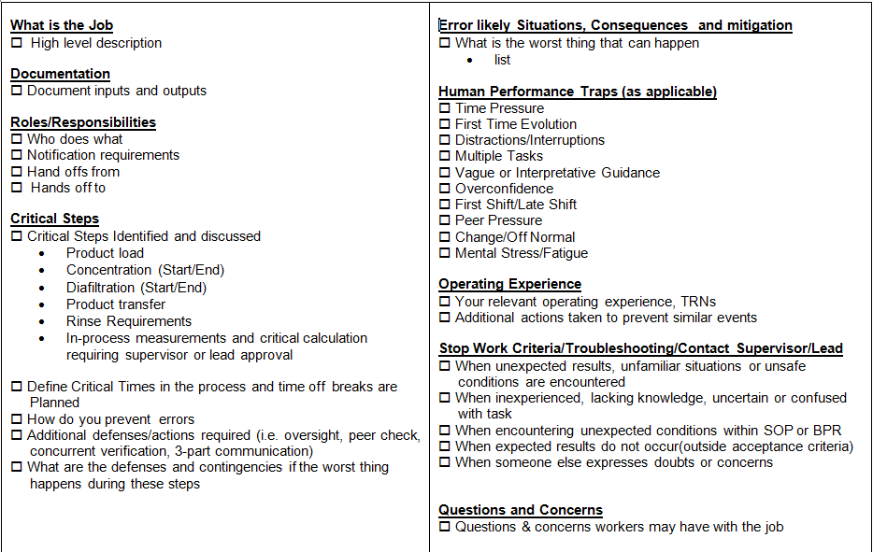
Pre-Job Briefing
Notes:
No matter the training methods determined, make sure you plan for failure and have appropriate floor level pre-execution training – often called a pre-job briefing. Plan to reduce human error.

Slide 18
Structured Discussion
Document Revision Drivers Why has this document revised?
Revision Scope Who does the revision impact?
Functional Area(s)
Job Role(s)
Task(s)
Revision Description A brief summary of the key changes end users need to know
Work Impact How will the document changes affect the end users’ work?
Discussion Questions Open-ended questions asked by the facilitator to assess knowledge transfer
Notes:
Structured Discussion training delivery method produces great results because it gets us out of our own head, drives us to a better understanding of changes
Through discussion we externalize thought, play with it, refactor and reabsorb it for a better understanding than we had before
An open ended question encourages full, meaningful answers
Person being asked questions uses their own knowledge on the subject
Open ended questions are the opposite of a closed-ended question, which encourages a short or single-word answer (example: “Do you understand?“ “Was that clear?“)
When using open-ended questions, control of conversation switches over to person being asked the questions, it begins an exchange between people
Begin with:
Why
How
What
Describe
Tell me about…
What do you think about...

Slide 19
Take-aways
Through this session, you should have learned how to:
  Apply a risk based approach to identifying training.
  Develop a learning plan for a change
  Explain how lean changes interact with an organization's learning management system

Slide 20

Questions?
Jeremiah B Genest– Phone: (857) 288-9361 – Email: jeremiah.genest@sanofi.com

