Slide 1
Change Management and Control: Lessons From a Consent Decree
Jeremiah B Genest– Sanofi
ASQ World Conference – Session W11 – May 2, 2017
Notes:
Opening slide
Ensure following provided:
Example template for activity
Training evaluation
Pre-job briefing example

Slide 2
The views and opinions expressed in the following PowerPoint slides are those of the individual presenter and should not be attributed to any company with which the presenter is now or has been employed or affiliated.

Slide 3
Learning Objectives
In this session you will:
  Evaluate lessons learned from a consent decree and building a robust pharmaceutical quality system for your use
  Explain how the pharmaceutical experience can deepen your understanding of ISO 9001:2015, especially risk based thinking
  Identify how change management fits into a culture of quality
  Understand how the change management system increases compliance
  Use a few simple but effective tools for change management

Slide 4

Comparison of Quality Systems
Key PQS and Business Feature | cGMP | ICH Q10 | ISO 9001
Change Management
System should be effective, ensure continual improvement, include risk management and change of product ownership, be evaluated post implementation. | --
CAPA
CAPA to be implemented following specified investigations and root cause to be determined.
Quality Risk Management
Enhanced, Quality by Design Approach | -- | Optional | Optional
Process Performance and Product Quality Monitoring System
Establish control strategy to facilitate timely feedback/feed forward, measure, analyze, identify sources of variation, and drive continual improvement. | -- | ICH Q8 | Product Realization
Business Process Performance | -- | --
Knowledge Management | --
Senior Management Responsibilities
Accountability for PQS including governance and reviews, establish Quality Policy and Quality Objectives. | -
√ indicates requirements covered in the respective PQS Underlined text emphasizes specific requirements.
Learning Objective 2
Notes:
The main differences between a PQS based on ICH Q10 and a PQS based on ISO 9001 or CGMPs relate to the
extent of:
• Continual improvement initiatives
• Senior management responsibilities
A change management system is a GMP requirement regardless of the PQS used, but the extent of application of a
change management system will depend on the PQS.
The key benefit of implementation of an ICH Q10-based PQS across a product lifecycle is that it helps to implement
the Quality by Design (QbD) concepts of ICH Q8 (R2). An ICH Q10 quality system:
• Strengthens the links between pharmaceutical development and commercial manufacturing activities
• Helps to facilitate innovation and continual improvement
Organizations that implement an ICH Q10-based PQS should be able to demonstrate an improved understanding of
the development and manufacturing processes that impact product quality. This insight should enable more effective
evaluation of the potential impact of change and may allow organizations to make changes under their PQS, without
necessarily having to file a post approval regulatory application/supplement. In addition, ICH Q10 describes the role
that senior managers have in assessment and review of the PQS.
cGMP = Regional regulatory requirements. Alignment of FDA and EMA regulatory requirements, and other major markets such as Japan and Canada.
ICH Q10 Pharmaceutical Quality Systems (The tripartite harmonised ICH Guideline was finalised under Step 4 in June 2008.
This Guideline applies to pharmaceutical drug substances and drug products, including biotechnology and biological products, throughout the product lifecycle.
The elements of Q10 should be applied in a manner that is appropriate and proportionate to each of the product lifecycle stages, recognising the differences among, and the different goals of each stage.) - http://www.ich.org/products/guidelines/quality/quality-single/article/pharmaceutical-quality-system.html

Slide 5

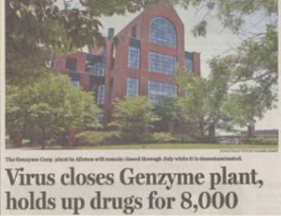
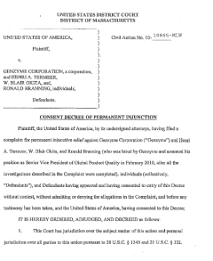
The Consent Decree - Background
Oct Genzyme engage 3rd party consultants to help in QS remediation
Jan ‘09
Apr ‘09
Jul ‘09
Oct ‘09
Feb FDA issues warning letter
to Genzyme
Jun & Jul Shutdown
to ensure eradication of
viral contaminant and re-start of bioreactors
Oct - Nov FDA inspection
ultimately leads to a consent decree

Slide 6
Consent Decree
Work Plan
Certification
Audit
Revision and Implementation of Quality System
Third party review and certification
Demonstration of sustainable performance during period third party audits
Use of the Revised Quality System for Operations as well as Facility and Equipment Modifications
Third party oversight
FDA Inspection
Change Management was one of the first elements of the revised quality system that was implemented
Creating a robust process allowed us to demonstrate control of change
6
Notes:
For workplan “Implementation of a revised quality system”. Upgraded of the facility and system.
Focus in front end on change control, that focused and recognized the importance of change management to create ta robust process that allowed us to demonstrate control to change

Slide 7
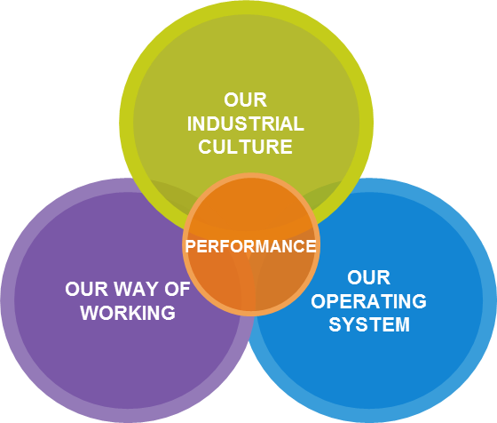
Our path, build the culture
A cultural change based on the Gemba mindset, requiring new managerial behavior and empowering employees
Employee Engagement
Empowerment
Gemba
Lean Capability
Learning Organization
Change Management
Performance driven while working together towards breakthrough transformation and continuous quality improvement
Mission/Vision
Performance Plans
Strategic Deployment
Communication
Project Portfolio Management Process
+QDCI
Individual Objectives setting
Coaching
Performance monitoring
Improvement Management
Towards an agile end-to-end flow where compliance & Quality are competitive advantages
Process Capability
Process Efficiency
Balanced Performance around Safety, Quality, Delivery, Cost and Involvement
3P Program
Site Governance
Learning Objective 3
Notes:
Change management was, and continues to be, central to our success

Slide 8
Change Management is…
Technical
Organization
People
The How
  Assess – What is the impact of our changes
  Handle – Implementing our changes
  Release- Using the change
Organization Focused
Set of best practices
Change Control is…
The What
  The execution step of an individual change
Scaled to Function
Notes:
Scaled to function means that sometimes companies have more than one sort of change control process.
Change management applies throughout the enterprise. Every change.
Change control is the set of processes to apply.
ICH Q10 defines change management as, “A systematic approach to proposing, evaluating, approving, implementing
and reviewing changes.”
This description makes clear that the scope of change management is broader than the scope of change control,
which is described in ICH Q7 [5], Section 13.
“Change control” often refers to the execution step of an individual change, whereas “change management” is a
more systematic holistic approach to the review and management of a portfolio of changes and the change process,
including all components of “change control.” In an ICH Q10-based PQS change management applies to the entire
product lifecycle. Additionally, if an organization chooses to operate an ISO 9001 system, the change management
system could also include other elements not covered under ICH Q10 or GMP, e.g., changes to business processes.
The high-level model here is adapted from the ICH Q10 definition of change management and
the four steps described in ICH Q10. Each step ends with either a gate or a decision point which
should be completed before proceeding to the next step.

Slide 9
Changes are to systems
Individuals
A change to any of the factors upsets the system's balance.
Once the change has begun, there are 2 possible ways of recovering a balance :
Social culture and structure
Structure
&
processes
Business
seen as a complete system
Strategy
Methods & techniques
The other
factors
evolve to align
with the change
The other
factors
resist and
the system returns
to the status quo
External environment
Success of change
Failure of
change
There is no such thing as a neutral change : any change modifies an ecosystem or equilibrium
Notes:
Individuals often want to just get their change. The art of change management is doing that nimbly and at the same time managing the impacts within and across systems.

Slide 10
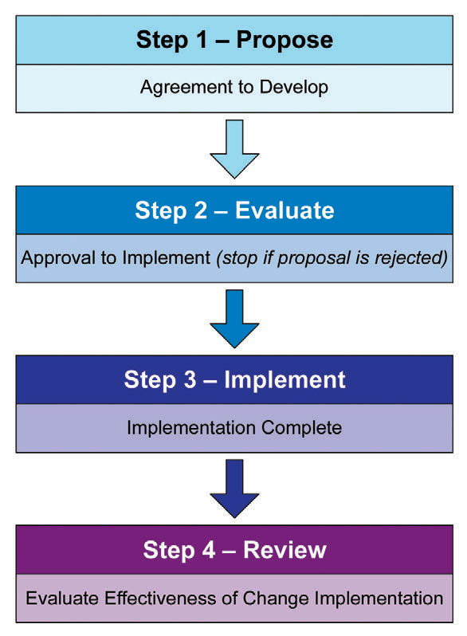
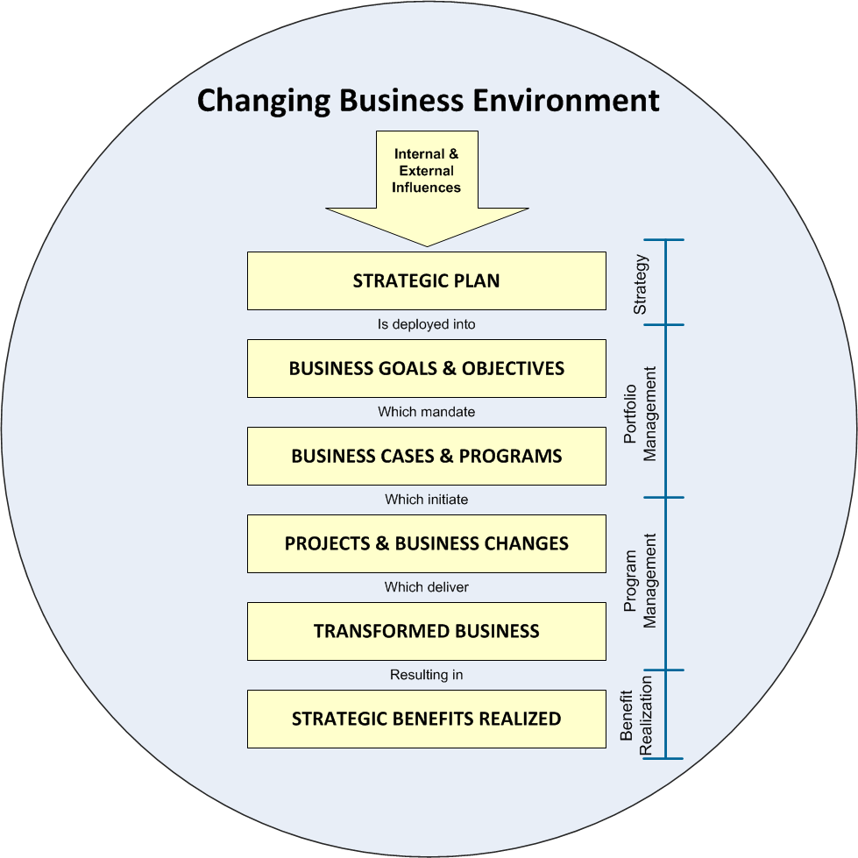
Changes are Strategic and Tactical
Learning Objective 3
Notes:
Change control fits into our strategic plan.
Discuss the various drivers for CCRs: business vs compliance for example
Ask the following question
In your view, how well does ALF currently assign responsibility for defining and delivering benefits?
Do you think that the CCR process is well integrated to this process

Slide 11
Level of Change
Level of Change | Change Management | Change Control
Transactional | Minor | Few Closely clustered
Operational | Major | Several Across several areas
Transformational | Fundamental | Many Iterative Often in waves
Notes:
Transactional – changing equipment, introducing a new process
Operational – introducing new systems, new ways of working
Transformational – new wyas of working, the consent decree and a merger (from Genzyme to Sanofi)

Slide 12
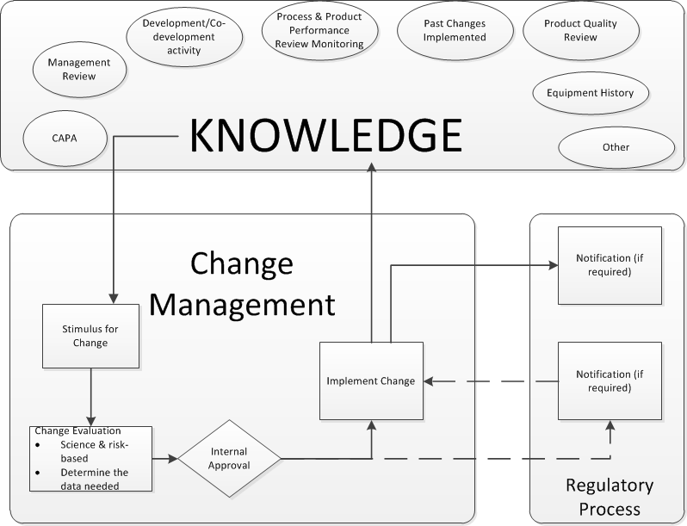
Knowledge Management
Learning Objective 4
Notes:
Change Management and Knowledge management are closely entwined. In a regulated industry like biopharma, the regulatory process in an important part.
An effective change management system includes active knowledge management, in which information from multiple sources is integrated to identify stimuli for changes
needed to improve product and/or process robustness.
These sources can include, but are not limited to, developmental studies, process understanding documents, product or
process trending, and product-specific CAPA outcomes. They should be comprehensive across the product lifecycle, including all relevant stakeholders (R&D,
manufacturing, CMOs, suppliers, etc.). With respect to sharing knowledge between the firm and suppliers, and between the firm and CMOs, considerations for sharing
knowledge that relates to product and process robustness or otherwise informs changes should be built into quality agreements and/or contracts.
In addition to individual sources of information, there should be a mechanism to provide a holistic view of quality performance for a specific product or product family
on a regular basis, as captured in the PQR. This should include steps taken to identify and manage variability introduced from raw materials and the manufacturing process that could impact on product quality during its lifecycle. This allows for the identification of further need for change not apparent
when the data are viewed in isolation.

Slide 13
Change Control: One or Many?
Simplify your variety of change controls
Understand levers:
  Regulatory
  Product release
  Risk
Strive for scalability within one change control system.
Notes:
Most important thing? Have a tool to navigate between the leveled changes.

Slide 14
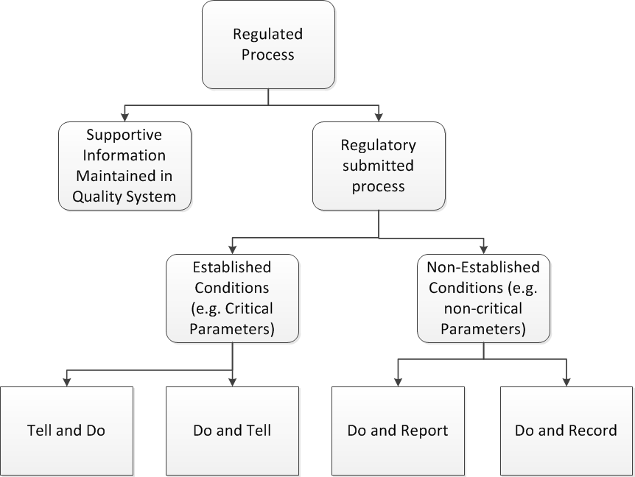
Understand the regulatory landscape
Notes:
Build your regulated process in, not only to a specific change control process but to the decision of which change control process to use.

Slide 15
Change is…
Propose
  Current and Future State
Evaluate
  Assemble the Team
  Develop Change Plan
  Obtain Approvals
Effectiveness Review
  Evaluate Effectiveness
Plan
Act
Review - Effectiveness Review
Propose and Evaluate
Review - Close
Implement
Check
Do
Close
  Ensure Change Plan executed
  Escalate unaddressed risks
Implement
  Execute Change Plan
  Escalate risks and delays
Notes:
Propose, we look at the current state, identify our challenge and the problems we strive to address. Compare to the PDCA lifecycle

Slide 16
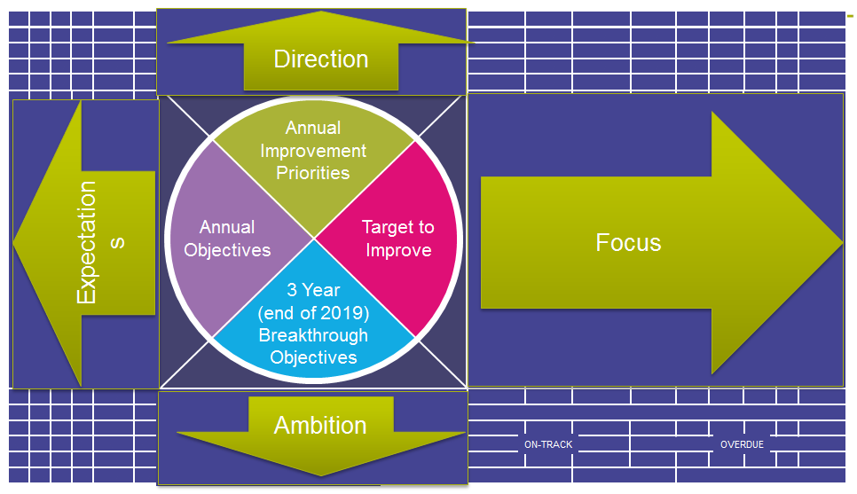
Propose the Change
Future State
Current State
Internal Questions
Strategic alignment?
Hidden cost
Impact to team
External Questions
Regulatory need?
Internal control?
Impact to other teams
Impact customers?
Positive outcome
Negative Impact, revise or stop
Positive Impact
Notes:
Propose is asking yourself some important questions about what we are doing and why.

Slide 17
Current State Future State
Identify the current processes
Process
Process
How are your processes changing?
Identify the current technology.
The means.
Technology
Technology
How is the technology changing?
Identify what do people do now
Identify what is important to people now
People
People
What will people do differently?
Notes:
Specific – The CCR Request needs to be accurate and leave no doubt as to what the CCR will achieve.
Measurable – How will the system owner know when the project is complete.
Achievable – Make the CCRas small as possible after all it is easier to eat an elephant one bite at a time. It is far easier to manage a few smaller CCRs than one big one.
Realistic – Make the CCR easy to deliver, if it is over complicated then it is likely to hit problems and run over budget, be delivered late or of poor quality.
Timely – Does the CCR have to be complete by a certain date? If so put it in the scope that the project has to be complete by that date.

Slide 18
Set Success Metrics
Set the metrics
  Economic
  Quality
  Technical
  Organization
Determine
  How
  When
  Why
Notes:
How to collect, when to collect and most important the why. All connect to the reason for the change

Slide 19
Activity
Identify a change
Follow along on the template
Activity 1
Notes:
Ask everyone to take a look at the templates before them. Ask them to identify a change. Brainstorm some examples. We will be using this change as we move through.

Slide 20
Evaluate
There are three levers for change
  Risk
  Science/Technical
  Organization and people
Experts evaluate change and develop a change plan
  Know your organization
  Build a matrix to identify

Slide 21
Know your organization
Build a decision tree or matrix to drive changes to the right teams
Ensure it is updated continually as changes are made
Department | Required if the change meets any of the following criteria:
Automation Engineering | Impacts a Process Automation System Impacts any Process Automation SOPs
Contamination Control | The change impacts environment integrity, conditions or monitoring, including: Changes to a controlled room or area that impact integrity Changes in sampling methodology Construction activities Changes in personnel or material flow The change will result in or modify exposure of product to the environment. The change can impact microbiological control within a process stream, raw material or process equipment. The changes are to water systems.
Engineering | The change is to equipment, piping, or instrumentation Impacts equipment operating or control parameters Impacts plot plans Impacts design documents The dimensions of the room are changing
Facilities | It is new equipment and Facilities is the equipment owner Change to equipment and Facilities is the equipment owner The preventative maintenance cycle/document is impacted by this change There any Facilities SOP’s affected by this change There are new requirements for materials or service providers Changes to Business Management System or Environmental Management System The dimensions of the room are changing
Finance | The change is to the functionality or use of Enterprise Resource Planning system The change is to the warehouse operating system Product Costs may need to be updated
Notes:
Create a tool that will help people quickly impact who is impacted, who needs to be consulted and involved. This will build your project team.

Slide 22

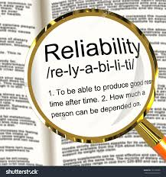
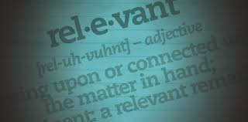
The importance of experts
Relevancy
Reliability
Accuracy
Efficiency
Notes:
The change Project team leverages SMEs to harness the collective intelligence (synergy) for the benefit of the site.
Relevancy – The information gathered is of value
Reliability – The process by which the information is collected should be consistent
Accuracy – The data should be expressed in a manner that most accurately reflects its information content
Efficiency – The design and implementation of the tasks should minimize the burden

Slide 23
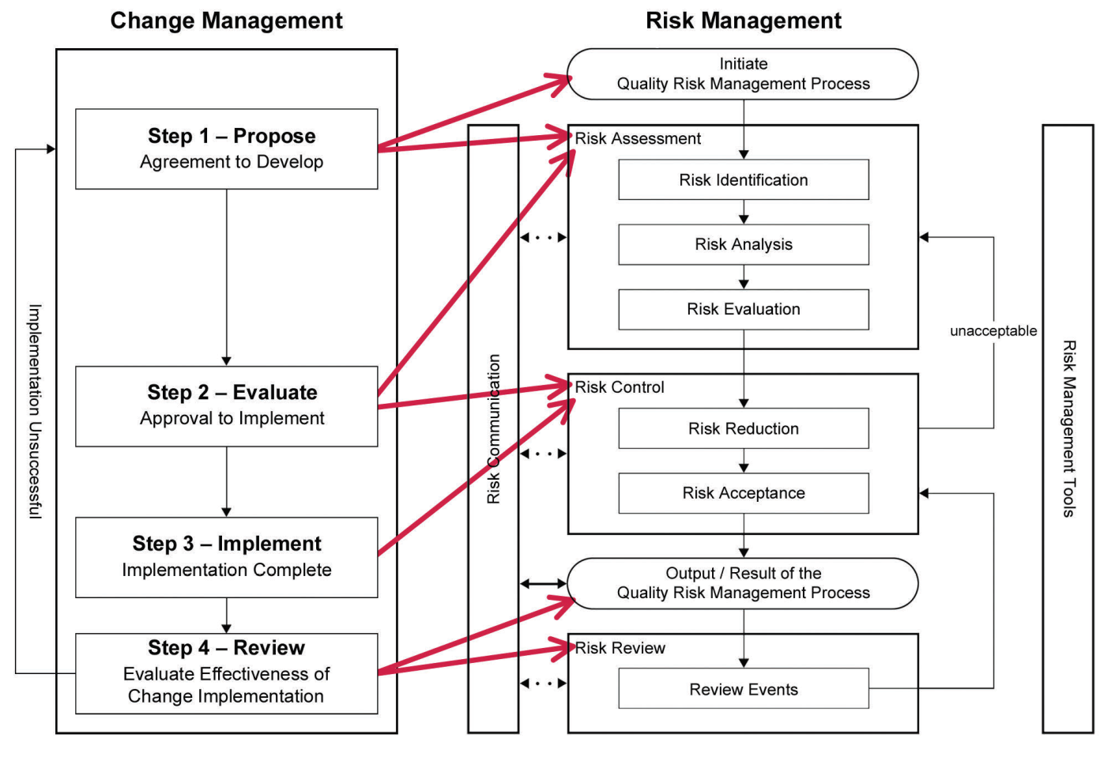
Risk Management
Differentiate between risk and impact
The level of effort commensurate with risk of the change
Learning Objective 4
Notes:
As outlined in ICH Q9, quality risk management can be used during change control help assess:
• The proposed change
• The effectiveness of the change once implemented
It is important to be able to understand two important concepts:
Differentiate between risk and impact
How to participate in a risk assessment

Slide 24
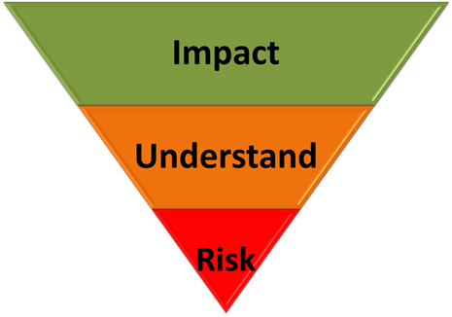
Differentiate between risk and impact
Risk is an event that may or may not happen as a result of the change
Impact is what always happens as a result of the change
  Impacts are to the business and it’s operations
All Changes have some element of risk
Risk can be effectively managed ONLY if it is understood.
Understanding can only be realized with sufficient information
Notes:
You will be told that the Risk is an event that may or may not happen. You will also be told that Impact is what will happen if the Risk occurs (or ‘eventuates’). Sounds clear, simple, direct.
Now let’s apply what we’ve learned. You are concerned (rightly) about crashing your car. Is that a risk? Or is it an impact? (Avoiding the pun on crash and impact). It is not certain that your car will crash, so that is a risk. What will be the impact? Easy: you may experience fatality. Or you may experience serious injury, or you may experience light injury.
But why isn’t crashing the car an Impact?
What caused the car crash? Did your brakes malfunction? Was that a risk? Was there a risk that your brakes would malfunction? Were you hit by a drunken driver? Was that a risk you faced when you were driving? Absolutely.
So let’s say: Risk = Possibility of being hit by a drunker driver. What is the impact? Crashing your car. What was the risk earlier is now the impact.
The distinction between risk and impact is not so clear. What is a risk from one perspective is an impact from another. But which perspective is the right one to take? And which perspective should you be taking when you fill in the risk register? Do you put “Car crash” under Risk or under Impact?
All decisions will have some element of risk associated with them and how the risk is to be ultimately managed can shape the actual decision itself.
Risk can be effectively managed ONLY if it is understood.
Understanding can only be realized with sufficient information available to provide appropriate context to the risk in relation to the decision to be made and the potential impact it will have on the business.

Slide 25
Understand the change
Aspect of a system or process that is critical to the proper functioning of the system.
Critical Parameter | Current | Future | Differences
What changes?
What needs to happen to make the change?
Activity 1
Notes:
Critical parameters – a well defined process will know most of these
Step #1 -- Define Extent of the Change
Be specific, and list all boundaries for all systems. Without a clear understanding of the change, you can't identify risks.
Take a tact of tying to identify what will probably occur or be going on before, during, and after the change. Try to consider as many environments or angles as possible.
Your goal here is to describe, as fully as possible, the environment and situation for the change. The more detail, the better.
Step #2 -- Determine Key Differences
The basis of the impact assessment is to compare the proposed state after the change with the state before the change. Of course, with something new there is no existing baseline, in which case you can choose a similar situation, or even do research about other implementations.
The goal is to identify all of the differences, large and small, between the pre and post -change states. Examine previous changes. Check for similar changes in other systems, departments, processes, etc. Check for failures by reviewing past change records, incident logs, and problem reports.
Here it is very important to uncover positive, negative, and neutral trends. This means you should check for successful changes as well.

Slide 26
Understand the effects
What will be done to monitor for the potential effect?
Intended and potential side effects – also potential failures
Potential Effects | Prevention Actions | Monitoring Actions
Prove effective
What will be done to prevent the potential effect?
Activity 1
Notes:
Step #3 -- Focus on Effects
Study each of the differences listed in the table created in the last step. Ask if this difference has the potential to cause unexpected side effects. Consider the reference materials—has their been a history of fault or failure because of this difference? Has this difference not had any impact? Be sure to imagine positive, negative and neutral affects. This step is also ideal for a group
Step #4 -- Sort and Prioritize
Your output is a list of recommendations, with pros and cons. Your work is self-justifying. That is, using plain simple terms, past experience, and formal planning, you will present what is currently happening, what might happen and ways to make sure the bad does not occur. This is all it takes for leaders to make decisions and prepare.
Step #5 -- Make a Decision
Use the results of the sorted, prioritized risk assessment to identify vulnerabilities and make recommendations to mitigate the risks. Use the recommendations to show how to avoid, or if too costly, respond effectively, should something go wrong with the change. Compare the benefits of following your recommendations to the potential costs of not following them. Decide whether the potential risk is acceptable or not.
Summary
A formalized approach to change impact assessment is inexpensive and can produce high quality decisions. It requires following a process, and having the time to follow a process. While the approach presented here is well tested and sound, it does have some limitations:
This method relies heavily on the references you choose -- choose the wrong reference or miss a reference and it might not work as well
Under monitoring actions stress the importance of continually updating your trending program.

Slide 27
Add risk assessment
Potential Effects | Likelihood | Severity
Likelihood of Occurrence: How likely is it that the potential failure will occur?
Severity: If the failure did occur, how extensive/ pervasive would the negative impact be?
Remote | Failure unlikely
Average | Failure reasonably likely
Certain | Failure very likely, or unknown
Minor | Insignificant effect, and/or no long-term consequences
Moderate | Moderate significant effect, and/or medium-term consequences
Critical | Significant effect, and/or lasting, long-term pervasive consequences
Notes:
It is often useful to add an element of risk thinking, by considering likelihood and severity. Even detectibility can be added.
Establish the criteria you will use for likelihood and severity. Ask the atendees if anyone has an idea why we do this first, rather than right before we will actually perform the ranking? (Answer: 1- to ensure that all participants in the risk assessment have a working vocabulary of the criteria, and 2- to keep ourselves honest and prevent any intentional or unintentional manipulation of the criteria based on an expected outcome.)
The criteria for likelihood and severity show here are qualitative in nature. For likelihood, we’ll be asking “how likely is it that the potential failure will occur?” We’ll answer that question as either “remote, average, or certain.” When we rank severity, we’ll be asking “if that potential failure WERE to occur, how extensive or pervasive would the negative impact be?” We will answer that question as either “minor, moderate, or critical” impact.
This serves as a gateway to more rigorous, quanatative risk tools.

Slide 28
Build criteria specific to you
Ranking | Guideline | Failures per Operation | Time between failures
 |  | Change Specific Criteria
Remote | Failure unlikely | <2 out of every 50 operations | >3 years
Average | Failure reasonable likely | 3-6 out of every 50 operations | >month but less than 3 years
Certain | Failure very likely | 7-10 out of every 50 operations Or Unknown | <Month Or Unknown
Ranking | Guideline | Change Specific Criteria
Minor | Insignificant effect, and/or no long-term consequences | No loss to product No impact to quality or to SISPQ Equipment breakage or malfunction that can be fixed through correct maintenance (~4 hours, with spare parts available)
Moderate | Moderately significant effect, and/or medium-term consequences | Probable SISPQ/Quality Impact to 1 lot Contaminates: 1 functional area, 1 piece of equipment, 1 unit of operations Equipment breakage or malfunction that requires fabrication or will take more than 4 hours
Critical | Significant effect, and/or lasting, long-term, or pervasive consequences | Probable SISPQ/Quality impact to more than 1 lot Pervasive contamination Hazardous situation that may endanger equipment (equipment only usable after additional design activities) Unknown severity
“Number of failures” and periods noted as “Time between failures” are provided for discussion purposes only. They are not actual examples and should not be viewed as recommendations.
Notes:
Criteria are as only as good as they are applicable

Slide 29
What If approach
What If? | Answer | Likelihood | Severity | Recommendations
What could go wrong? | What would happen if it did? | How likely? | Consequences | What will we do about them Again – prevent and monitor
Rely on the experience of the team!
Notes:
Another way to come up with potential effects is to use the What If tool.
What –If Analysis is a structured brainstorming method of determining what things can go wrong and judging the likelihood and consequences of those situations occurring. The answers to these questions form the basis for making judgments regarding the acceptability of those risks and determining a recommended course of action for those risks judged to be unacceptable. An experienced review team can effectively and productively discern major issues concerning a process or system. Lead by an energetic and focused facilitator, each member of the review team participates in assessing what can go wrong based on their past experiences and knowledge of similar situations.

Slide 30
Current vs Future Controls
Current controls are the processes you will implement the change under
  Affect Likelihood (detectability)
Future controls are what you put in place as a result of the change
  Mitigations

Slide 31
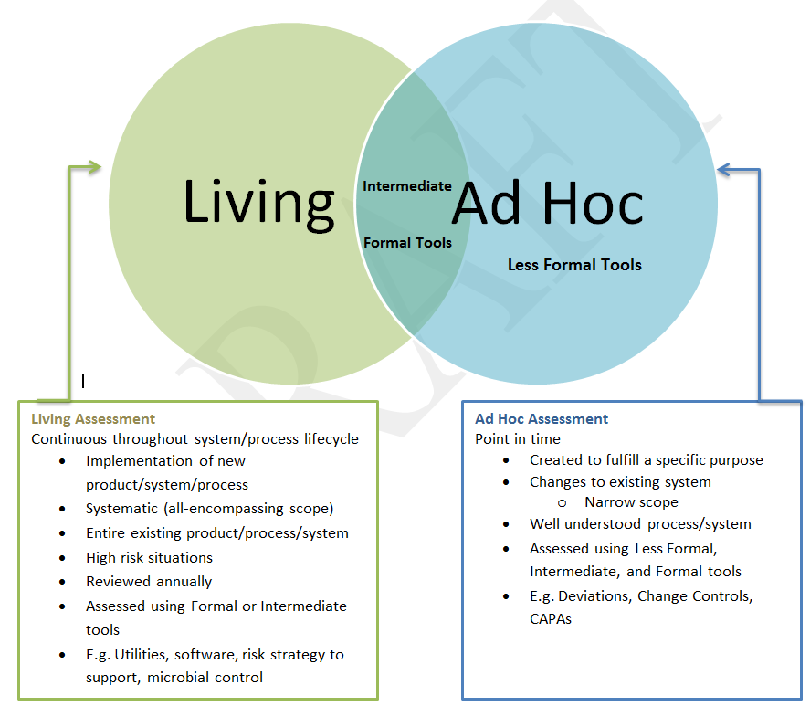
Risk Management Considerations
Not all changes utilize the same tool
Identify upfront
Known when to go to a more formal tool
Notes:
Living Risk Assessments
Living risk assessments are performed in conjunction with the implementation of a new system, product, or process, or to prospectively evaluate risks associated with an existing system in an effort to prevent risk realization. They are updated throughout the product /system lifecycle to continuously assess risks that may arise or change as the product/system matures. Living risk assessments require a risk review on an annual basis at a minimum. They may apply to:
New or existing product development
New or existing process/method development (as applicable)
New or existing equipment, utility, and/or software systems
New or existing facilities, system(s)
Technology transfer
Product/process improvement
Vendor selection/qualification
Validation studies
New technology
Entire processes and systems
Site Risk Profile Reports
Ad Hoc Risk Assessments
Ad hoc risk assessments are invoked to fulfill a specific purpose, such as to evaluate the impact of a change or to facilitate risk-based decision making on well-understood, lower risk situations. They may apply to:
Deviations and Investigations
Change control
CAPA
Material sampling
Laboratory investigations
Complaint handling
Documentation
Training/education
Auditing/inspection
Periodic quality and product reviews
Existing manufacturing processes and facilities
Decommissioning
Engineering concept phase
Projects
Packaging and Label Changes (as applicable)
Technology Transfer (as applicable)

Slide 32
People
Time taken to accept the change depends on the input required
Exterior
Refusal - Rejection
Commitment
Integration
Change
Shock
“ I'll go for it ”
“ It's not true
It's not possible
I can't believe it ”
Denial
Commitment
Anger
Fear
“ If I try hard, can I make things the way they used to be ? »
Negotiation (protection strategies)
Exploration
Discovery of meaning
“ I see things differently ”
Time
“ Nothing works with me ”
Sadness
Acceptance
“ It's not what I had planned but I'll manage ”
Resistance
Exploration
Interior
Source: Elizabeth Kübler-Ross
| 32
Notes:
1 - Title: Time required to mourn the death of an idealised existence
2 - The K-R curve shows the emotional dimension of change
+ the role of time and the importance of implementing the right measures at the right time
The ultimate goal of change management is to drive organizational results and outcomes by engaging employees and inspiring their adoption of a new way of working. Whether it is a process, system, job role or organizational structure change (or all of the above), a project is only successful if individual employees change their daily behaviors and start doing their jobs in a new way. This is the essence of change management.
Giving employees a significant part to play in the transition process facilitates new beginnings in five ways:
It gives employees new insight into the real problems being faced by the organization as it comes out of past and redefines itself. When employees understand the problems, they are in the business for solutions.
By sharing these problems, you align yourself and your employees on one side and the problems on the other. The polarity is not between you and them; you are allies, not adversaries. If relationships has been frayed by change, this is a chance to rebuild them.
Giving employees a part brings their firsthand knowledge to bear on solving problems. Joint decisions are not necessarily better than unilateral ones, but including employees makes their knowledge available to the decision maker, whoever that may be.
The knowledge thus provided is more than the facts about the problem – it also includes facts about the self-interest of the various parties in the situation. Outcomes work bet if they serve the self-interest of those involved. Without that knowledge, the results are likely to be solutions that, however technically or economically satisfactory, run afoul of human respect.
Finally, everyone who plays a part is implicitly implicated in the outcome. That is, after all, how democracy works: you vote, and your vote is an implicit promise to abide by the results. Although actual votes are rare in organizations, this essential strength of democracy is still attainable and advantageous. As in the political arena, it is more important that people accept the solution, whatever it is, than that it is the ideal solution. In most cases, excellence is about seven parts commitment and three parts strategy.

Slide 33
Change Management & Human Performance
Strategy – Communicate the why
Internalization – What behavioral change do we expect?
Focus – Have we appropriately directed people’s attention to the change?
Notes:
Awareness of the business reasons for change. Awareness is the goal/outcome of early communications related to an organizational change
Desire to engage and participate in the change. Desire is the goal/outcome of sponsorship and resistance management
Knowledge about how to change. Knowledge is the goal/outcome of training and coaching
Ability to realize or implement the change at the required performance level. Ability is the goal/outcome of additional coaching, practice and time
Reinforcement to ensure change sticks. Reinforcement is the goal/outcome of adoption measurement, corrective action and recognition of successful change

Slide 34

How will people learn?
Outline what the learner needs to know, apply, and master to become proficient.
Identify competency: Competency Management
Know Has knowledge of:
Apply Can apply knowledge of:
Master Can mentor/coach others in:
Part B: State the performance requirements and expectations related to this competency (knowledge, skills, attitude).
Know: Apply: Master:
Part C: Document influences or challenges that impact performance in this area.
Activity 2
Notes:
Start with stating in measurable terms the answers to the following questions. What objectives does the change want to achieve? What do performers need to do to achieve these objective(s)?
Bloom’s taxonomy to understand who we expect people to demonstrate.

Slide 35
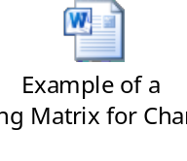
How much training do I need?
Is a change in knowledge or skills needed to execute the procedure?
Is the process or change complex? Are there multiple changes?
Criticality of Process and risk of performance error? What is the difficulty in detecting errors?
What is the identified audience (e.g., location, size, department, single site vs. multiple sites)?
Is the goal to change workers‘ conditioned behavior?
Activity 3
Notes:
Open the example. The workshop practitioners have a copy of this. Discuss.

Slide 36
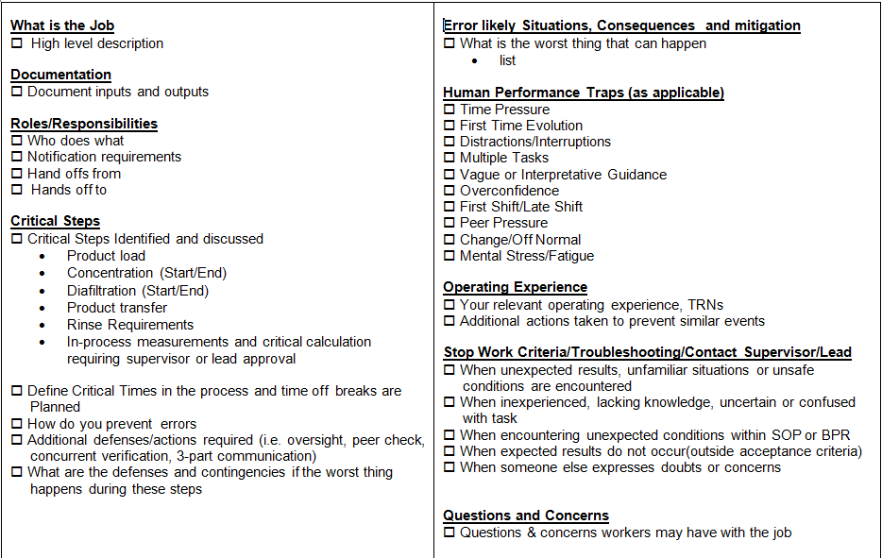

Pre-Job Briefing
Notes:
No matter the training methods determined, make sure you plan for failure and have appropriate floor level pre-execution training – often called a pre-job briefing. Plan to reduce human error.

Slide 37
Building an Action Plan
Objective
Task
Deliverable
Address the potential effect
What process will be used?
What evidence proves?
How will I know it will be done correctly
Risk
AND
Impact
Who and When
Notes:
Each preventive and monitoring action is fleshed out in the action plan
Action plans have 3 parts:
Objective: What are we addressing. An Impact? A Risk?
Task: What process will be used
Deliverable: What evidence proves its complete. Evidence is always proof the task was complete to the satisfaction of the change plan.
Evidence should always be complete. This may be a reference to completed work in another GMP system.

Slide 38
Identify the Effectiveness Review
Audit Method
Spot Check
Monitoring
Trend Analysis
Periodic Product Review
Ensure an effective review:
  Data
  success criteria
Length of Time
Less Time:
  Higher opportunity for occurrence / observation
  Higher probability of detection
  Engineered solution
  Fewer observations needed for high degree of confidence
More Time:
  Lower opportunity for occurrence/ observation
  Lower probability of detection
  Behavioral/ training solution
  More observations needed for high degree of confidence
Connect to success metric!
Notes:
Preventive measures turn into the effectiveness review
Considerations to ensure an effective review of the implementation of the change include:
•Sufficient data points, as described in the implementation plan, should be gathered to the timelines described, before an assessment of the change is made.
• The success criteria should be achieved. If not, reasons why they have not been achieved should be assessed along with the mitigation steps to address the reasons why, including reverting to the previous operating state where appropriate. This may require the proposal of a subsequent change or amendment of the implementation plan to ensure success.
• Data and knowledge gathered from implementation of the change should be shared with the development function and other locations, as appropriate, to ensure that learning can be applied in products under development or to similar products manufactured at the same or other locations
Audit Method is used when the solution involves changes to a system where a determination is made whether changes are in-place procedurally and in-use behaviorally. An example is an audit of a new line clearance checklist to demonstrate effective implementation of the new line clearance checklist.
Spot Check is used for random observations of performance or review of records provide immediate, but limited feedback. An example is a spot-check of batch records to ensure that the pH step was performed correctly after training on the new procedure.
Sampling is used for observations of variables or attributes per defined sampling plan. An example of sampling is when a statistical sample is randomly drawn from lot XYZ123 post implementation of process improvement to confirm the absence of defect.
Monitoring is used for real-time observations over a defined period. An example of monitoring is the real time observation of to verify that changes to operator owning practices were implemented.
Trend Analysis is the retrospective review of data to verify that expected results were achieved. An example of trend analysis is the review of environmental monitoring (EM) data for the period covering the last 30 batches to show the downward trend in EM excursions due to process improvements.
Periodic Product Review is a retrospective review at least annually of trends of multiple parameters to confirm the state of control. An example of periodic product review is the review of data after major changes were made to the facility and equipment as part of a process technology upgrade post recall.
Less Time. Allow relatively less time after implementing the solution when:
Higher opportunity for occurrence / observation
Higher probability of detection
Engineered solution
Fewer observations needed for high degree of confidence
More Time. Allow relatively more time after implementing the solution when:
Lower opportunity for occurrence/ observation
Lower probability of detection
Behavioral/ training solution
More observations needed for high degree of confidence

Slide 39
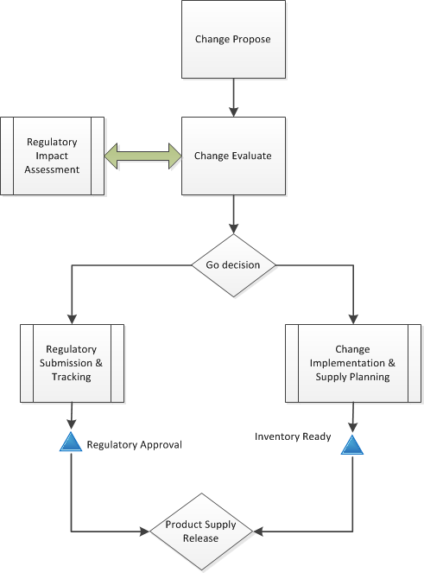
Inventory Impact
Assess Regulatory Impact
Apply Supply Chain thinking
Notes:
Removing uncertainty during submission processes
When regulatory knowledge is integrated into processes and systems, global variation filings can be accomplished much more quickly.
Optimizing inventory management
Companies can only release updated product to a market after it has been approved by the relevant health authority. Firms work hard to prevent mistakes and avoid sending updated product before it is approved, but it gets complicated by the vast number of variations submitted each year.
The length of time it takes to secure regulatory approvals across each market can have an impact all the way down to the production line. Accurate demand forecasting is essential to optimize production and minimize time spent running dual production lines while waiting for approvals to take place.
Improving the timing of supply release
To effectively manage supply release, approvals must be tracked globally and reflected in product registration details. That information needs to be readily available to quality teams or “Qualified Persons” (QP) in Europe.
This requires affiliates to track the status of variation filings in a shared system so that the global view into approvals stays current. Grouping a variation submission and its associated communications by health authority helps regulatory keep track of what has actually been approved.

Slide 40
Gate – Are we ready?
Vision | Importance
What is the vision for this change | Why is this change important to our organization
Success Measurements | Process Measurements
How will we measure success | How will we show progress towards our vision?
Who and what is affected?
What people, departments and processes need to change in order to realize our vision?
How will we support people?
What actions will we do to support people through the change?
What is our plan?
Detailed action plan
Activity 4
Notes:
If you can answer these questions than you are ready. Very useful to have an appropriate management decision making body, often called a change management board.
Have individuals take 10 minutes to fill out their template, and then share with individual next to them. Discuss.

Slide 41
Implement
Execute the change plan
  Provide evidence of completion
Escalate significant risks or delays
Daily | Weekly | Monthly
Review status | Change Control Review Board | Quality Management Review
Dashboards | Appropriate management reviews | Site Quality Council
Daily Capacity Management
Notes:
Have appropriate mechanics for evaluating status of changes

Slide 42
Change Closure (Review)
Ensure change plan executed correctly
  Determine if change is fit-for-purpose
  If the change fails, escalate through a deviation system
Escalate significant risks or delays
Notes:
Have a way to flag changes that fail and address the issue(s)

Slide 43
Lessons Learned
Identify
Document
Analyze
Store
Retrieve
What is valuable for future changes?
Document and Share findings
Analyze and organize to apply
How will they be usable in the future?
Retrieve for next change
What went right?
What went wrong?
What needs to be improved?
Apply Knowledge Management to your Change Process
Notes:
Apply knowledge management to your change management process for continual learning.
Consistency meetings are very helpful here. Take time to reflect.

Slide 44
Effectiveness Review (Review)
Gather data according to effectiveness review strategy
Evaluate data to determine effectiveness
If ineffective,
  Create a deviation to evaluate impact and determine next step
Notes:
Perform the effectiveness review. Feedback into appropriate knowledge management loops.

Slide 45
Manage for success
Leading Measures
Lagging Measures
Effectiveness Measures
Scope Changes IQ/OQ/PQ (or similar) issues/ nonconformances
Effectiveness Review Trending and monitoring program Deviations related to changes
Efficiency Measures
Action Item Status
Plan Approval (schedule adherence) Implementation Adherence (schedule adherence) Closure adherence (schedule adherence)
Learning Objective 4
Notes:
Have metrics that meet the needs of the organization to ensure changes happen effectively and make a difference

Slide 46
Take-aways
Through this session, you should have:
  Evaluated lessons learned from a consent decree and building a robust pharmaceutical quality system for your use.
  Explained how the pharmaceutical experience can deepen your understanding of ISO 9001:2015, especially risk based thinking
  Identified how change management fits into a culture of quality
  Understood how the change management system increases compliance
  Used a few simple but effective tools for change management.

Slide 47

Questions?
Jeremiah B Genest– Phone: (857) 288-9361 – Email: jeremiah.genest@sanofi.com

Slide 48
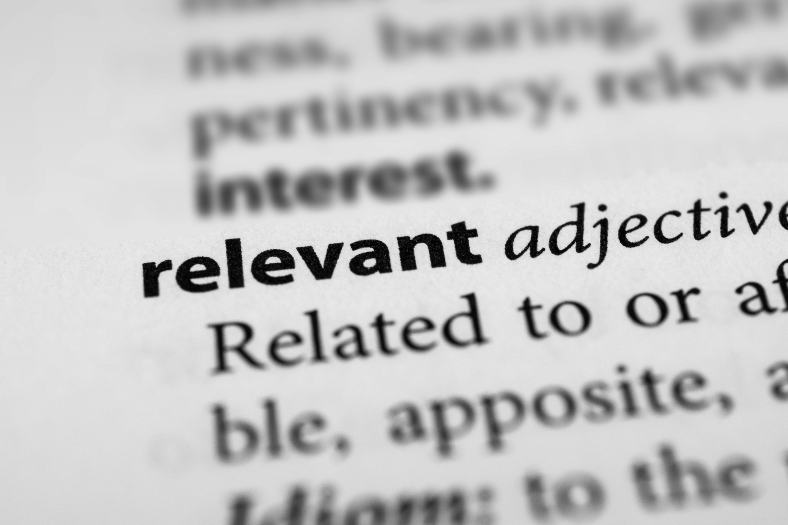
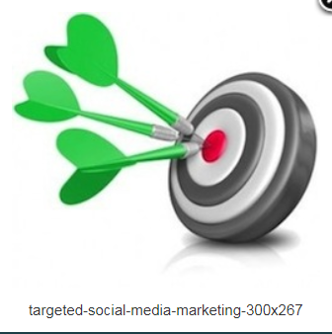
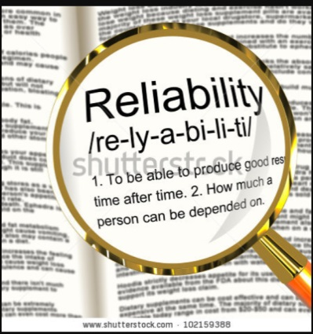
Image Sources
Shutterstock Royalty-free stock photo ID: 351465032

