Slide 1
Auditing the quality system for data integrity
Jeremiah Genest
October 19, 2019

Slide 2
By the end of this session, you will be able to:
Apply a situational awareness to an organization
Analyze the technical and cultural hurdles focusing on the core areas of governance, training, organizational controls, process and systems
Create and utilize data maps to drive detection and remediation
Apply mitigations to the common cultural hurdles

Slide 3


Data Integrity is….
. . . degree to which data are complete, consistent, accurate, trustworthy . . . throughout the data life cycle. Data should be collected and maintained in a secure manner, so they are attributable, legible, contemporaneous, original (or a true copy), and accurate. Assuring DI requires appropriate quality and risk management systems, including adherence to sound scientific principles and good documentation practices.
. . . completeness, consistency, accuracy of data, which should be attributable, legible, contemporaneous, original or true copy, and accurate (ALCOA). DI is critical throughout the data life cycle, including creation, modification, processing, maintenance, archival, retrieval, transmission, and disposition of data after retention period ends. System designs & controls should enable easy detection of errors, omissions, and aberrant results throughout the life cycle.
Notes:
Ask audience what is DI, and hear/discuss answers from class. Then show MHRA regulatory definition above. Ask class to take a minute to read MHRA. Then show FDA definition and ask class to read that.

Slide 4
Data Integrity is Fundamental
Digital Maturity
Quality 4.0
Resources
Information Systems
Organization and Processes
Culture
Digitalization
Workforce 4.0
Available and Qualified
Holistic Value Network
Integration and Traceability
Holistic Control Strategy
Lifecycle Management
Communication
Decision Making
Lifecycle Management
Data Integrity by Design

Slide 5
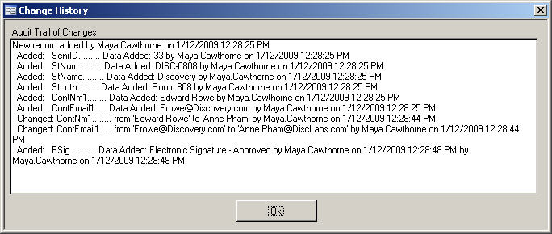

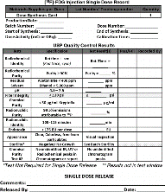

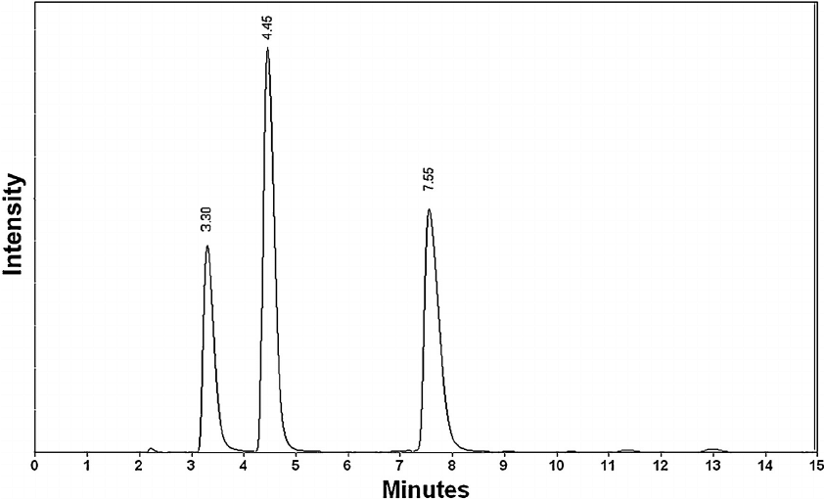
What is Data?
  Static / Fixed Records
    Entry in batch records
    Laboratory test records
    Paper printouts from a system
PAPER
Electronic
  Dynamic Records
    Laboratory results
    Filtration results
    Chromatograms
  Recipes / settings
  Computer stored records
Data Integrity applies to both
Paper data (static records) can’t replace electronic data (dynamic records) when electronic exists (e.g., PDF copy of report from Mfg equipment or manual recording from a display )
Notes:
Ask audience: What is data? Hear answers/discussion. Then point out that there are two main categories at VVS.
Ask audience for examples of paper data after animating the word ‘paper’ above. Then animate the equipment reading pic, then blue box. Go over blue box with class, then animate word ‘Electronic.’ Ask audience for examples of electronic data. Animate green box, and go over. Animate text box and go over with class. Point out any examples they missed listed below. Animate the audit trail example when you mention it, and let the class see it to understand better what they are. Point out a few aspects of audit trails here (e.g. that it is a record interactions by a human with the system, reviewing electronic records includes review of audit trails, etc.)
Ask audience for example of electronic data before animating green box above.
Balances (printed / hand recorded)
Equipment Instrument/Gauge Readings
Chromatography Data System
Temperature Monitoring (FDMS/Temp Tale)
Training Records
Alarm system records / Acknolwedgements
Recipe Audit Trail
HMI Log ins, system alarms

Slide 6
What is Metadata?
What is Metadata?
METADATA
Data that describe attributes of other data, and provide context and meaning (data about data).
Describe structure, data elements, inter-relationships and other characteristics of data.
Permits data to be attributable to an individual.
Can be any attribute that expands information related to the data.
DATES: 14 Mar 19
TIME: 07:34
UNITS: g/L
ID #: BR-0123
Notes:
Ask audience what is metadata. Wait for and discuss responses.
Talking points:
ALCOA speaks not just to the sources of data, but also metadata
Metadata provides the context to the data

Slide 7
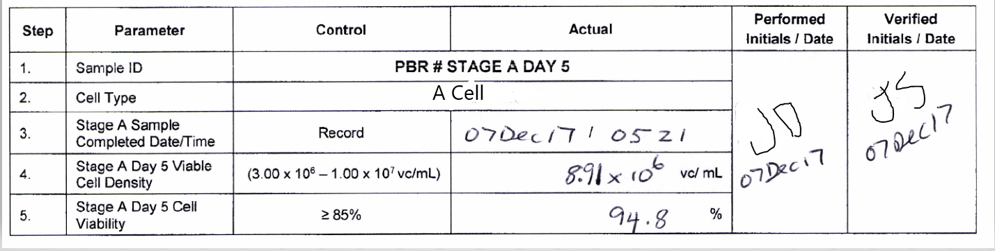
Metadata examples
8.91x10⁶
8.91x10⁶ vc/mL
8.91x10⁶ vc/mL 01Jul2019 08:02:02
8.91x10⁶ vc/mL 01Jul2019 08:02:02 performed by: Dwight.Schrute
8.91x10⁶ vc/mL 01Jul2019 08:02:02 performed by: Dwight.Schrute Method: CHOBEETS1
Method revision history
System setting changes
Testing into compliance
Manual recording of electronic process does not reconstruct entire process.
Notes:
Ask audience: what metadata might accompany this value? Then build out the metadata.
Redbox:
What are you not seeing during review?

Slide 8
Audit Trails
Audit Trail review enables data reconstruction.
Adhere to review frequency specified by Regulations, for example in GMP:
  211.188: review after each significant step in manufacture/processing/packing/holding
  211.22: review data before batch release - apply same review frequency for audit trail
Risk-based approach based on process, data criticality, control mechanisms, and product impact. Reliability of review must be proven.
Not an “IT thing”
  Audit trail review of electronic record analogous to cross-outs on paper record.
  Requires both process and capability understanding.
Notes:
Ask audience: what is the most important method for reconstructing the data? Answer: Audit Trail Review, which is an FDA requirement.
Go over two relevant examples shown above of GMP requirements. State that we must use a risk-based approach, and how to apply such an approach to audit trail review.
Ask audience: How do we demonstrate the reliability of audit trail reviews? Discuss answers as a class.
Challenges with a “review of everything approach”
Define and validate risk based approach
Not an IT Thing: IT doesn’t have the understanding of the process like an operator.

Slide 9
Audit Trail Review
Routine / data audit trail review: performed during routine data review processes.
  During test record or batch record review
  Identifying the steps in the process of generation of the results
Periodic audit trail review: performed to ensure Audit Trial is configured correctly and administrative activities are being performed per the appropriate SOP.
  Identify administrative activities
  Evaluate validated state of a system

Slide 10

Audit Trails
Sometimes called Event Logs, User Events, System Logs, Parameter History etc.
Provide full story for reconstructing data
Things you might find:
Changes to user permissions
Changes to values
Changes to parameters / settings
Testing into compliance
Repeated runs
Different users performing tasks than documented on records
Notes:
Ask audience: What would you expect to find when reviewing an audit trail?
Others:
Malfunctions, alarms, deletions, etc

Slide 11
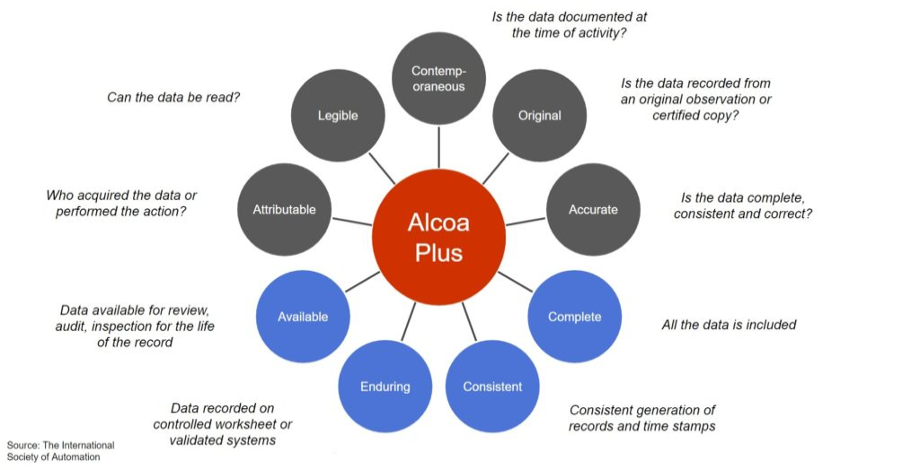
ALCOA+

Slide 12
Attributable
Information is captured in the record so it is uniquely identified as executed by originator.
Data must be attributable to the person or system generating the data, or performing an activity. Users shall choose passwords that are not obvious and are sufficiently complex that the password cannot be easily guessed by a colleague.
Users shall keep their passwords secret from other users, and if they do keep a record of their password it must be in a secure location not accessible to others.
Ensuring data is attributable can be complicated when an automated process is started by one shift worker and continues to run autonomously through other shifts under the supervision of other operators. Clear timesheets, or similar records, are needed to document the shift changes, and to maintain a record of which operators made interventions to the process during that extended operation.
PAPER RECORD | ELECTRONIC RECORD
Initials / Date DKS 01Jul19 | Log-on User ID dwight.schrute 01Jul2019
Hand Written Signature Dwight K. Schrute 01Jul19 | Electronic Signature Dwight Schrute 01Jul2019, 13:01:01 EST

Slide 13
Legible
Requirements that data are readable, understandable and allow a clear picture of sequencing of steps or events so all cGxP activities conducted can be fully reconstructed by record reviewers throughout records retention period.
Where a user is required to record a reason for change, for example in an audit trail, the reason recorded should clearly explain why the change was necessary and reference any supporting documentation such as an approved change request. This will facilitate reconstruction of the event and understanding of the motivation for the change such that a reviewer or auditor can decide if the change was procedurally or scientifically justified.
Any errors in recording data shall be conserved in the original documentation, with a clear identification of the error or reason for change; the original data must remain visible; and the correct data must be recorded along with the user name, date, and time.
Where entries are handwritten, they should be clear and readable by anyone, and written in indelible ink.
Audit trail requirements are inherent within Attributable, Legible, and Complete.
PAPER RECORD | ELECTRONIC RECORD
No Pencil | Enforce Saving
Indelible Ink | No Over-Writing or Deletion
No Correction Fluid | No Annotation Tools
Correction with Single Line Cross-Out that is Initialed, Dated, and Explained | Changes Captured in Audit Trail, All Original and Modified Data Must Be Visible

Slide 14
Contemporaneous
Documentation of action at the same time it is observed or occurs .
Users shall record data at the time it is generated and shall use the time shown on a networked computer or official company-maintained clock to provide the date and time if manually recorded (instead of using a personal wristwatch that may not be synchronized to company time).
Users must always record the current date and time, irrespective of when the task should have been completed.
PAPER RECORD | ELECTRONIC RECORD
Record Time and Date | Date and Time Locked
Sign Bottom of Page when Complete | Attribute User Login and Date Time Stamp to Activity
No Back Dating | Records Saved Immediately
No Pre-completion of Records | Completion of Step Must Precede Progress to Next Step

Slide 15
Original
Original: The first or source capture of data or information and all subsequent data required to fully reconstruct conduct of activity including all associated metadata.
Original record: Data as the file or format in which it was originally generated, preserving the integrity (accuracy, completeness, content and meaning) of the record, e.g. original paper record of manual observation, or electronic raw data file from computerized system.
Data must be recorded directly into the authorized media.
Users must record the first reading/measurement/calculated result, even where that value may be deleterious to the overall pass/fail status of the task.
In the event that a user makes an error in completing a paper form or the form sustains damage in some way, the original paper form must be kept and cannot be discarded for a new form.
Users must not take unauthorized copies of blank controlled forms with the intent of using them to replace any forms containing mistakes or undesirable results.
Consideration should be given to incorporating watermarks and iridescent inks into forms to allow easy detection of unauthorized photocopying, over and above the procedural requirement for controlled issuance of forms.
All documents should have a unique identification number, a form design that provides sufficient space for manual data entries, and make clear what data should be recorded and where.

Slide 16
Original, continued
Users must take care to preserve the original record, which would be the first location in which the information is recorded. For example, when manually writing down a balance reading the user must write it directly into their laboratory notebook or controlled form; a temporary recording onto a scrap of paper would make the scrap of paper the original record.
All unused forms should be accounted for, and either defaced and destroyed, or returned for secure filing, with access to the (electronic) templates strictly controlled.
Reviewers need to ensure they review the original records (or true copies thereof) including complete data. For dynamic data, the review should be done on the electronic data.
PAPER RECORD | ELECTRONIC RECORD
Original Laboratory Notebook | Original Chromatographic Data
Logbook | Audit Trail
Balance Printout | SAP Transaction
Batch Record | Electronic Equipment Data

Slide 17
Accurate
Data are correct, truthful, valid and reliable
Users must rigorously follow written procedures governing their daily tasks and apply their training and skills to ensure that any data they generate is accurate. Care must be taken when manually writing or typing data to avoid transcription errors; self-checking of recorded or calculated data should be encouraged as part of routine working practices.
In a laboratory environment this would include ensuring that equipment is calibrated and has the correct range and resolution for the intended measurements, that any reagents are within their expiry date, and that the test method and parameters are appropriate for the sample under test.
In a clinical study the data must represent the real facts of the study, including accurate measurement of patient vital signs using calibrated blood pressure monitors, weigh scales, etc., and recording all responses.

Slide 18
Complete
Complete data relies on the user collecting and preserving all of the original data, derived data and results, metadata, and audit trail.
Complete data requires the user to collect all records created or modified and not selecting only those records that meet specifications.
Where multiple results are generated, the user must ensure that all results are formally addressed and reported. All operator actions must be recorded and maintained.
The user must follow a clearly defined procedure to invalidate any results where there is sound scientific justification to do so, and must preserve all data, metadata, and audit trail entries related to the results, invalidated or not.
A user must not delete electronic GxP data or destroy GxP paper records that are necessary to preserve the data, content or meaning as required under the predicate rules. Such data can only be deleted at the end of the

Slide 19
Consistent
Due care and attention must be given to any task undertaken by the user that generates data.
The user may develop a consistent set of key phrases for reasons for change and error corrections to facilitate searching and reviewing.
Users reviewing data must first determine “can the data be trusted” before making an approve/reject decision on the data as compared to its governing specification.
This may involve examining audit trails and metadata, verifying operational sequences using the time stamps recorded, searching for duplicate or modified data, and checking the original data upstream of the activity

Slide 20
Enduring
Data must be recorded in a permanent, maintainable form for the retention period.
Procedures should confirm that archived data, including relevant metadata, is available and human readable.
Any data created electronically must be stored in a location that is backed up.
It is not recommended to store GxP data on local computer hard drives.
Users of controlled forms and worksheets must take care to protect the forms throughout their use and then to return them to the original issuer or archivist for safe archival for the retention period.

Slide 21
Available
A user must ensure that all of the data they have generated, whether recorded on paper or electronically, is filed in a logical and labeled secure location for ease of retrieval.
It is good practice that filenames for electronic data are chosen to reflect the contents of the file to facilitate search and retrieval.

Slide 22
Data Integrity is….
External Environment
Internal environment
Data Lifecycle
Good Documentation Practices

Slide 23
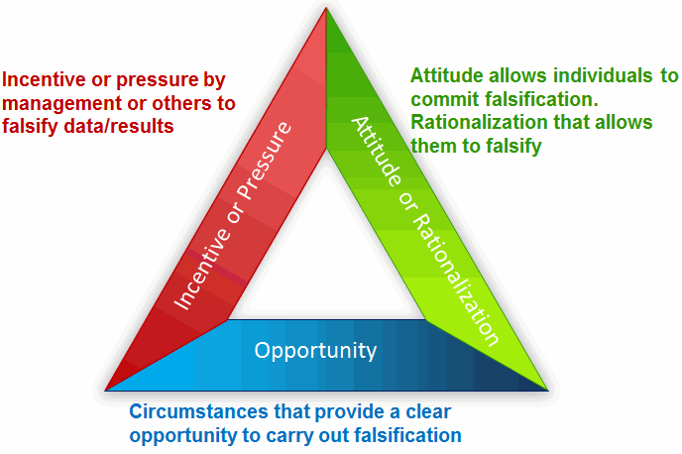
Falsification
Exists When | To Break
Managerial pressure or financial gains are two main drivers to push people to commit fraud. Setting unrealistic objectives such as stretch goals, turnaround time or key performance indicators that are totally divorced from reality especially when these are linked to pay or advancement will only encourage staff to falsify data to receive rewards. These goals coupled with poor analytical instruments and methods will only ensure that corners will be cut to meet deadlines or targets. | Management must lead by example – not through communication or establishing data governance structures but by ensuring the pressure to falsify data is removed. This means setting realistic expectations that are compatible with the organization’s capacity and process capability.
To commit fraud people must either have an incentive or can rationalize that this is an acceptable practice within an organization or department. | Staff need to understand how their actions can impact the health of the patient. Ensure individuals know the importance of reliable and accurate data to the wellbeing of the patient as well as the business health of the company.
The opportunity to falsify data can be due to encouragement by management as a means of keeping cost down or a combination of lax controls or poor oversight of activities that contribute to staff being able to commit fraud. | Implement a process that is technically controlled so there is little, if any, opportunity to commit falsification of data.

Slide 24
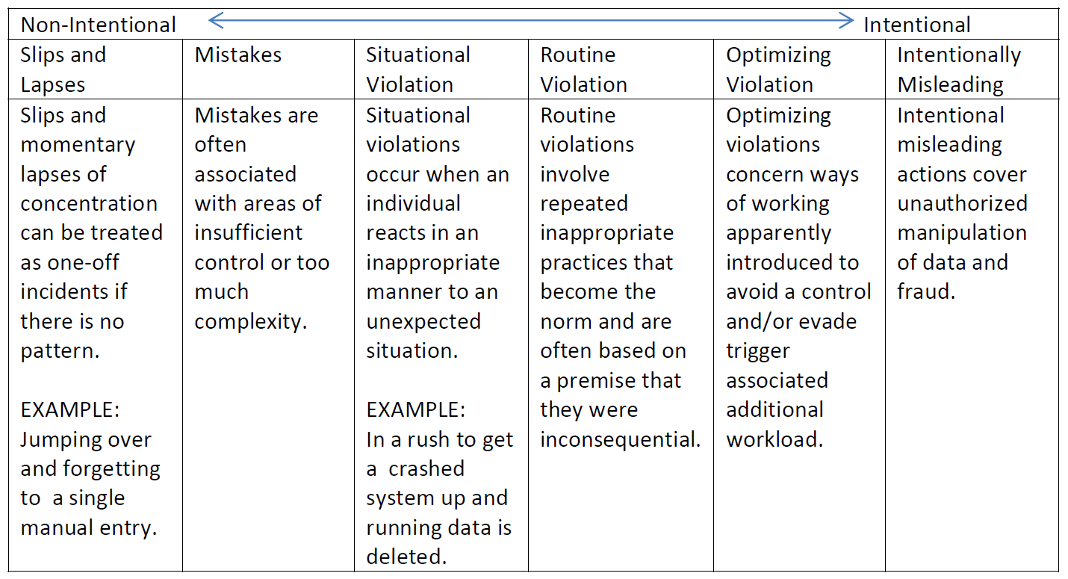
What about mistakes?
Notes:
Mistakes are human nature – we all have fat finger moments. This is why we build our processes and technologies to ensure we capture these errors and self-correct them. These errors should be tracked and trended, but only as a way to drive continuous improvement. It is important to have the capability in your quality systems to be able to evaluate mistakes up-to-and including fraud.
It helps to be able to classify issues and determine if there are changes to governance, management systems and behaviors necessary.

Slide 25
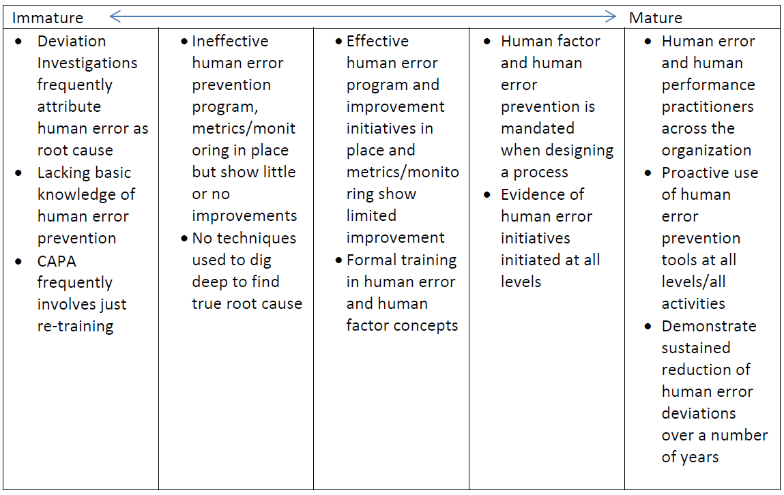
Human error built into investigations

Slide 26
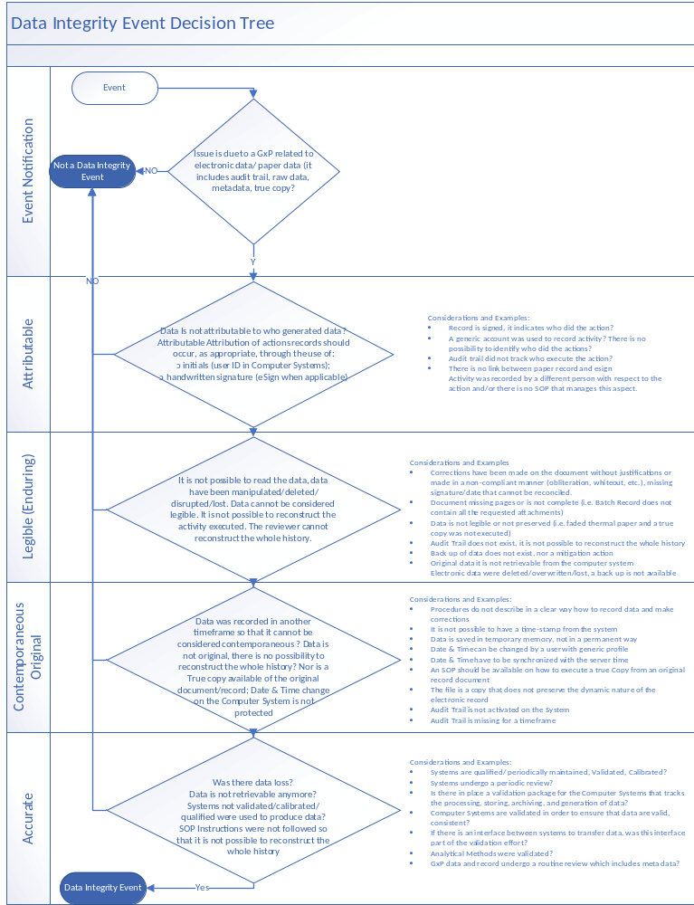
Decision Tree
Holistic system overview for events
Look for trends

Slide 27
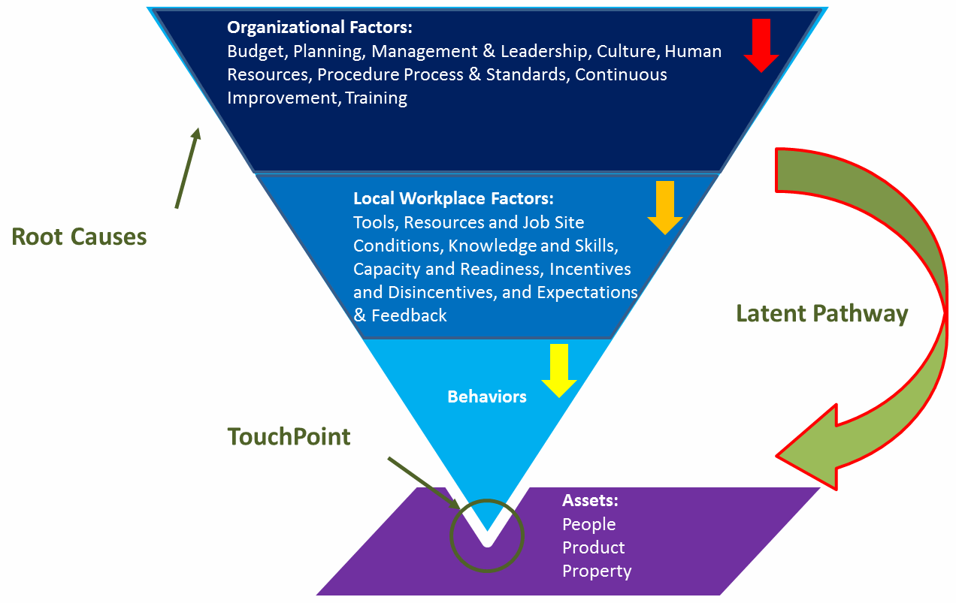
Build the Quality Culture

Slide 28
Risk Assessment
Ranking | Manufacturing/Facilities |  | Laboratory |  | Quality Systems
 | Process / Materials | Data | Process / Materials | Data | Data
5 | Capture & Purification | CPP (including well controlled) | Final Formulation & Finished Product, Stability | C of A, Release | Deviation, Regulatory Data
3 | Media, Buffer, Cell Culture & Utilities | KPP, cleaning or sterilization critical parameter | Intermediates & Raw Materials | Purity, Identity, Microbial (not C of A or release) | CCR, CAPA, SOP
1 | Other | Other | All other (e.g. Reagents, Utilities) | All other testing | Training, GRT, Other
Ranking | Signature | Controlled Access/ Different User levels | Data Archival
4 | None | No access control | No Data Archival
3 | Paper Signature | Controlled via room access or procedural controls | Paper Archival
2 | Paper Signature & Witness/Verify (if applicable) | Access controlled w/ limited user levels or generic accounts | Paper & Electronic Archival
1 | Esign | Access controlled w/ sufficient user levels | Automatic Electronic Archival
The risk-based approach will utilize three factors, data criticality, existing controls, and level of detection
Ranking | Review/ Approval | Audit Trail (exists/reviewed)
4 | None | Does not Exist
3 | Review/Approval performed but only final result (not raw or meta data) OR No verify or witness considerations | Paper Audit Trail created & reviewed
2 | Verify or Witness considerations AND some Raw/Meta Data Review/Approval performed but not all data or not all signatures | Electronic Exists & Reviewed
1 | Verify or Witness considerations as well as manager/quality approvers Raw/Meta data | Electronic Exists & Reviewed/Flags Suspected Data

Slide 29
Data Integrity is a result of many factors
Data Integrity Controls
Organizational
Technical
Policies, Procedures and Directives
Training & awareness
Change Management
Exceptions & investigations
Audits
Contract & vendor management
Infrastructure & architecture
Security
Access controls
Storage
Backup
Archival
Audit trails
Interfaces
Enterprise systems
QRM
Operational
Validation
Business continuity & disaster recovery
Quality Culture
Code of Conduct
Data Review
Job Aids
OJT
Quality Mgmt System
Human Performance
Good Documentation Practices
Organizational Controls
Operational Controls
Technical Controls
Data Integrity
Data Governance

Slide 30
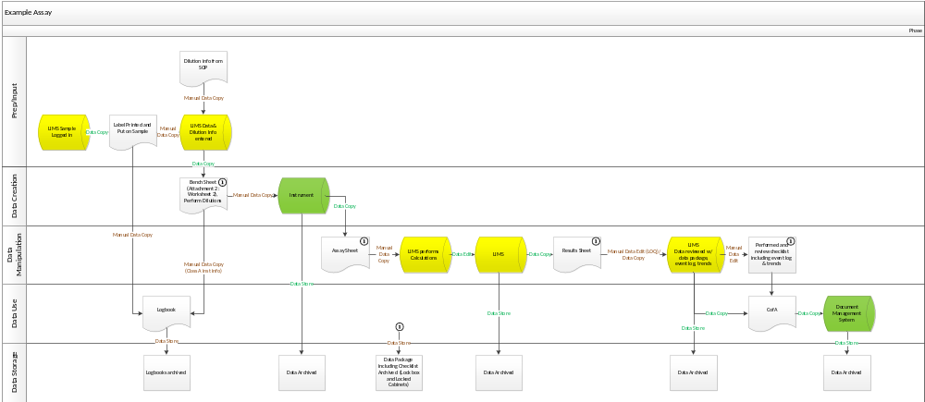
Data Map

Slide 31
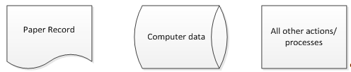
Data Map
Data process maps look at the entire data life-cycle from creation through storage (covering key components of create, modify and delete) and include all operations with both paper and electronic records. Data maps are cross-functional diagrams (swim-lanes) and have the following sections:
Prep/Input
Data Creation
Data Manipulation (include delete)
Data Use
Data Storage

Slide 32
The 5 Questions
Do you have your source data?
Do you review your source data?
Does your review include meaningful metadata?
Do you have proper segregation of duties?
Have you validated your systems for intended use?
Do you know where your data is throughout the lifecycle?
Is it readily retrievable, secure from inadvertent deletion or modification and backed up by a validated process?
Have you defined the source data appropriately? (not paper for electronic systems)
Is the source data reviewed through the system? (not paper for electronic systems)
Are audit trails reviewed with the data review?
Are parameters / settings reviewed?
Are user settings and access reviewed?
Do users have individual logins?
Do users have the appropriate role for their job function and are permissions appropriate?
Are System Administrators separate from everyday users and limited to the least number of users?
Has system been validated for its use? (all features, ranges and settings that will be used in the day to day activities)
Are controls in place for secure date and time stamps and synchronization?

Slide 33
An Audit Checklist
Concept | Question
User Access | Ask Operator: what level of access do you have? Can you delete data, change programs, change date/time?
User Access | Try to change date/time on system, including time zone while under an operator login.
User Access | Who has admin access? Are they independent of persons responsible for the content of the records generated by the system for regulated purposes?
User Access | Is a periodic review of user access performed? Are accounts deleted/disabled?
Archive | Check “Recycle Bin” on windows desktop…no GMP data should be in there.
Archive | Are the electronic records for this system being maintained (e.g., backed-up, archived) in a secure manner?
Archive | Are the electronic records for this system maintained / archived in a manner that preserves their ‘content and meaning’ (i.e., as verified true copies of the original electronic data set to include metadata and with provisions for software to view the data)?
Archive | Has the archival process been validated/ verified?
Audit Trail | Ask to see the audit trail. Can they pull it up? Ask supervisor: What do they review? SOP on when they review? Can you trace actions to personnel?

Slide 34
Audit Checklist
Concept | Question
Originality | Are supervisory or quality personnel reviewing the electronic records and relevant metadata (such as audit trails) for this system or are supervisory personnel merely reviewing the final printout?
Traceability | Do actions in logbooks/on paper match actions in the system? Did the person who ran the run record it in both places?
Accuracy | What happens if a test fails? Where does the electronic or paper record go? When can you retest? Who has to approve a retest?
Accuracy | If there are manual entries during any process, is there a witness or verify step? How do they ensure accuracy?
Accuracy | If a printout is used, is it verified against the electronic? Or is the printing process validated?

Slide 35
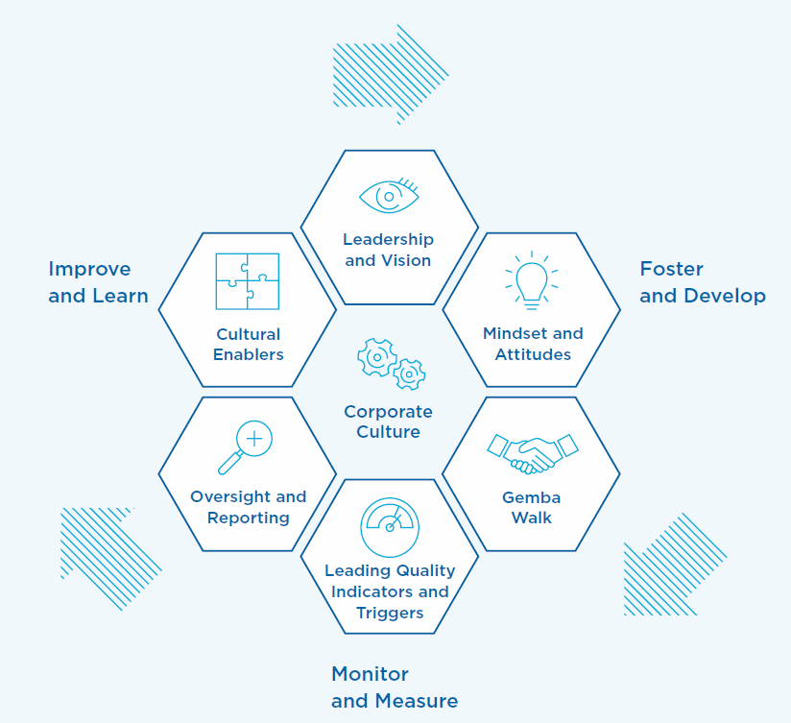
Quality Culture

Slide 36
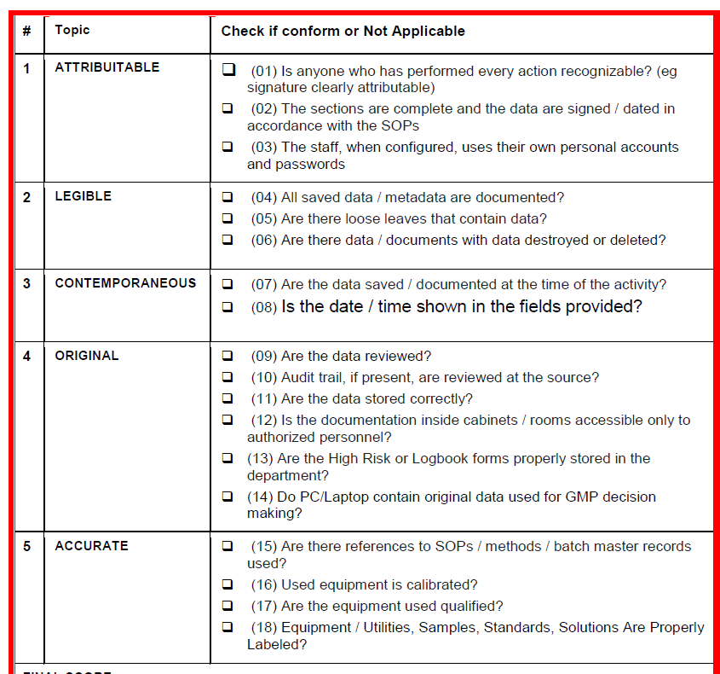
GEMBA Walks for Data Integrity
Enabler for Cultural Change
Role-modeling opportunity for leaders
A way to empower personnel
Opportunity for continuous improvement

Slide 37
At the end of this session, you should be able to
Apply a situational awareness to an organization
Analyze the technical and cultural hurdles focusing on the core areas of governance, training, organizational controls, process and systems
Create and utilize data maps to drive detection and remediation
Apply mitigations to the common cultural hurdles

Slide 38
Questions?

