Slide 1
The Role of Mixed Reality in Quality 4.0
Jeremiah Genest, Head of Digital Quality (VVS)
February 11, 2020
Notes:
Steve F to kickoff

Slide 2





Who am I?
20 Years in Quality
Head of Digital Quality at Thermo Fisher Scientific - VVS
Pharmaceutical Industry
  Millennium Pharmaceuticals
  Takeda
  Sanofi
Build and maintain quality systems
Change Manager
Technology
Implementer
Multiple transformational lean initiatives
Consent decree
.
Variety of initiatives in automation, data science and other technological solutions
.
Chair of the Team and Workplace Excellence Forum
CMQ/OE, CPGP, PMP
Passionate About: Creating a culture of quality based on transparency and candor
https://investigationsquality.com/

Slide 3

Augment Execution Systems within Pharma Services Group - Technical Operations
Thermo Fisher’s Vision Industry 4.0
We define and develop best practices and standards in pharma manufacturing and packaging
We help employees within PSG, as well as our clients, adopt and implement cutting-edge technologies
We provide data engineering and process analytics to help guide business decisions
Chris Binion
Director, Augmented Execution Systems

Slide 4
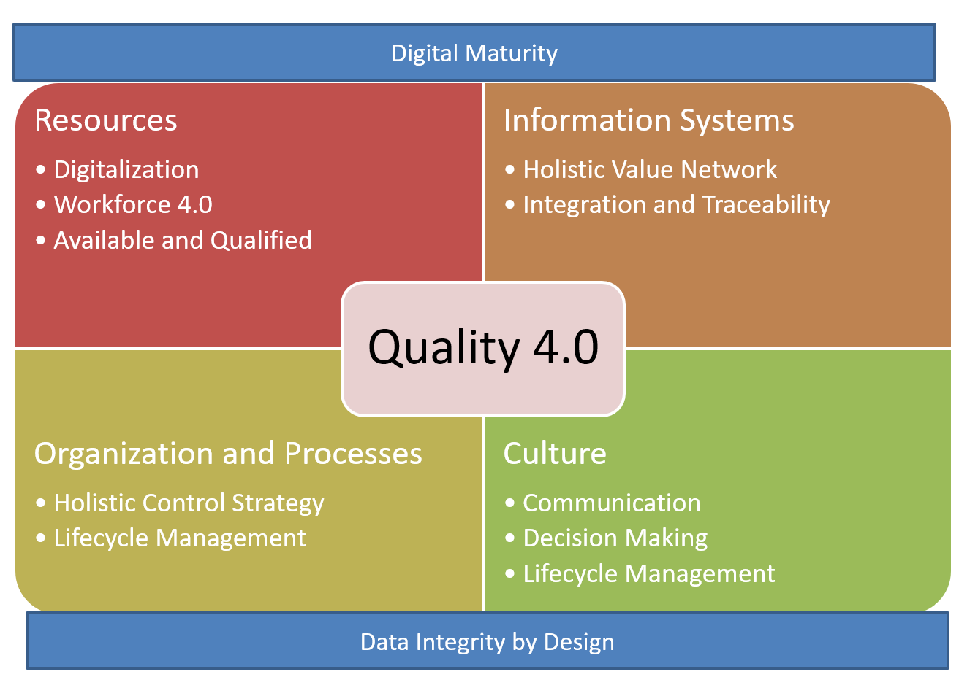
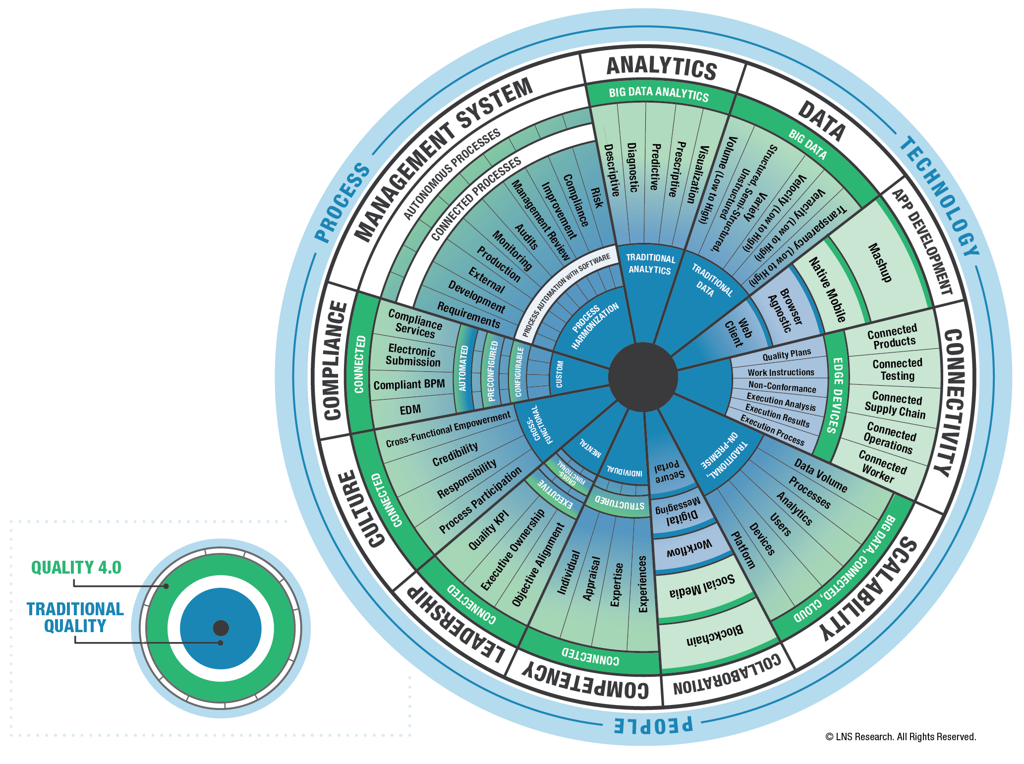
Interconnected Worker as part of Quality 4.0

Slide 5
BioPhorum Group Digital Plant Maturity Model (DPMM)
v2 May 2018
Level 1
Pre-digital Plant
Primarily Paper based processes
Level 2
Digital Silos
“Islands of automation”
Level 3
Connected Plant
Vertical Integration
Level 4
Predictive Plant
Level 5
Adaptive Plant
Predominately manual processing.
Low level of automation.
Basic PLC controls.
Applications are stand-alone with minimal or no integration
Some manual processes.
Batch records may be semi-electronic or “paper on glass”
Local batch-recipe system interfaced to PLCs
Site-specific systems; limited integration across functional silos
Analytics on demand, “why did it happen?” high manual effort
Plants operate independently with little “real-time” supply chain visibility
ERP, LES, MES and Automation layer are fully integrated to support digitized business processes.
Full Electronic Batch record with review by exception.
Industry standards such as ISA 88 (recipe) and ISA 95 (material, equipment and personnel) have been adopted.
Standard application platform adopted across plant network
Analytics semiautomated; “where else can it happen?”
Islands of real-time Process analytics
Enterprise Integration – internal integration of plant to value chain
Integration of Product Development and Manufacturing (PLM)
Advanced production technologies start to be used
End-to-end supply chain visibility with limited external collaborations (suppliers / CMOs).
“Enterprise Recipe Management” (ERM) process in place.
Online/At-line quality testing with Real Time Release.
Proactive analytics across plant and internal value chain; “what can happen and when?”
Integrated Real-time Process analytics
Simulation used for process modeling and improvements
Full end-to-end value-chain integration from suppliers to patients
Modular, mobile and collaborative Manufacturing Environment
Advanced production technologies used as standard.
“Plug-n-play everything” from an instrument to a production scale or a CMO
Zero system down-time (including upgrades) – continuous evolution.
In-line, real-time, continuous, closed loop, process verification and control with automated real-time quality release
Self-aware, continuously adaptive, “Autonomous” plant; exception conditions handled by remote experts
Advanced simulation used across value chain for modeling, testing and improvement of manufacturing and supporting business processes
Trusted information insights are freely and securely available. Pervasive use of adaptive analytics and Self/Machine learning across value chain.
Many plants
Industry aggregate
Few approaching
Some other industries
Not currently achievable
DPMM and assessment tool can be leveraged as framework for plotting our journey

Slide 6


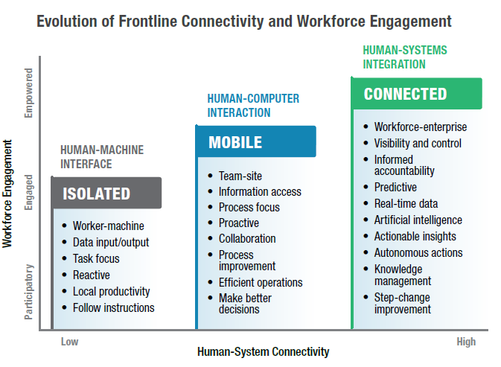


Building a Connected Workforce
Aging Workforce
Digital Natives
WORKFORCE CHALLENGES
• Recruit, train and retain people to address skills gap
• Enable organizational learning and knowledge transfer
• Engage and empower frontline workforce
• Drive productivity, safety and quality improvements
Connected Workforce
Dynamic Operations
Digitalization
Notes:
Much of the strategic emphasis on Connected Worker initiatives is driven by several interrelated trends that impact the industrial workforce.This “perfect storm” demands a response from every industrial organization.
The U.S.Bureau of Labor Statistics estimates a shortage of more than two million manufacturing workers by 2025, with more than 10,000 baby boomers retiring daily.This impacts manufacturers as valuable skills, experience, and institutional knowledge are lost.
The widespread implementation of IX programs introduces a wide array of new digital technologies to enable the factory of the future, such as IIoT, automation systems, advanced analytics, and many others.These dynamics change the competencies needed to effectively deploy digital technologies and provide the operational agility required to respond to a dynamic production environment.
The next generation of employees entering the workforce and advancing through the ranks are digital natives with an entirely new set of perceptions and expectations regarding technology and attitudes about work in general.
To be competitive industrial organizations must address the resulting skills gap with a strategic approach that recognizes both the risks and opportunities presented by these workforce trends.This includes rethinking how the frontline workforce is managed and the role of Connected Worker digital technologies in meeting unprecedented challenges in hiring, training, and retaining a workforce with the requisite competencies and agility.

Slide 7
Part of a wider roadmap for transformation
Strategy
Drive from the floor
Solve for today’s and tomorrow’s problems
Opportunity
Digital
World
Industry
4.0
Sustain the change
Adapt
Pilot
Physical
World
Virtual
World
Learn
Experiment
Willingness to fail
Knowledge management
Continuous improvements

Slide 8
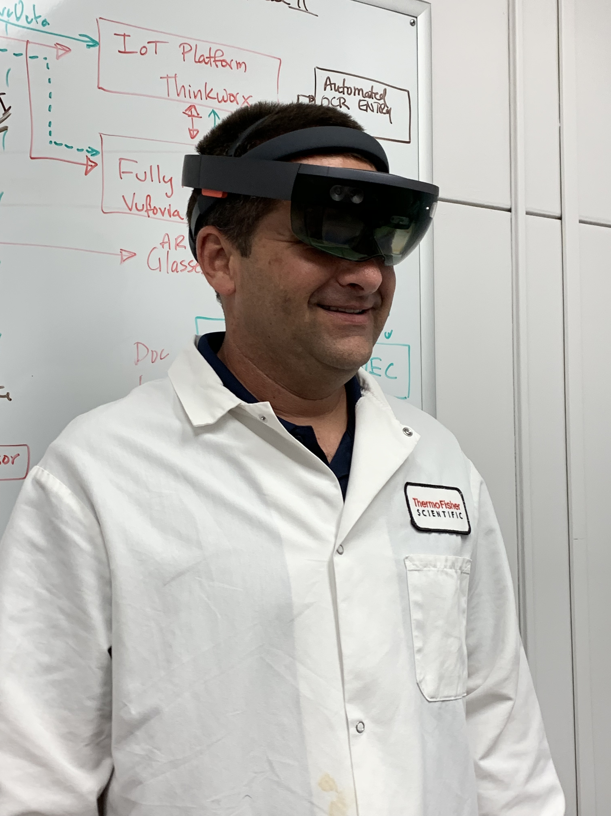
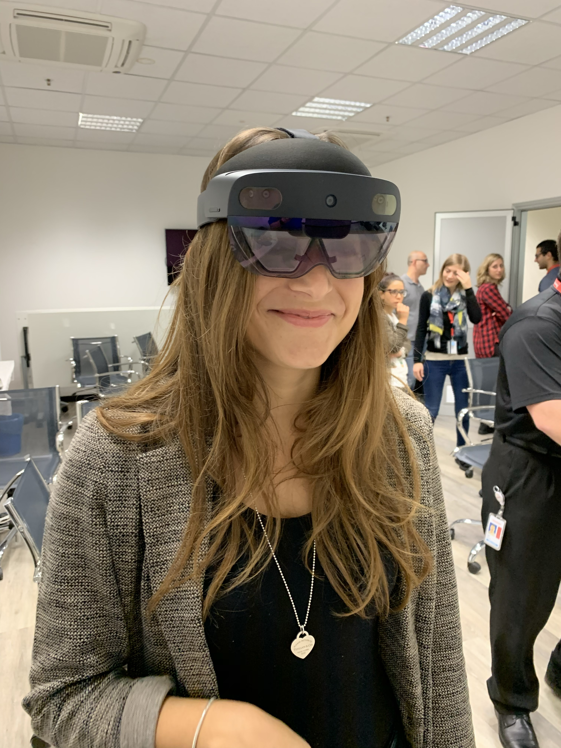
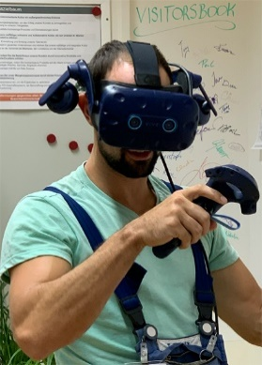
Mixed Reality as a strategic automation opportunity
AR / VR as Digital Enabler
Engage
Make it easy for employees to be successful
Educate
Enhance the operator’s ability to execute by providing tools that ensure performance
Enable
Reduce risk associated with human error from complex, incomplete or unclear process steps

Slide 9
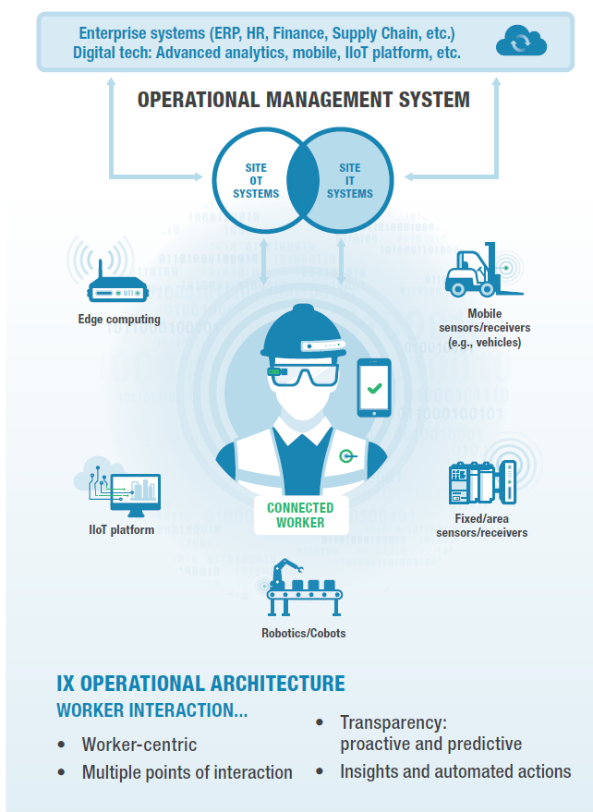

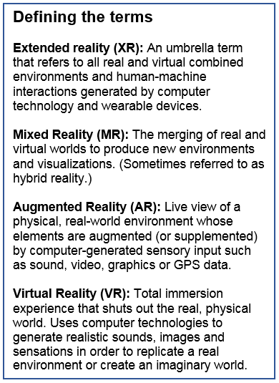



Slide 10



AR / VR as a digital enabler
AR / VR as Digital Enabler
REALITY:
THE REAL WORLD
Mixed Reality
(MR)
Augmented Reality
(AR)
Virtual Reality
(VR)
THE DIGITAL
WORLD
Guides
Remote Assist
Telepresence
Virtual Reality
Detailed instructional videos in real time viewed through a HoloLens
Tech-enabled video chat, combining elements such as holographics with live conversation
Leverage local tools
(e.g., smart phone) to enable remote observation of a site in real time
Creates a risk-free virtual environment for training or engaging with products and tools
Supported by Augmented Execution System (AES) that ties to operations
Notes:
Pain points for remote assist:
Our products continue to increase in complexity
Repairs are time-consuming and down time can be costly
Repair experts are often not located
on-site
Pain points for virtual reality:
Onboarding and training personnel is time and resource intensive
Hiring, training, and deploying enough resources to meet growing demand is challenging

Slide 11
GUIDES

Slide 12
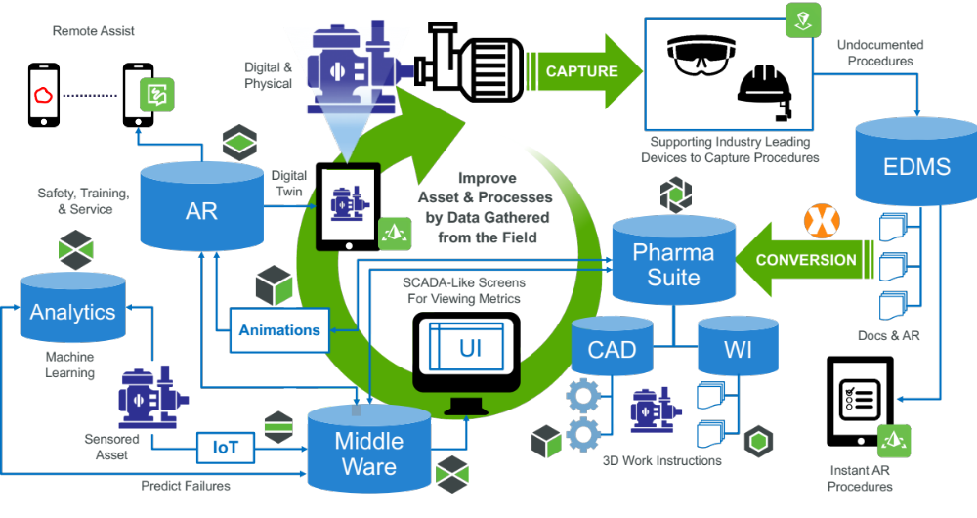
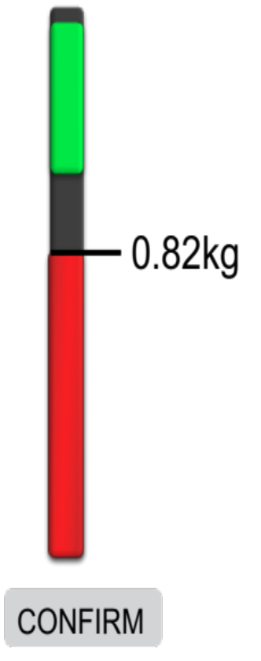
IoT Automated
Balance 23 Online
Status: Active
Step 4.2.2.2
Weight 1.0kg +0.1kg
Magnesium Sulfate Lot A203208
0.82kg
Confirm

Slide 13
AES Overview
Human
Interface
Augmented
Execution
System
Manufacturing
Execution
System
Data Capture
Batch
Production
Record
Equipment Execution
Equipment Recipe
Batch Execution
Operator Execution
Batch Prod. Guides (BPG)
BPG Recipe
BPG Data
Holographic Equipment Interface
HMI
Equipment Data
Data Collection / Reporting
AR Interface
EBR
HUD
Batch Automation
Statistical Process Control
Golden Batch
Data Analytics
Batch Perf. Data
Augmented Execution
Data Analytics

Slide 14

Connecting the Operator
Holographic Display
HD Camera
Step 7: Weight 1.0 kg of Magnesium Sulfate Lot 123456
Balance
CMMS
Operator
LMS
Material
ERP
Step 7: Actual Weight 1.2 kg
Supervisor
QOTF
Quality Management System

Slide 15
Authoring
Authoring EBR
  Process Steps
  Verification Systems Integration
  Select Elements for Step
    Holographic Guides
    3D Models
    Video
    Documents
    Pictures
    Remote Assist
    QR Code Reader
    Keypad
    Voice to Text
    Confirm Button: eSig/Date/Time
Build from EBR
Load Template Style
Populate Template Automatically from EBR
Load Elements as Optional
Store on CDS (Cloud) with Azure Stack on Prem
Load Guide Steps that Require Spatial Anchoring or 3D models
Place Models or Anchors in Real World
Verify

Slide 16
Step Confirmed
Step 4.2.3.1 Pour Magnesium Sulfate Lot A203208 into Hopper
Magnesium Sulfate Lot A203208
Expiry 6/30/2021
Confirmed
Confirm

Slide 17
REMOTE
ASSIST

Slide 18
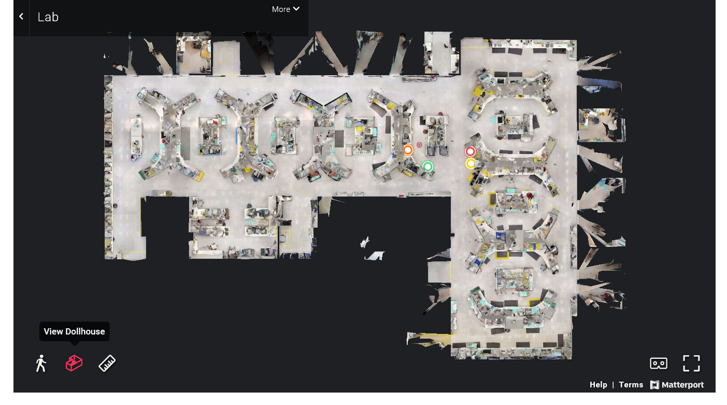
Telepresence
https://my.matterport.com/models/ZBzR85k5f8z?section=media&mediasection=showcase

Slide 19
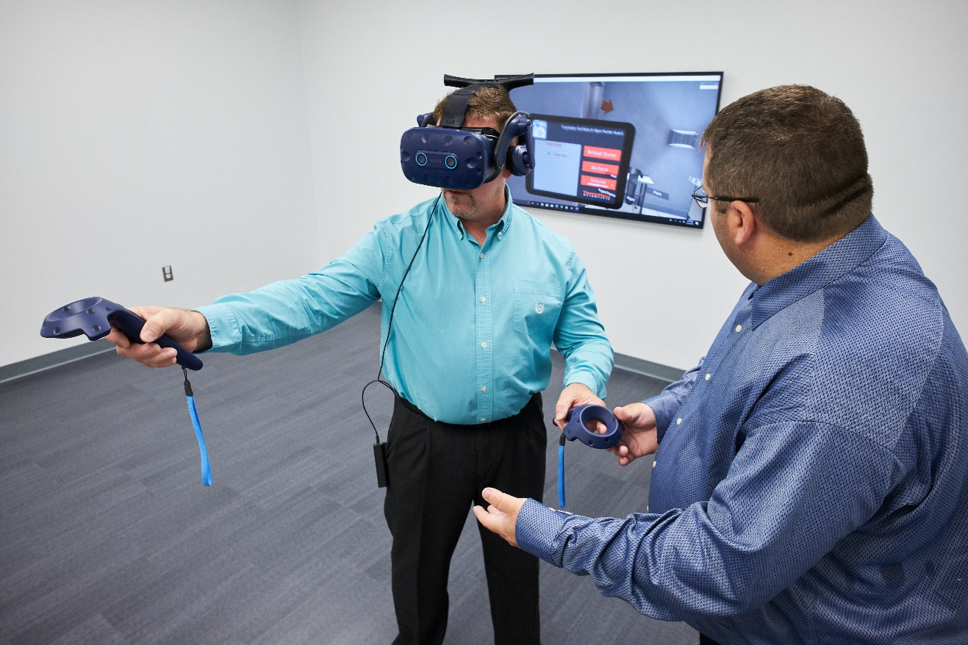
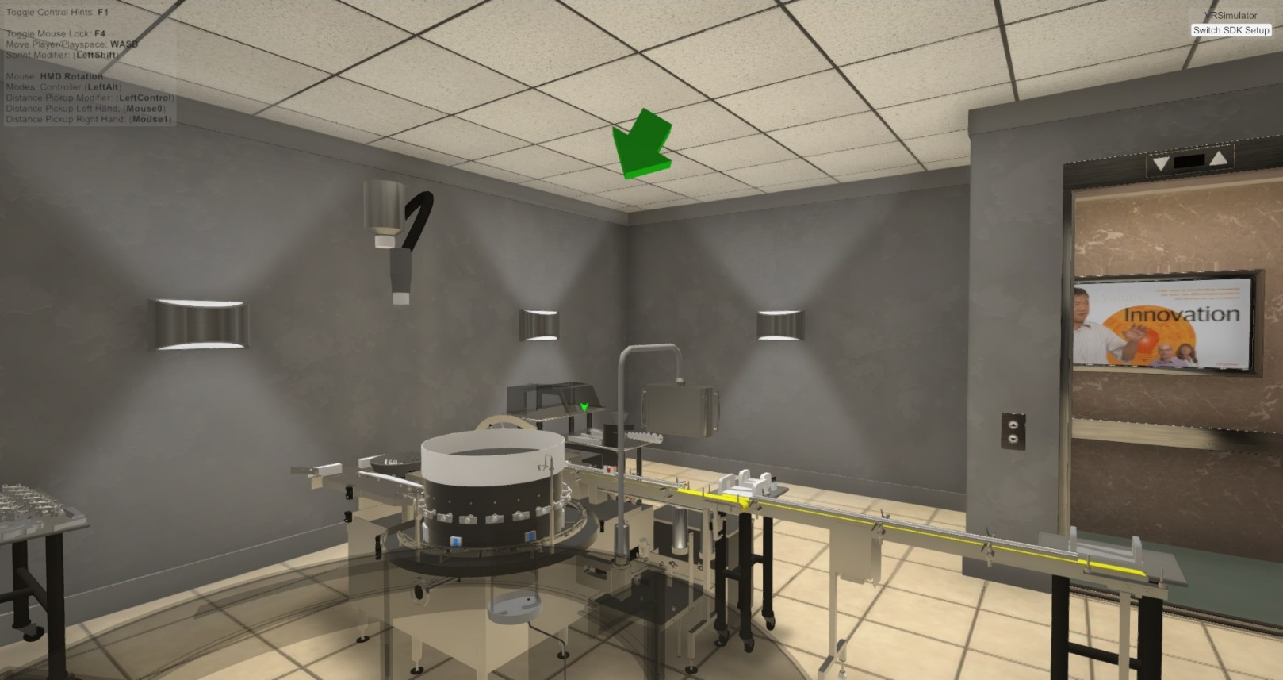



Virtual Reality
Compliance – Reduced human related deviations
Reduced rejection and rework
New Hire Training – Decrease training costs, reduction human related deviations, decrease time to competency

Slide 20
New Skills
Profile
Ability to visually recreate or hand model complex equipment to be deployed and used within VR/MR game engines.
Support Learning and Development teams by building graphic content to aide in the creation of augmented work procedures.
Work with 3D CAD drawings to make them VR/MR ready.
Coordinates with Engineering, Service, and Quality teams, etc. for knowledge transfer to support the development of training courses to align with the company goals.
Integrate proper design philosophies in creating UI and UX for VR/MR applications.
Skills Required
Proficiency in the use of 3D Modeling tools including: Unity, Unreal, Autodesk Maya/Max, 3D Lighting and UV Unwrapping/ Texturing software.
Digital arts
Problem Solving
Communication
Critical Thinking
Design thinking

Slide 21



Bringing it all Together
People
Visualization
Comprehension
Modelization
Validation
“The big scope”
Training
Optimization
Usage
Modification
Maintenance
Data
Devices
Deep Learning
Big Data
Machine Learning
Mixed reality
Internet of Things
Automation

Slide 22
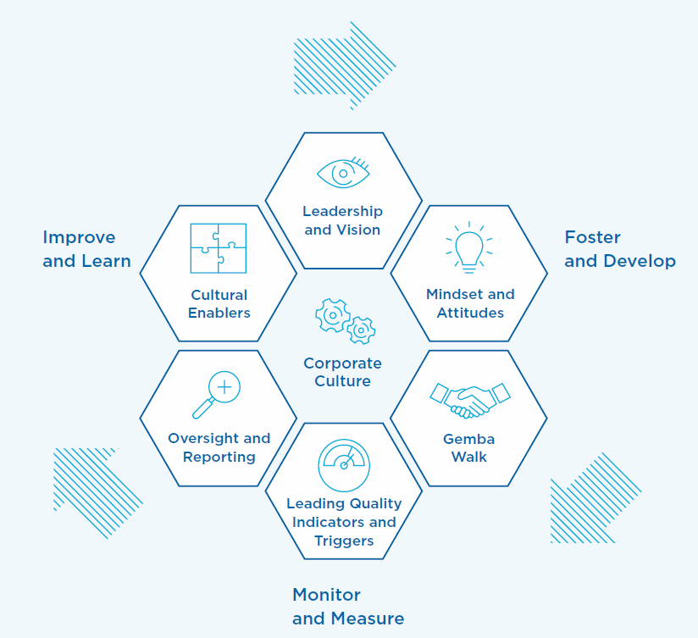
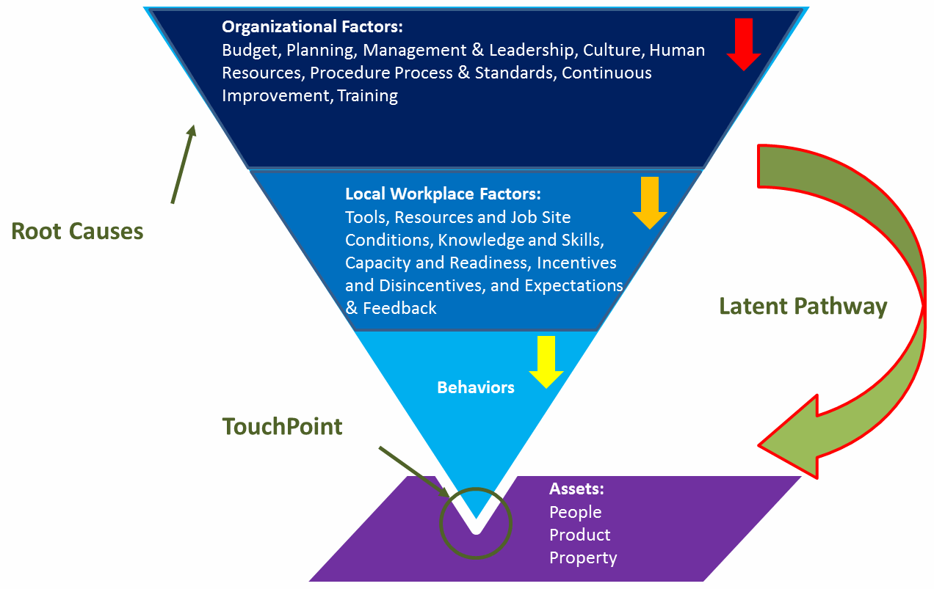
Building the Culture

Slide 23
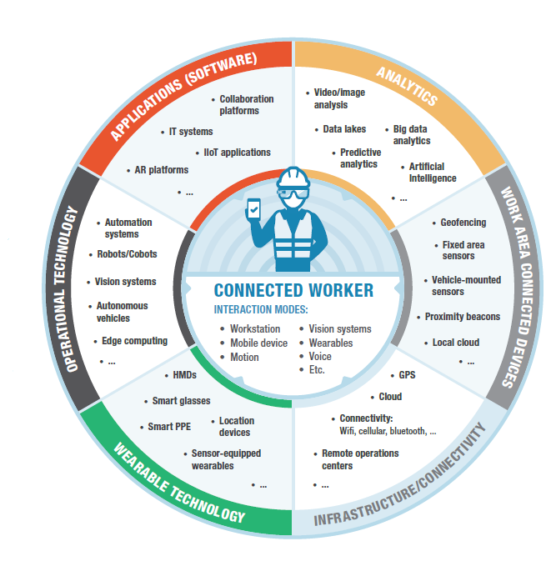
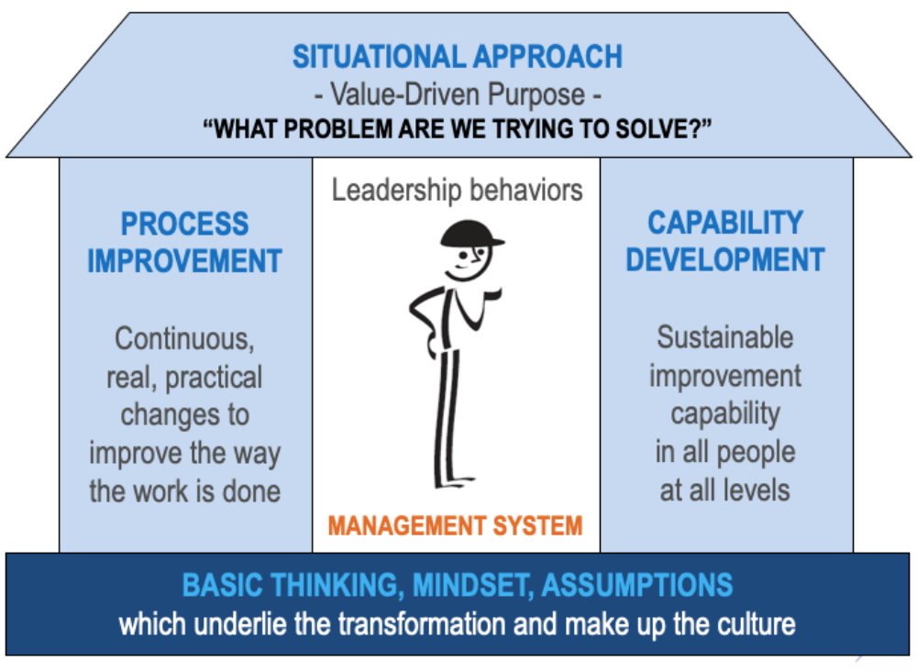
In Summary

