Slide 1
Contamination Control, Risk and the Quality Management System
Jeremiah Genest
Head of Quality Management Systems
Amylyx Pharmaceuticals

Slide 2
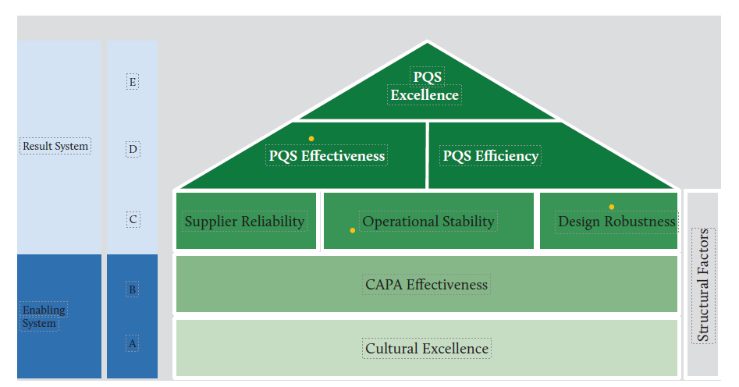
Ensuring the House of Quality Is Built for Contamination Control
Risk Management
Knowledge Management
Notes:
So far, the revised Annex 1 of the EU GMP Guidance has not been published - and there is still much speculation about the implementation time after publication. But the draft versions published so far, which have also been extensively commented on, at least give an indication of what can be expected in some areas. In addition to the increased importance of Quality Risk Management (QRM) and the discussion on Pre-Use, Post-Sterilisation Integrity Testing (PUPSIT) of the filters, it is particularly striking that for the first time an overarching recording and concerted management of contamination control measures is required, called "Contamination Control Strategy" in the draft. In other words, an overarching strategy, perhaps comparable to a PQR or a quality oversight strategy.
From the St Gallen’s report on Quality Culture commissioned by the FDA

Slide 3





The 5 P’s of GXPs
GXP
People
Procedure
Products
Premises and
Suppliers
Principles
Have clear roles and responsibilities
Follow all procedures
Are fully trained and assessed for the work they do.
Are documented and recorded
Cover all critical processes
Ensure deviations are fully investigated and reported
Have robust change management
Meets requirements and is reproducible
Records
SISPQ
Traceability
Appropriately designed, selected and and controlled
Meets intended use
Oversight and Governance
Values and Culture
Accountability
Notes:
The various measures that serve to control contamination, such as personnel hygiene and clothing requirements, cleaning and disinfection processes, environmental monitoring and ventilation technology, are often assigned to different areas of responsibility. This often makes coordination difficult, and the effects of changes in one area on other areas are not adequately recorded. The Contamination Control Strategy is intended to link these measures, to better record interactions and to facilitate an analysis of possible gaps in the system (gap analysis).

Slide 4






Contamination Control Strategies
Design, traffic flows, utilities, maintenance preventative and repair, cleaning, disinfection, monitoring systems
Premises
Raw materials, in-process tests, end product tests, containers, closures, manufacturing aids and consumables
Product
Principle
Manufacturing
Process
Design, equipment, in-process controls, in-process tests, single-use, interventions
Risk assessments, supplier management and outsourcing, trending, analysis, investigational tools, CAPA, continuous improvement, change management
Process
Personnel
Training, certification, gowning, process simulations
Notes:
Traffic flows – personnel, product, materials, waste

Slide 5
Risk Management is a Living Process
Continuous throughout system/process lifecycle
Implementation of new product/system/process
Systematic (all-encompassing scope)
Entire existing product/process/system
High risk situations
Reviewed annually
Assessed using Formal or Intermediate tools
E.g. Utilities, software, risk strategy to support, microbial and viral control
Assessment
Intermediate
Point in time
Created to fulfill a specific purpose
Changes to existing system
Narrow scope
Well understood process/system
Assessed using Less Formal, Intermediate, and Formal tools
E.g. Deviations, Change Controls, CAPAs
LIVING
Assessment
AD HOC
Less Formal Tools
Formal Tools
Notes:
HACAAP, FMEA, when and how. Looking at process prospectively don’t wait for failures to happen. Moving beyond lagging indicators.
We’ve all been there, we need to take a risk based approach to determining environmental monitoring, so we go to a HAACP or FMEA and realize those tools just do not work to provide information to determine how to distribute monitoring to best verify
that processes are operating under control.
What you want to do is build a heat map showing the relative probability of contamination in a defined area or room| covering six areas:
Amenability of equipment and surfaces to cleaning and sanitization
Personnel presence and flow
Material flow
Proximity to open product or exposed direct product-contact material
Interventions/operations by personnel and their complexity
Frequency of interventions/process operations.
This approach builds off of the design activities and is part of a set of living risk assessments that inform the environmental monitoring part of your contamination control strategy.
Hope to see you in Bethesda to discuss more!

Slide 6
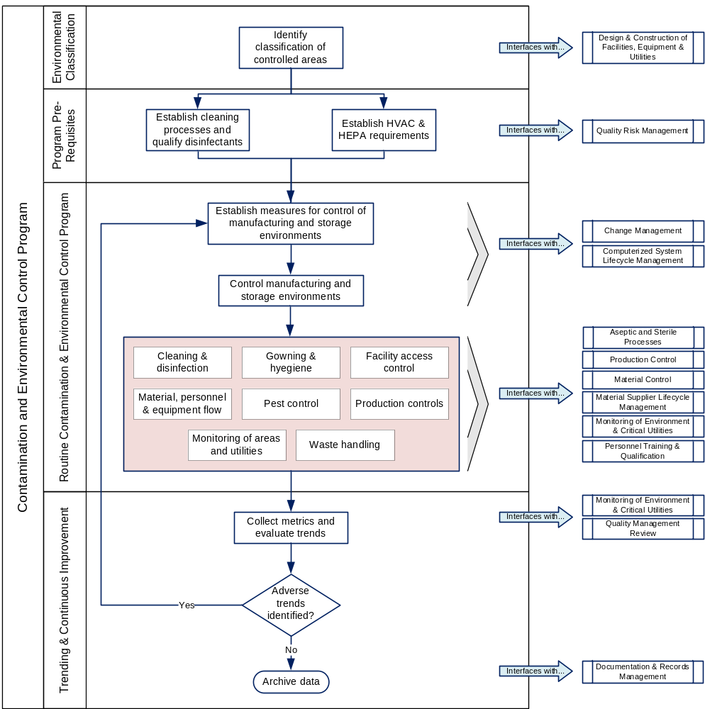
Sits on top of risk management for:
Manufacturing processes
Aseptic manufacturing processes
Cleaning processes
Decontamination processes
Sterilization processes
Facility
Suppliers
Materials

Slide 7
Governance
Monitoring of Controls and Preventive Actions (KRI and KPI to assess status of contamination control)
Personal Monitoring
In - Process Monitoring
Method Performance
Environmental Monitoring
Utility
Monitoring
Pest
Control
Validation of Controls and Preventive Actions
Personnel Qualification and Requalification
Process Qualification and Lifecycle
Analytical Method Qualification and ALCM
Facility, Utility & Equipment Qualification & Lifecycle
Controls and Preventive Actions (Targeted/ risk based measures of contamination avoidance)
)
Pillars
Process
Design
Performing
Execution
Facility
Design
Use
Maintenance
Training and Behavior
Hygiene and Gowning
Cleaning and Disinfection
Change Control
Basics
Quality Risk Management
Knowledge Management and CAPA (Root Cause)
Notes:
Stress the differences between cleaning and disinfection. Look at flora in environment, challenge isolates and trend.
Avoid complacency
Can’t stress the culture enough

Slide 8
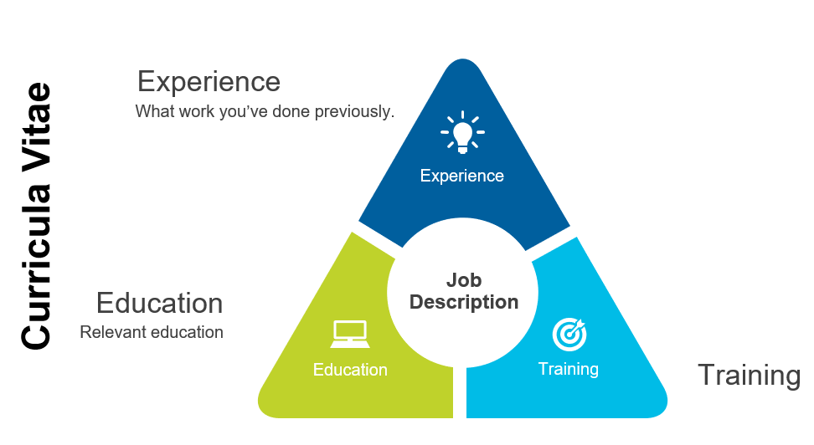
Personnel Qualification – Gowning and Beyond!
Monitor & Adjust
Reaction
LEVEL 1
Engagement
Relevance
Customer Satisfaction
MONITOR
ON –THE – JOB LEARNING
REINFORCE
Results
LEVEL 4
Behavior
Leading Indicators
Desired Outcomes
LEVEL
3
Learning
ENCOURAGE
Clearly tied to key risk indicators
LEVEL 2
REWARD
Knowledge
Skills
Attitude
Confidence
Commitment
Notes:
Culture building. Mention the value of GEMBA. Setting people up for success. Draw parallels to quality culture.

Slide 9
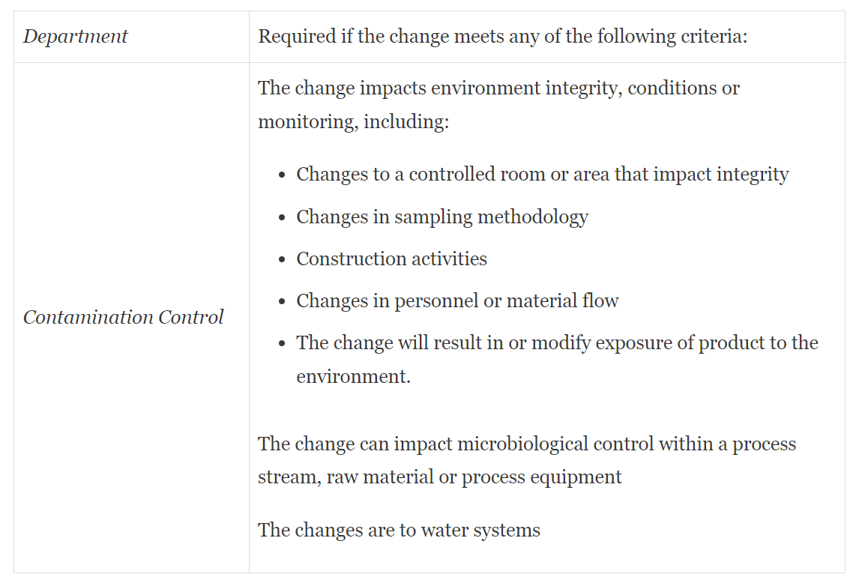
Build Contamination Control Across Processes
Knowledge
Management
Investigation/CAPA
Defined Strategy for Deviation Management
Tied into Governance
Contamination
Control
Interim Controls
Lessons Learned
Escalation Paths
Transfer expertise – utilize tools (e.g. decision trees)
6 - Update
1- Generate
Change Control
Knowledge
Is
sustained
Create/
Capture
Involve Contamination Control appropriately
Ensure your
system uses it
5 - Apply
2 - Assess
Suitability /
Generalization
Ad Hoc risk assessments that ask the right questions
Standardize
(job aids,
Checklists)
Make knowledge
available
Leveraging interim controls consistently
4- Contextualize
3 - Share

Slide 10
Governance
Monitoring of Controls and Preventive Actions
Personal Monitoring
In - Process Monitoring
Method Performance
Environmental Monitoring
Utility
Monitoring
Pest
Control
Validation of Controls and Preventive Actions
Personnel Qualification and Requalification
Process Qualification and Lifecycle
Analytical Method Qualification and ALCM
Facility, Utility & Equipment Qualification & Lifecycle
Controls and Preventive Actions
Pillars
Process
Design
Performing
Execution
Facility
Design
Use
Maintenance
Training and Behavior
Hygiene and Gowning
Cleaning and Disinfection
Change Control
Basics
Quality Risk Management
Knowledge Management and CAPA (Root Cause)
Notes:
For example, The environmental control program, including EM program, cleaning and disinfection program, qualification and periodic re-testing of the disinfectants should be looked at as a lifecycle approach (feedback loop). As a matter of fact, the historical EM data review, Figure 1, is one of the triggers to adapt or improve the cleaning and disinfection program and confirm that the disinfectant and sporicide microbial efficacy profile and spectrum is adequate. Finally, periodic historical EM data review and analysis must be performed to: - Confirm the absence of the increase in excursions from the previous historical EM data analysis. - Identify the specific re-occurrence of trend or adverse events (e.g., the recurring deviation with the same microorganism or recurring excursion on the same sampling position). - Identify specific worst-case microorganism. - Categorize the source of isolate and contamination factors. - Confirm the absence of a high occurrence of microorganisms of concern or microorganisms considered as objectionable or those under official scrutiny, e.g., Burkholderia cepacia.
Actions and alerts should be continuously challenged base don data coming from facility – listen to the data.

Slide 11
Contamination Control Strategy
Based on living risk management and tied to design lifecycle approach
Targeted/ risk-based measures of contamination avoidance
Key performance indicators to assess status of contamination control and live them
A defined strategy for deviation management (investigations), CAPA and Change Control
Notes:
A contamination control strategy contains a section for continuous improvement (make sure the document is subject to periodic updates) that includes:
preparation of reports (frequency!), e.g., management reports or PQRs
evaluation of incidents and deviations and related CAPAs
trending analysis of EM, product quality review, etc.
internal communication/escalation via regular or extraordinary meetings with defined participants.
KPIs and their evaluation
Provide the trigger that would lead to improvement derived from data reviewing (e.g., visual inspection defect characterization).
Look for the subtle trends and take action early at appropriate level

