Slide 1
Enabling the Process Owner to Drive Improvement
Jeremiah Genest
Date: 16-May-2022

Slide 2

Learning Objectives
01-
Define the Process Owner
The role of the process owner and process management within the quality system
Evaluate the Change Program
02-
How to introduce Process Ownership
Describe how Process Owners are Empowered
03-
How to train and empower Process Owners to drive action

Slide 3
The Problem (established company)
Changes take too long
2
Processes are
complicated
Uncertain Accountability
1
Average change to process and procedure>100 days
Significant changes are expensive
3
Balkanized processes
Missing segments of processes
40% of deviations are “Manpower”
Poorly defined KPIs
Unclear who owns improvement
Current State
Process Ownership is lacking

Slide 4



Process Governance Challenges
Turf War
Lack of Maturity
Turf wars or power struggles between support groups
Lack of Maturity in One or more areas
Challenges
Process Governance
Lack of Accountability
Resistance
Resistance to governance rules
Stakeholders who resist assuming ownership of their own processes
Notes:
Governance and ownership challenges often arise in an organization for four reasons:
Business stakeholders who resist assuming ownership of their own processes, data and/or knowledge, or have balkanized/siloed accountability
Turf wars or power struggles between groups of stakeholders
Lack of maturity in one or more areas
Resistance to established governance rules
The Business Struggles with Accountability
Processes often have a number of stakeholders, but no apparent owners. This results in opportunity costs as compulsory process changes (e.g. legislative requirements, systems capacity, or company structural changes) or process improvements are not implemented because the business process owner is unaware of the change, or no clear business process owner has been identified which leads to an increase in risk.
Sometimes processes have a number of stakeholders who all think they are the owners of parts of the process or the whole process. When this overlap happens, each supposed owner often identifies their own strategy for the process and issues their own process change instructions to conform to their understanding of the purpose of the business process. These conflicting instructions lead to frustration and confusion by all parties involved.
Lack of accountability in process and system leads to inefficient processes, organizational disharmony, and wasted energy that can be better spent on process improvements.
Turf Wars
Due to silo thinking there can be subdivided processes, owned by different parts of the organization. For example, count how many types of change control your organization has. This requires silos to be broken down, and this takes time.
Lack of Maturity
Governance is challenging if process maturity is uneven across the organization.
Failure to Adhere to Governance
It can be hard to get the business to apply policy and standard consistently.

Slide 5
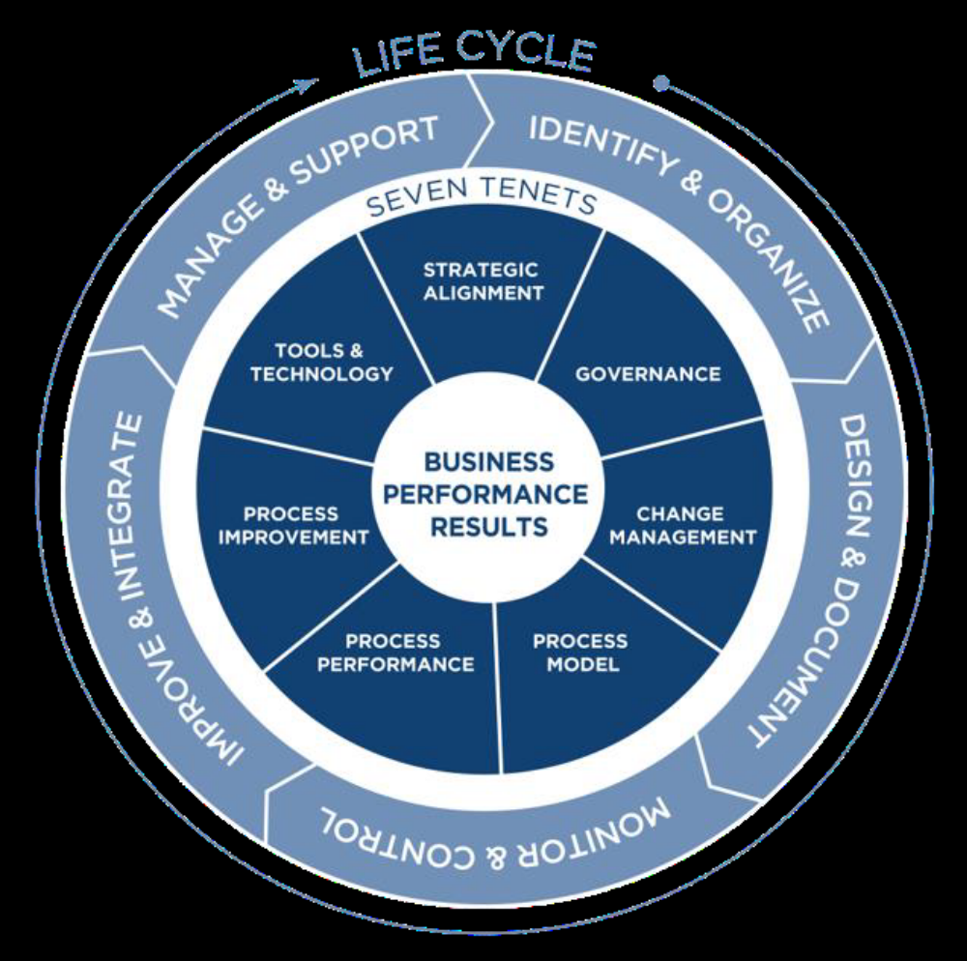
Business Process Management (BPM) is a systematic approach to enabling an organization’s workflow to be more effective, efficient and capable of adapting to an ever-changing environment.
APQC’s Seven Tenets of Process Management
Notes:
1. Create constancy of purpose toward improvement of product and service, with the aim to become competitive and to stay in business, and to provide jobs.
5. Improve constantly and forever the system of production and service, to improve quality and productivity, and thus constantly decrease costs.
6. Institute training on the job.
7. Institute leadership. The aim of supervision should be to help people and machines and gadgets to do a better job. Supervision of management is in need of overhaul, as well as supervision of production workers.
8. Drive out fear, so that everyone may work effectively for the company.
9. Break down barriers between departments. People in research, design, sales, and production must work as a team, to foresee problems of production and in use that may be encountered with the product or service.
14. Put everybody in the company to work to accomplish the transformation. The transformation is everybody's job.

Slide 6
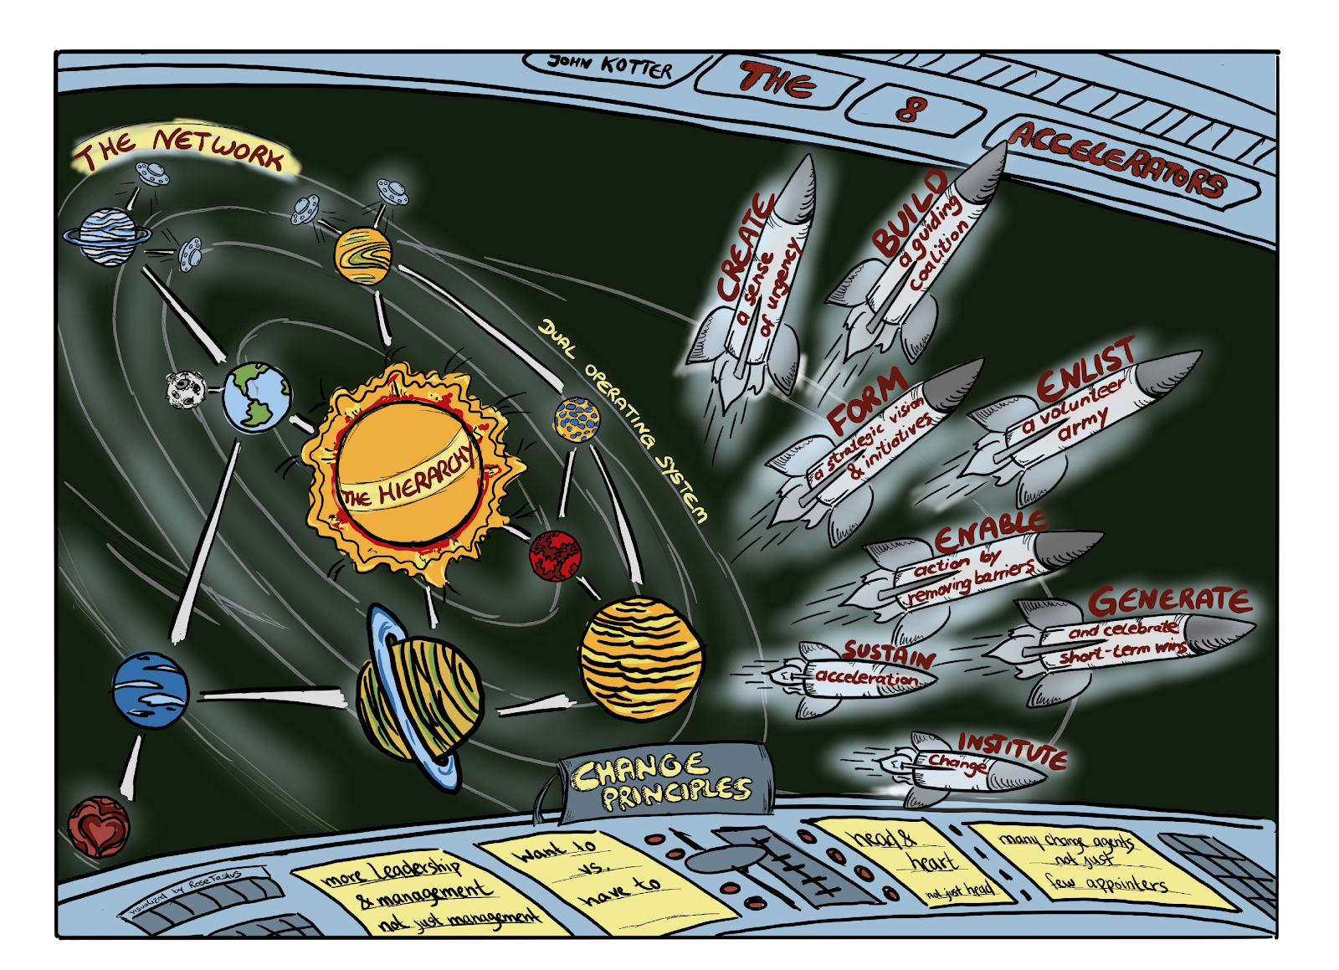
Notes:
Building culture means change. There are a lot of models for change out there, but for the work we pursue around building a culture of quality and excellence I think there are few better than John Kotter’s model.
Kotter sets forth Eight Accelerators of Change which can be leveraged in cultural change:
AcceleratorFocus when building CultureCreate a Sense of Urgency around a
Big OpportunityThe urgency here is the strategic threats from having a less-than-robust quality culture and the opportunities it creates. This is the True North. With this accelerator working, large groups of people are committed to building and improving a culture of quality.
The translation of the sense of urgency from leadership down to the working level is a constant need. People must understand the argument laid out by leadership, but it needs to be linked with their own needs and less about the business need 5 years out. This is pretty fundamental, if folks don’t see how the culture vision will make immediate changes to their work then it will never be prioritized.
It is advantageous to have several different facets of this urgency that might appear to different segments in the organization. Manufacturing may be focused on human error reduction while research is excited around innovation. Both are moving forward in a similar direction.Build and evolve a guiding coalitionYou need a coalition throughout the organization deeply committed to a culture of quality and the benefits it will bring. Culture will never happen when it is viewed as a quality initiative only. Ideally there will be lots of branches and initiatives moving in the same direction. Communicating between these elements of the change initiatives and leveraging between initiatives is vital.
This is about fostering an environment that turns around the big opportunity and gives the member the opportunity to be different and creative. As a result, the participants of the coalition will find ways to work together different from their ordinary habits. This will increase the speed of decision-making and enables the organization to be more agile.Form a change vision and strategic initiativesArticulating the vision of culture shows a fit to strategic opportunities can move you with speed and agility to that vision. By choosing a few strategic opportunities around culture you can move quickly to them.Enlist a volunteer armyCommunicate in ways that lead large numbers of people to buy into the vision and want to help. You want to excite and mobilize as many active and passive members of the organization as possible.Enable action by removing barriersWork swiftly to achieve initiatives and continue to find new ones that are strategically relevant. Identify barriers that are slowing down the growth of a quality culture and remove them.Generate (and celebrate) short-term winsLook for wins big and most specially small and celebrate them. These wins, and their celebration, have psychological power and play a crucial role in building and sustaining culture transformation. The created credibility helps to develop a certain standing for the network within the organization and can also convince people, who did not have a positive attitude towards the network before.Sustain accelerationDon’t let a few wins slow you down. Keep going, keep growing, keep doing and celebrating. This accelerator helps to keep the spirit within the employees up and motivates them further to strive for the big opportunity of developing and reaping the benefits of a quality culture.Institute changeInstitutionalize the changes in process and procedure, in way of working and behavior.Kotter’s 8 Accelerators of ChangeKotter also lists five principles:
PrincipleExplanationMany people active in the change, not just the
usual few folksThe engagement of a large number of people for part-time involvement in the change, as opposed to relying on the same few people to work it full time.A want-to and a get-to (not just a
have-to) mind-setPeople need to want to be change agents and feel that as change agents they have the power to make the change happen. They need to have the ‘spirit of volunteerism” and there needs to be enthusiasm for quality and excellence.Action that is head and heart drivenPeople need to be motivated to participate not only by logical arguments based on a business case. Rather there must be an emotional element that drives their engagement.
The Burning Platform element of Culture will undoubtedly speak to the head but also must speak to the heart. In the pharmaceutical industry the Heart elements of the burning platform could include getting medicines to market quicker for the patient as well as making workers lives better.
Sensemaking and storytelling are key.Much more leadership, not just
more managementLeadership is about vision and inspired action and management is about project management and budget reviews. The secondary operating system needs more of the former.
Democratic leadership, utilizing reflection and feedback is critical for the leader to maintain behaviors that support the change idea and do not contradict it.Two systems, one organizationThe network and the hierarchy must be inseparable and in constant communication. The idea of a network approach to change is critical here.. Change needs to sit next to traditional ways of working to truly be able to make a difference.
The network has a start-up character, which allows working flexible and agile on the change process and taking fast decisions

Slide 7





Building a Process Owner to Drive Improvement
Define
Identify
Train
Implement
Mature and Sustain
Define what a process is
Define your processes
Build a competency framework
Identify process owners
Build organizational excitement
Train the process owners to the competency framework
In-Place
Key deliverables
In-Use
Build to maturity model

Slide 8
Communication
Metrics Tracking
Performance Management
Rewards and Recognition
Sustaining Ownership
Continuous Improvement
Business Case
Sustainability
Change Objectives and Goals
Anchor
and embed the change once it is implemented and is determined to be effective
Change Risk Assessment
Project Charter and Documentation
Strategic Plan
Success Criteria and Measures

Slide 9
Process Framework Ignites Understanding
Regulatory
Requirements
Process
Framework
Benchmarks
Industry
Best Practices
Strategic Alignment
Process Framework
Organization Structure
By establishing a framework, organizations are better able to understand core processes as well as supporting processes, and they can plainly see how the supporting processes affect the performance of core processes.
Operational Needs
Notes:
Process frameworks and models ignite understanding. By establishing a framework, organizations are better able to understand core processes as well as supporting processes, and they can plainly see how the supporting processes affect the performance of core processes.
Attempting process management without a model is a losing battle. Models make abstract, complex processes more tangible by providing a concrete illustration of how processes work and how they fit together. When an organization can visualize how its processes interact, it can better coordinate improvement projects, choose measures, and manage personnel.
Subcategories of Process Models
The following concepts comprise the major components involved in the process model tenet:
» Process documentation—Is the capture and codification of a process, including the information necessary to conduct the process, which can include the use of RACI, SIPOCS, and knowledge maps.
» Framework—Is a “hierarchical decomposition” of a business that describes the work an organization does in terms of process groups, processes, and activities
» Process design—the activity of determining workflow, technology needs, and requirements for implementing a process. It can include the use of tools like flowcharts and simulation software.
» Process variation—Includes the various forms and variants of processes. Mature organizations indicate the rules where process can vary from the enterprise-wide standards. This is typically based on role of the process in providing a competitive differentiator and business line or regional considerations.
» Accessibility—This term refers to the storage and controls around accessing process-related information.
» Expertise—Is the identification and scope of subject matter experts involved in the organization’s process efforts.
Process frameworks illustrate a hierarchy or decomposition of processes.

Slide 10
Governance
Drive a culture of improvement and innovation
08
01
Steering Committee to monitor health and determine priorities for large projects
Ensure best practices are adopted across organization
07
02
Engaged and effective leaders
Coordinate activities between various improvement groups
06
03
Align process improvements to strategic goals and objectives
Define Process Owners
05
04
Ensure stakeholder involvement at all levels

Slide 11


Process Governance
The process governance committee is a cross-functional group of leaders that provide oversight and governance for process work, prioritize opportunities, and align processes and process work with organizational strategy and objectives.
RESPONSIBILITIES AND MOTIVATION
Key Skillsets
Align process management with organizational strategy and objectives
Communication and facilitation
Provide guidance and approval for Process Management
Business Acumen
Review measures and evaluate program efficacy.
Change Management
Performance Management
Report measures, success stories, and
challenges to the organization.
Project Management
Review measures and evaluate program efficacy.
Process Concepts
Prioritize process needs in the business for the
BPM function.
System Thinking
Drive buy-in for process management in the business.

Slide 12
Organization Clout
A director level individual who possesses organizational clout and can command, not just negotiate
Accountable for the Process
Whose areas of responsibility directly intersect most with the process who possesses organizational clout and can command, not just negotiate
Criteria for Selecting a Process Owner
Equity Across Functions
Ability to oversee and work with the teams within the core business process and have major equity across the functions in the business process
Understands the Process
Possess a broad understanding of the activities and challenges across the business process, with knowledge of upstream and downstream activities (e.g., suppliers and customers)
Voice of Process
Have the ability to do what is best for the overall performance of the process and its customers, rather than for just the functions or operations falling within the process.

Slide 13

The Process Owner
EDIT PERSONA TITLE
RESPONSIBILITIES
Competencies
Explaining the purpose of a process
Define the process, including people, process steps, and technology, as well as the connections to other processes.
Ensuring process objectives, targets and measurements
Assess and improve process maturity.
Identify risks, roadblocks, and improvement opportunities.
Negotiating other process conflicts with respective process owners
Reviewing, approving and communicating process changes and/or improvements
Advising management of process breaches or interruptions
Manage documentation, policies, and training related to the process.
Subject Matter Expertise
Business Acumen
Process Improvement
Communication and facilitation
Process management
Systems thinking
Process concepts
Change Management
Documentation
Training
You can edit this text.
Notes:
Process owners are a fundamental and visible difference part of building a process oriented organizations and are crucial to striving for an effective organization. As the champion of a process, they take overall responsibility for process performance and coordinate all the interfaces in cross-functional processes.
Being a process owner should be the critical part of a person’s job, so they can shepherd the evolution of processes and to keep the organization always moving forward and prevent the reversion to less effective processes.
The process owner plays a fundamental role in managing the interfaces between key processes with the objective of preventing horizontal silos and has overall responsibility of the performance of the end-to-end process, utilizing metrics to track, measure and monitor the status and drive continuous improvement initiatives. Process owners ensure that staff are adequately trained and allocated to processes. As this may result in conflicts arising between process owners, teams, and functional management it is critical that process owners exist in a wider community of practice with appropriate governance and senior leadership support.
Process owners are accountable for designing processes; day-to-day management of processes; and fostering process related learning.
Process owners must ensure that process staff are trained to have both organizational knowledge and process knowledge. To assist in staff training, processes, standards and procedures should be documented, maintained, and reviewed regularly.

Slide 14
Process Owner helps Drive Culture
Social Collaboration
Willingness to change
Data-based learning
Confidence in Systems and Processes
Openness to innovation
Collaboration
Willingness
to change
Democratic Leadership Style
Shaping change
Process Owner
Open Communication
Learning Culture
Recognise the value of mistakes
14
Notes:
Process Owners should be supported by the right infrastructure. You cannot be a SME on a end-to-end-process, provide governance and drive improvement and be expected to be a world class tech writer, training developer and technology implementer. The process owner leads and sets the direction for those activities.
The process owner sits in a central role as we build culture and drive for maturity.

Slide 15
Governance Model Initiation and Execution
Governance Committee
Quality oversight
Resource Management
Process Framework
Governance
Result Management
Information
Decisions
Demand Management
Idea
Idea
Project
Project Initiation
Project Execution
Project Closure
Scope
Cost
Communication
Business
Time
Quality
Procurement
Process
Owners
Resource
Risk
Integration
Demand Management
Project/Program Management
Result Management
Steering Committee
Deciding execution
Controlling & managing the projects
Tracking & Evaluating the results
Managing Process Framework
Notes:
Governance is a critical tenet because it assigns accountability for process activities. Governance encompasses all the structural elements that help process management function. It is concerned with roles, responsibility, accountability, oversight, sponsorship, and management structures. The governance of process management often dictates the efficiency and speed at which an organization implements and embeds process management into its practices. Subcategories of Governance The following concepts comprise the major components involved in the governance tenet: » Governance team—body of decision makers responsible and accountable for process management efforts within the organization » Roles—formal or informal process management roles and responsibilities that align with the organizational or functional roles (e.g., formal process owners) » Process management approach—the standards, methodologies, and tools used for process initiatives within the organization » Interaction model—the visibility of process management throughout the organization and the standard operating procedures connecting them

Slide 16

Process Owner Deliverables
Task | Demonstrated by
Ensuring process objectives are met | Gap Assessment against relevant external (e.g. regulations, standards, benchmarks) and internal (e.g. policy, strategy) obligations Process Definition Document and Resource Requirements Plan
Developing, deploying and managing process documentation | Process and procedure documented (e.g. SOP, WI, etc)
Determine training requirements | Role based curricula in place
Determining, implementing and monitoring metrics | Metrics plan in place and in use
Improving process performance | Improvement plan in place and in use
Representing Process to Leadership | Communication plan in place and in use
Representing the process during internal audits and third-party audits and inspections | Inspection readiness plan in place and in use

Slide 17
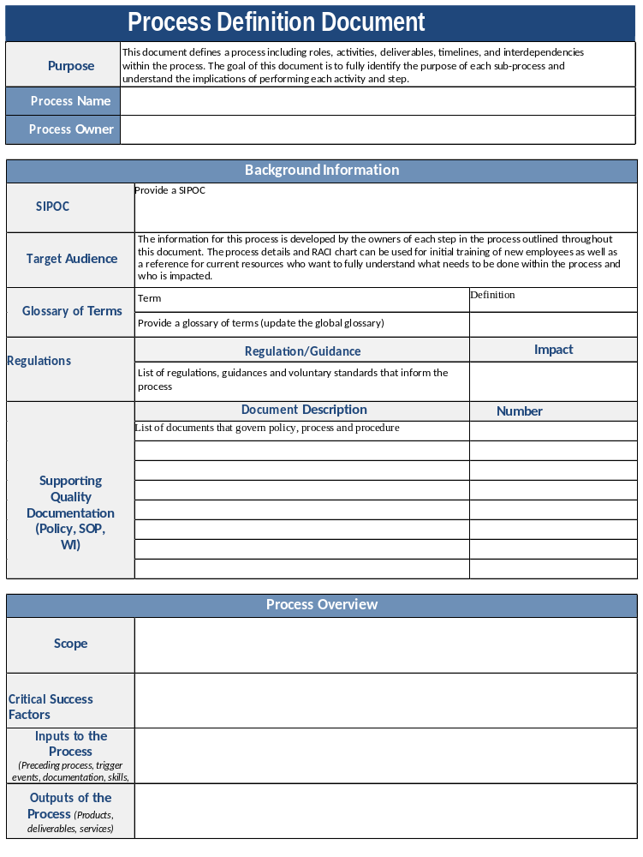
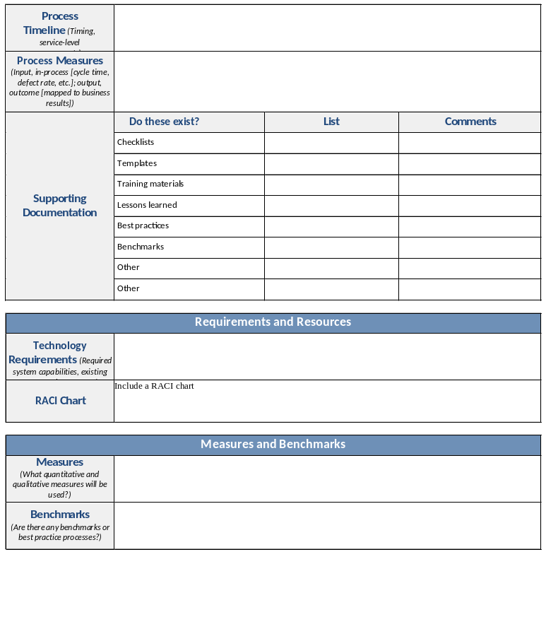
Process definition

Slide 18
Process Landscape
Management
Process
Control come from other processes in architecture or from an External Stakeholder or a Process Enabler
Core
Process
Support
Process
Define key measures
m
m
Define key measures
Management Process
Information that will be referenced by processes Methods & Rules that will control & constrain the processing
Management Process
Core
Process
Core
Process
Guides
Input to Process:
Material to be transformed Information to be processes States to be changed
Outputs of Process:
Materials transformed Information processed States changed
Support
Process
Inputs
Outputs
Support
Process
Inputs come from other processes in architecture or from an External Stakeholder
The Process
Being Analyzed
(e.g. Verify Product)
Outputs go to other processes in architecture or to an External Stakeholder
Enablers
People assigned to process Technologies used in process Facilities that are used
m
Define key measures
Support Process
Enablers come from other processes in architecture or from an External Stakeholder
Core
Process
Management
Process

Slide 19





Meeting Our Obligations
04
Advance stakeholder outcomes
Improve performance to achieve and sustain targeted goals
03
02
Conform consistently to procedures and practices
Comply to
requirements
01

Slide 20
We measure success by
Level 1 | Level 2 | Level 3 | Level 4
System Requirements: | System Requirements | System Requirements: | System Requirements
0-50% In-Use to regulations, guidances and internal policies | 51-75% In-Use to regulations, guidances and internal policies | 76-99% In-Use to regulations, guidances and internal policies | 100% In-Use to regulations, guidances and internal policies
System Performance: | System Performance | System Performance | System Performance
Metrics defined by Management are meeting 0–50% of target over the last 6 months | Metrics defined by Management are meeting 51–75% of target over the last 6 months | Metrics defined by Management are meeting 76–99% of target over the last 6 months | Metrics defined by Management are meeting 100 % of target over the last 6 months
No event/deviation trending in place or unmitigated major/critical events exist. | Event/deviation trending for major/critical events does not meet agreed upon timelines or has no interim controls in place. | Event/deviation trending for major/critical events (with inteim controls) meets agreed upon timelines OR is closed for less than three months. | All mitigations have been closed for more than 3 months with no new trends identified and successful effectiveness checks.
Inspection Outcomes | Inspection Outcome | Inspection Outcomes | Inspection Outcomes
Internal Assessments/Internal Audits/External Health Authority inspection observations were not anticipated. One or more critical or more than 3 major observations open for any given system resulting from an External Health Authority inspection, Internal Audit or Self-assessment by the Primary Process Owner. | Internal Assessment/Internal Audit/External Health Authority inspection observations are known issues but are not being adequately addressed, resulting in repeat observations. No critical and NMT 3 major observations open for any given system resulting from an External Health Authority inspection, Internal Audit or Self-assessment by the Primary Process Owner. | Internal Assessment/ Internal Audit/ External Health Authority inspection observations are known issues and have existing remediation plans documented in a quality system (e.g. CAPA, CCR). No critical and NMT 1 major observation open for any given system resulting from an External Health Authority inspection,, Internal Audit or Self-assessment by the Primary Process Owner. . | Internal Assessment/ Internal Audit/ External Health Authority inspection observations are known issues and have existing remediation plans documented in a quality system (e.g. CAPA, CCR).

Slide 21
We measure success by
Level 1 | Level 2 | Level 3 | Level 4
Inspection Readiness | Inspection Readiness | Inspection Readiness | Inspection Readiness
Inspection Readiness activities are not identified and/or completed. Regulatory Intelligence items are not evaluated or addressed. | Inspection Readiness activities identifies at least 1 critical risk and/or medium risks without a remediation plan in place. Regulatory Intelligence items are evaluated outside timeframes. Actions are open for greater than 1 year. | Inspection Readiness activities identifies no critical risks, and not more than 2 medium risks with remediation plans in place. Regulatory Intelligence items are evaluated on time. No action plans open greater than 1 year | Inspection readiness activities have no un-remediated risks. Regulatory intelligence items are evaluated on time. No open action items.
Culture/Mindset | Culture/Mindset | Culture/Mindset | Culture/Mindset
No system/process owners identified. No programs are in place to proactively drive continuous improvement. Inadequate number of resources or shifting resources from one system to another. No risk-based approach identified. | Some system/process owner has been identified. Programs are in place to proactively drive continuous improvement.(e.g. CAPA robustness and Human Error Prevention). Adequate number of resources to manage the system. | Process owner has been identified and ensure the QMS is in alignment with policies and standards. Proactive programs are in place and some programs have shown improvement over the last three quarters. Adequate number of resources that are cross trained and able to support multiple operations and quality initiatives. | Process owner proactively demonstrate initiatives to improve the process. All programs have shown improvement over the last three quarters. Area has knowledge, skills and abilities to maintain a compliant and efficient quality system.

Slide 22
Take-Away: Process Owners Drive Improvement
01
Strategic Alignment. Process Ownership is a core to maturity
Process Improvement. Drive to maturity and continuous improvement.
06
02
Governance. Owned by the business
Case Study
Process Performance. Clear KPIs. Use KRIs and KBIs.
05
03
Change Management. Build for Sustainability
Process Model. Ignite Understanding
04

Slide 23
Thank You
Jeremiah Genest
Head of Quality Management Systems
Amylyx

