Slide 1
Building a Quality Culture
SQA Quality College
GEN-215
Jeremiah Genest

Slide 2
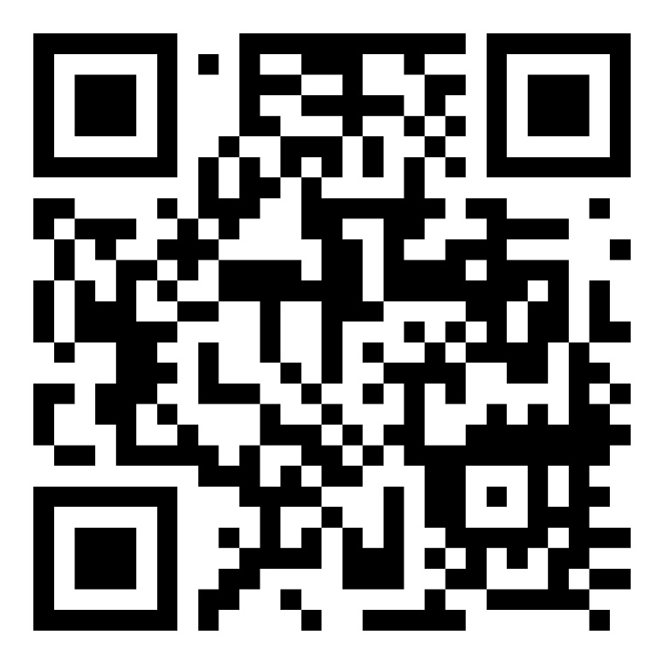
For more Information visit my blog “Investigations of a Dog”

Slide 3
Quality Culture
Quality Culture is the overriding attitude, both expressed and implied, of an organization towards quality. It is characterized by two distinct elements: a cultural/psychological element of shared values, beliefs, expectations, and commitment towards quality and, a structural/managerial element with defined processes that enhance quality and aim at coordinating individual efforts.
A mature quality culture, in many cases, requires changing from a compliance-led approach to an excellence-led approach, and requires a transformational change to be implemented. Culture drives people’s behavior, innovation, and customer service.
Notes:
https://unsplash.com/photos/vdXMSiX-n6M

Slide 4
Goals
01
Identify the levers of culture within an organization
03
Implement key behavior indicators (KBI) to drive change within an organization
02
Develop values that drive desired quality behaviors
04
Utilize key tools, such as microfeedback, Gemba walks and storytelling to build and maintain a quality culture.

Slide 5







Agenda
Elements and Levers
Key Behaviour Indicators
GEMBA Walks
Call to Action
Building Values that Drive Behaviours
Feedback
Building an Action Plan

Slide 6
Identifying the elements and levers of a quality culture, including current regulatory agency thinking
Elements and Levers
Key Behaviour Indicators
GEMBA Walks
Call to Action
Building Values that Drive Behaviors
Feedback
Building an Action Plan

Slide 7
Edgar Schein Organization Culture Model
Organisational attributes that can be seen, felt and heard by the uninitiated observer, including facilities, offices etc, and how people interact visually with others and outside organizations (work as ritual)
Means to achieve quality goals (e.g. human performance, knowledge management, risk management)
Goals and the ways to measure and correct
ARTIFACTS
ESPOUSED VALUES
Professed culture of an organisation's members, e.g. company slogans, mission statements etc.
Values of Performance Excellence
Compelling Story
Psychological Safety
BASIC ASSUMPTIONS
Which are unseen and not actively defined in everyday interactions between members of the organisation
Answers the question “What is Quality?”
True North

Slide 8
8 Key Dimensions of the Definition of Quality (ISO9001-2015)
Performance
How well the product performs in comparison to how it was designed to perform
Perceived Quality
Reliability
Based on customer’s experience before, during & after they purchase a product
Likelihood that the product will perform throughout its expected life
Serviceability
Durability
What the ease of fixing or repairing the product if it fails
Quality
The actual life expectancy of the product
Aesthetics
Conformance
The style, materials & visual appeal of a product
Does the product meet its specifications as designed
Features
What different functions or task can the product perform

Slide 9
ISO 10010:2022 Quality management — Guidance to understand, evaluate and improve organizational quality culture
Embed and Sustain
Understand the Context
Ensure ongoing activities to sustain the Desired Quality Culture
Measure and Monitor Performance against agreed metrics
Use results of analysis for continuous improvement activities
Understand issues affecting organizational quality culture
  Size, complexity, maturity, location
  External and internal needs and expectations
Embed and Sustain
Desired Quality Culture
Understand the
Context of the
Organization
Quality Culture Framework
You can edit this text
Determine and Implement
Actions to Achieve
Desired Quality Culture
Determine Desired
Quality Culture
Determine Desired
Determine Current
Quality Culture
Implement Actions
Ensure Quality Culture is consistent with:
  Context
  Policies
  Vision
  Mission
  Values
Determine relevant risks and opportunities
Take Actions to address relevant risks and opportunities
Determine Current
Develop Assessment tools and metrics
Analyze Current Quality Culture
Evaluate Results

Slide 10
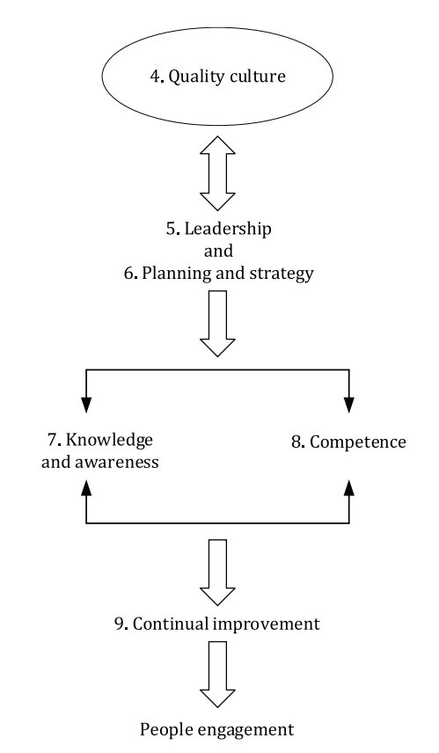
ISO10018:2020 Quality management — Guidance for people engagement
Notes:
ISO10018:2020 Quality management — Guidance for people engagement [1]
The ISO10018:2020 Quality management — Guidance for people engagement document gives guidelines for engaging people in an organization’s quality management system and guidance on enhancing their involvement and competence within it.
This document is applicable to any organization, regardless of its size, type or activity.
The standard describes the importance of establishing a quality culture and the need for leadership and management “to establish a unity of purpose and shared values.” In general, this standard lays out concepts for quality culture and considerations for its implementation including potential actions steps. It also discusses how the concepts are linked to and supportive of other ISO quality management standards. This document generally serves as a framework to identify any large gaps in an existing quality culture program as well as a reference to other quality related ISO standards and is a starting point for a high-level overview of quality culture concepts.

Slide 11
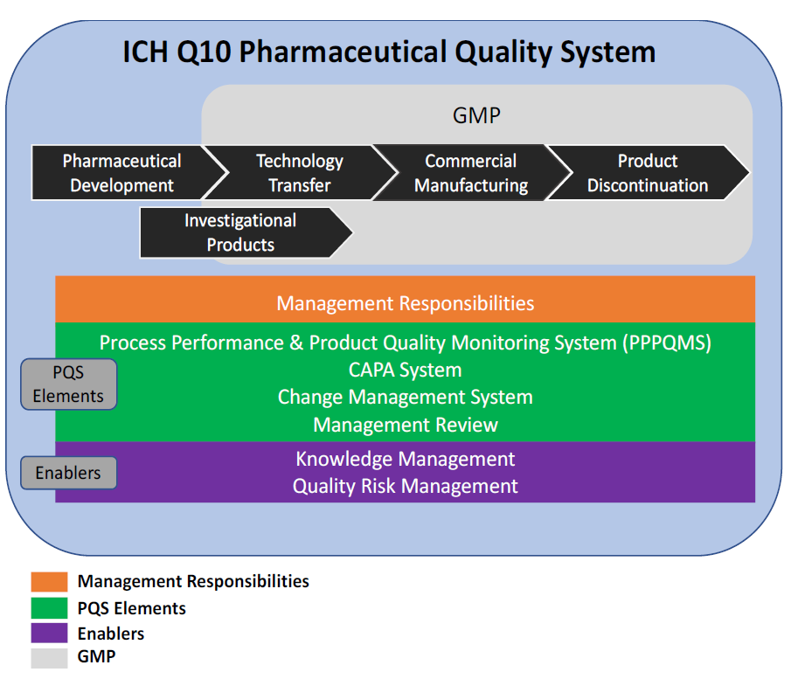
International Conference of Harmonization
ICH E6 (R3) emphasize quality “should be implemented to identify the factors critical to ensuring trial quality and the risks that threaten the integrity of those factors and ultimately the reliability of the trial results.”
ICH E8 requires us to “Establish a Culture that Supports Open Dialogue”
Notes:
ICHQ10 Pharmaceutical Quality System
The International Conference on Harmonisation’s (ICH) quality guidelines Q8, Q9, Q10 and Q11 identify important key focus areas for a pharmaceutical quality system. [2,12-14].
Of these, ICH Q10 is the most relevant for quality culture because it describes a comprehensive model for an effective pharmaceutical quality management system. It is based on International Organization for Standardization (ISO) quality concepts, including applicable good manufacturing practice (GMP) regulations, and also integrates with ICH Q8 Pharmaceutical Development and ICH Q9 Quality Risk Management.
The ICH Q10 guidance provides the following parameters: Management Responsibilities and Review; Knowledge Management, Corrective and Preventive Action, Change Management, Quality Risk Management, Process Performance and Product Quality Monitoring, and Cultural Excellence Enablers (Organizational, technical, and tools enablers).
ICH Q10 is a model for a pharmaceutical quality system that can be implemented throughout the different stages of a product lifecycle. Much of the content of ICH Q10 applicable to manufacturing sites is currently specified by regional GMP requirements. ICH Q10 is not intended to create any new expectations beyond current regulatory requirements. Consequently, the content of ICH Q10 that is additional to current regional GMP requirements is optional. ICH Q10 demonstrates industry and regulatory authorities’ support of an effective pharmaceutical quality system to enhance the quality and availability of medicines around the world in the interest of public health. Implementation of ICH Q10 throughout the product lifecycle should facilitate innovation and continual improvement and strengthen the link between pharmaceutical development and manufacturing activities.
This guideline applies to the systems supporting the development and manufacture of pharmaceutical drug substances and drug products, including biotechnology and biological products, throughout the product lifecycle. Although not implicitly explained in ICH Q10, it does align with the foundational elements/concepts in this standard that are critical for a successful quality culture (0 ).
Paragraph updated:'This guideline applies to the systems supporting the development and manufacture of pharmaceutical drug substances and drug products, including biotechnology and biological products, throughout the product lifecycle. Although not implicitly explained in ICH Q10, it does align with the foundational elements/concepts in this standard that are critical for a successful quality culture (2).’
ICH E6(R3) aims to foster a quality culture by proactively designing quality into clinical trials and drug development planning. This guideline recommends that quality by design should be implemented to identify the data and processes that are crucial in ensuring trial quality, the risks that have the potential to compromise the integrity of those factors, and the reliability of the trial results. In all sections, the guideline emphasizes need for ensuring quality. Key activities of the clinical trial – monitoring and data management are considered essential quality control activities. The use of novel technologies has raised the bar for quality and enhanced the responsibilities of the stakeholders.

Slide 12
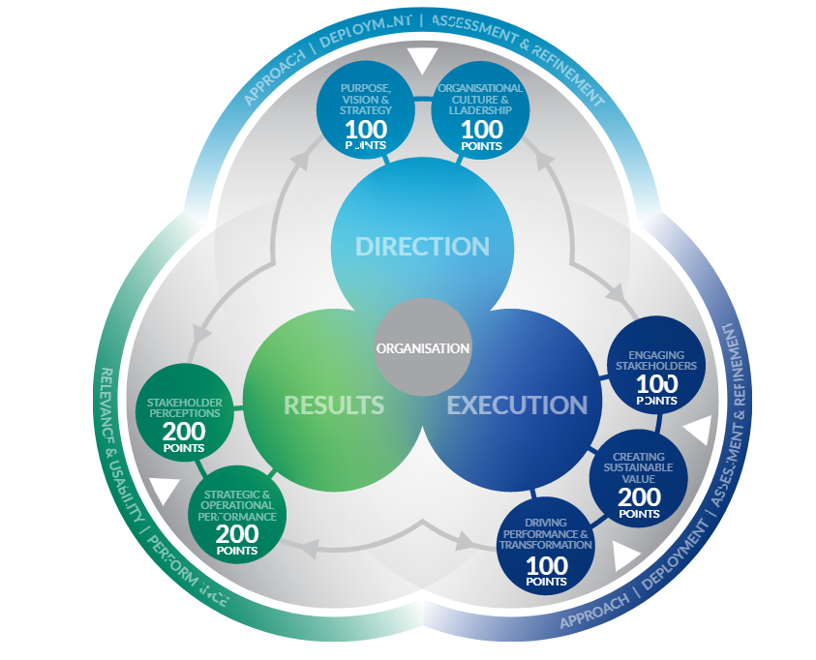
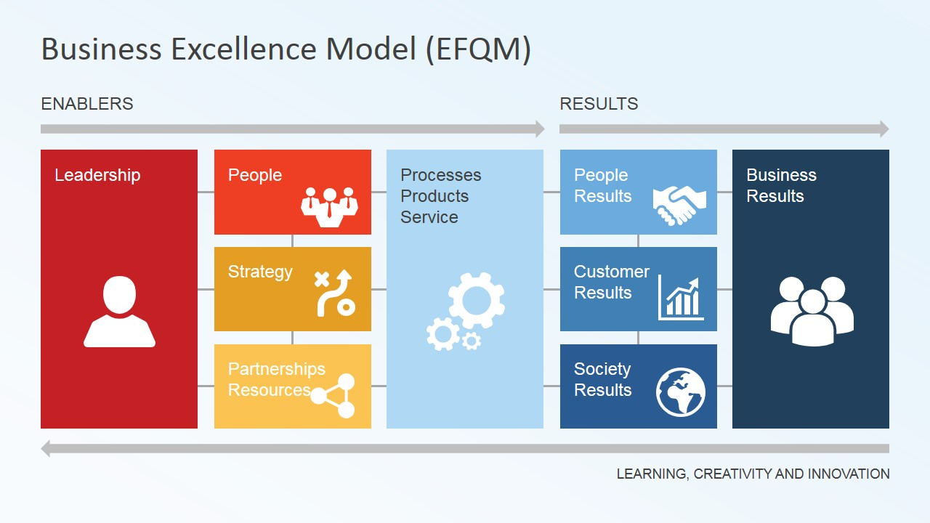
EFQM
https://efqm.org/the-efqm-model/
Notes:
The EFQM is a not-for-profit organization founded in Brussels in 1989 that partners with more than 50 thousand organizations across the globe to provide the skills to develop a culture of continuous improvement. The EFQM Model “is a globally recognized management framework that supports organizations in managing change and improving performance.” It is a model, essentially developed within the European environment and taking into account regulations in the EU market. The Model structure is based on the 3 key sections labeled Direction, Execution, and Results.
The model has the purpose to help organizations to achieve success by measuring where they are on the path to create sustainable value. It helps understand the gaps and possible solutions available, empowerment to progress and significantly improve an organization’s performance.
Each key section (Direction, Execution and Results) can be assessed with a scoring matrix chart. The assessment follows a RADAR (Results, Approaches, Deploy, Assess, Refine) logic. The maximum number for each sub-category, which is divided across the seven criteria as shown in the image below, varies between 100 and 200, adding up to a maximum of 1000 points. Therefore, success is measured in a multi-dimensional and holistic approach.

Slide 13
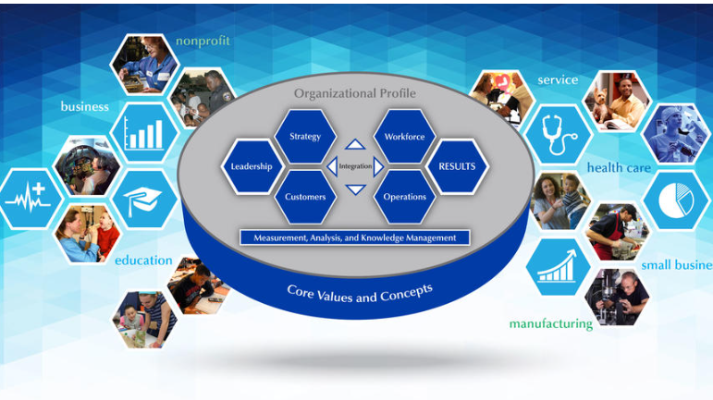
Malcolm Baldridge Framework
Notes:
Malcolm Baldrige Excellence Framework [4]
The Baldrige Performance Excellence Program is designed around a set of core values and concepts which are embedded in systematic processes leading to measurable performance results in the following categories: Leadership and Governance, Financial, Market and Strategy, Product and Process, Workforce, and Customer. Although the concepts remain aligned, the evaluation criteria are customized for application in three sectors: Education, Healthcare and Industry. The Excellence Framework provides definitions and evaluation criteria for the following core concepts:
Systems Perspective
Visionary Leadership
Customer- (or Patient-, or Student-) Focused Excellence
Valuing People
Organizational Learning and Agility
Focus on Success
Managing for Innovation
Management by Fact
Societal Contributions
Ethics and Transparency
Delivering Value and Results
The below diagram from the Malcom Baldridge framework illustrates interdependency of the core concepts just discussed.

Slide 14
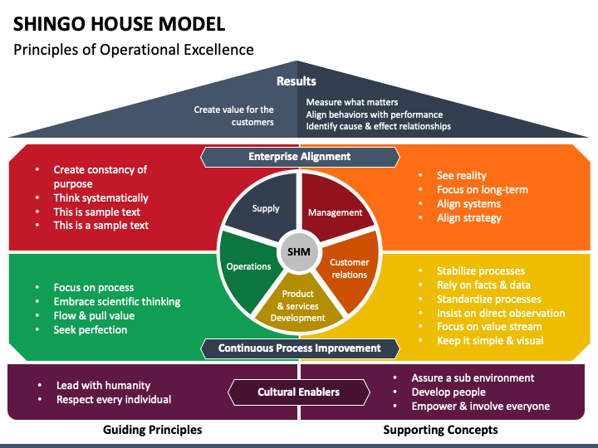
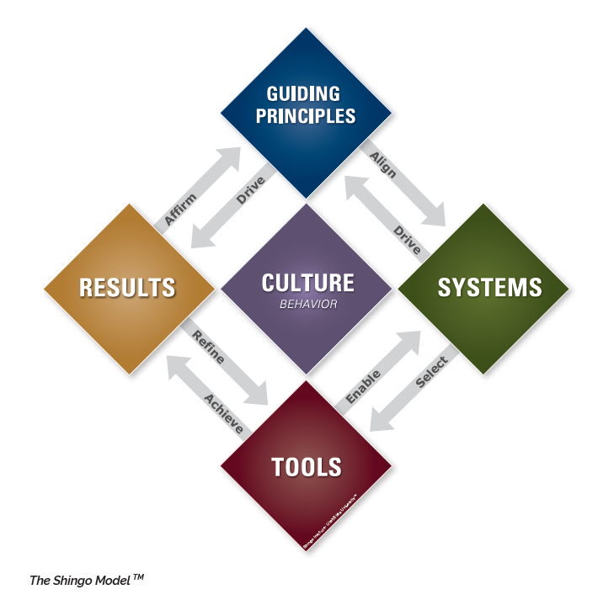
Shingo Model
https://shingo.org/shingo-model/
Notes:
Shingo Model
Dr. Shigeo Shingo was an early pioneer developing the concepts of LEAN, Total Quality Management, and Just in Time manufacturing working with Toyota in Japan. His approach to quality centered on the belief that long-term success depends on a relentless quest to improve. Sustainable results require a culture in which every person is engaged every day in making improvements to systems and tools and having that culture aligned to specific guiding principles. The Shingo Model has been developed and refined based on research by the Shingo Institute established in his memory at the University of Utah in the United States. The ten Shingo Guiding Principles are divided into three dimensions: Culture Enablers which addresses the people of the organization; Continuous Improvement which focuses on ensuring the processes maximize value; and Enterprise Alignment which emphasizes a common focus on the systematic thinking and primary purpose of an organization to create value for the customer. Within each of these dimensions the guiding principles are further elaborated, and the model describes enablers that can be used to ensure the culture is aligned and makes best use of the systems and tools to deliver the desired results.

Slide 15
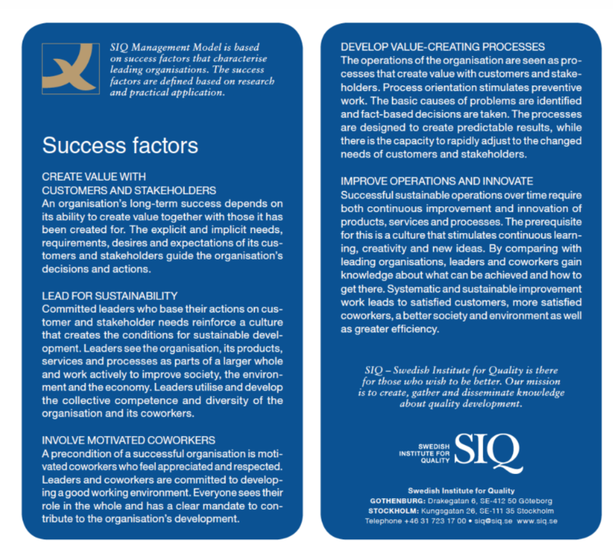
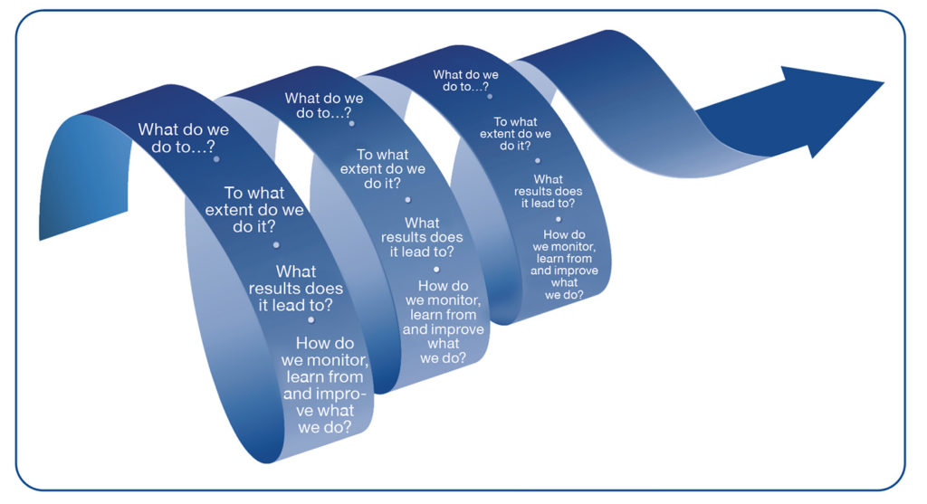
Swedish Institute for Quality (SIQ)
https://en.siq.se/in-english/siq-management-model/
https://en.siq.se/in-english/siq-management-model/
Notes:
Swedish Institute for Quality (SIQ) is an excellence model designed to address the 5th wave of Quality (Q5) which is described as focused on societal satisfaction and how global technological development has erased borders. SIQ calls out “the inefficiency arising from uncommitted employees” as a key weakness in Q5. To address this the model focuses on doing the “right things” in the “right way”. The most recent update of the SIQ model includes a focus on sustainability principles to achieve societal satisfaction which is unique to the other models addressed by this standard. As sustainability becomes a greater focus of many businesses, this model is well positioned to support its assessment.
The three pillars of the SIQ model are culture, structure, and systematics (a way of asking questions that leads to insights and motivations.) Similar to PDA’s approach, the SIQ model is backed by research [17] and built around a focus on working methods and the idea that in order to improve results we have to change the way we work. For purposes of this standard, we will focus on the culture portion of the SIQ model which includes five success factors: creating value with customers and stakeholder; leading for sustainability; involving motivated co-workers; develop value-creating processes and improve operations and innovate.

Slide 16
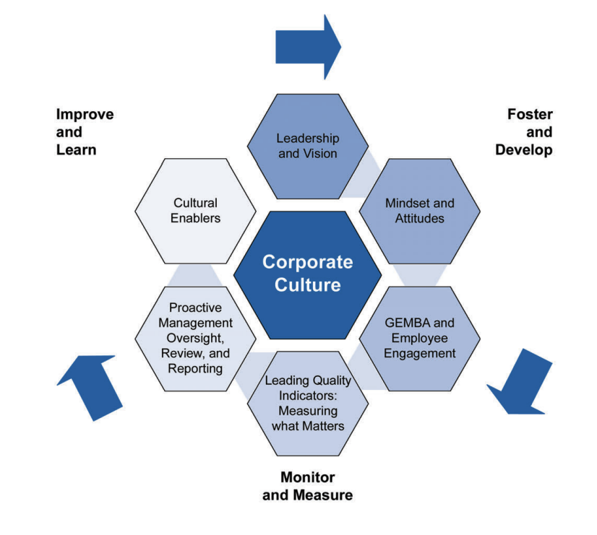
International Society for Pharmaceutical Engineering
Notes:
ISPE Advancing Pharmaceutical Quality (APQ), Cultural Excellence Guide
International Society for Pharmaceutical Engineering (ISPE) has written a guide that shares insights on quality culture improvement across six dimensions and outlines a series of assessments, approaches, practices, measures, and improvement tools to support implementation of a cultural excellence framework at all levels within an organization. The APQ program provides a framework for assessing and enhancing the effectiveness of the Pharmaceutical Quality System (PQS) as described in ICH Q10.
The APQ program recognizes that the ability to advance quality management maturity lies within the pharmaceutical industry and builds upon the ICH Q10 model. The APQ enhances the PQS elements with the aspects of cultural excellence, operational excellence (OPEX), knowledge management, and continual improvement. It provides a comprehensive approach for assessing and improving an organization’s quality management maturity to advance the state of quality within the organization.
The APQ program focuses on eight overarching aspects:
Integrate quality management maturity, cultural, and operational excellence principles, tools, and approaches
Support and incentivize continual improvement
Foster industry ownership of quality beyond compliance
Promote effective and efficient use of resources
Encourage self-improvement and supplier improvement
Enable structured benchmarking, knowledge sharing, and learning among organizations
Increase the reliability of supply for quality products
Offer routes to delivering sustainable competitive advantage
At the core of the APQ Program is the Assess, Aspire, Act and Advance framework which provides a set of tools, resources, and systematic approaches for organizations to advance the maturity and effectiveness of their quality culture.
ISPE APQ Cultural Excellence Guide shares insights on quality culture improvement across six key dimensions and outlines practical approaches, practices, and tools to support implementation of the cultural excellence framework. It is based upon the 2017 ISPE Cultural Excellence report with enhanced features supporting key behavior assessment at employee and management levels, a robust recognition and reward program, and third-party contract evaluation. As shown in the diagram below, it provides a quality management framework for assessing and advancing corporate culture maturity by evaluating the following elements:
Leadership and Vision
Mindsets and Attitudes
Gemba and Employee Engagement
Leading Quality Indicators with Metrics that Matter
Proactive Management Oversight, Review and Reporting
Cultural Enablers

Slide 17
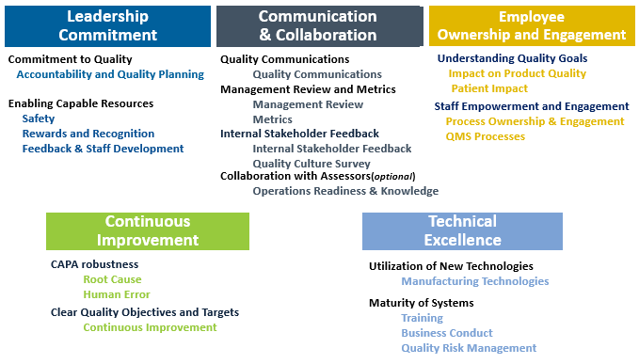
PDA
Notes:
The PDA has designed a comprehensive Quality Culture Assessment Tool and Training to guide companies to a better understanding of quality culture, how to assess it, and what actions to take to improve it. The tool helps a company effectively collect verifiable data that will help them to assess their culture at all levels of their organization. The PDA model identifies 21 elements of Quality Culture over five categories that can be objectively assessed. The tool defines criteria for five levels of maturity enabling a site to compute a maturity score by element and category. The individual site scores are collected by PDA who produces an industry benchmarking report where sites can use to find their relative strengths and weaknesses as compared to overall industry results. The PDA Tool has been developed based on research demonstrating a positive correlation between culture behaviors and quality system elements and refined through industry testing and user feedback. The research demonstrated that the presence of specific quality system elements can be a surrogate for more positive culture and behaviors within a pharmaceutical manufacturing environment. The model is based on ICH Q10 principles as well as incorporating mature quality system elements that go beyond GMP requirements such as process ownership, safety culture, rewards and recognition, and level of technology implementation.

Slide 18
FDA CDER Quality Management Maturity Initiative
Goals
Foster a strong quality culture mindset
Recognize establishments that have advanced quality management practices and acknowledge establishments that strive to continually improve quality management practices
Identify areas where quality management practices can be enhanced and provide suggestions for growth opportunities
Minimize risks to product availability to assure reliable market supply
Five Practice Areas
Management Commitment to Quality
Business Continuity
Advanced Pharmaceutical Quality System (PQS)
Technical Excellence
Employee Engagement and Empowerment
Notes:
Quality Management Maturity (QMM) is the state attained when drug manufacturers have consistent, reliable, and robust business processes to achieve quality objectives and promote continual improvement.

Slide 19
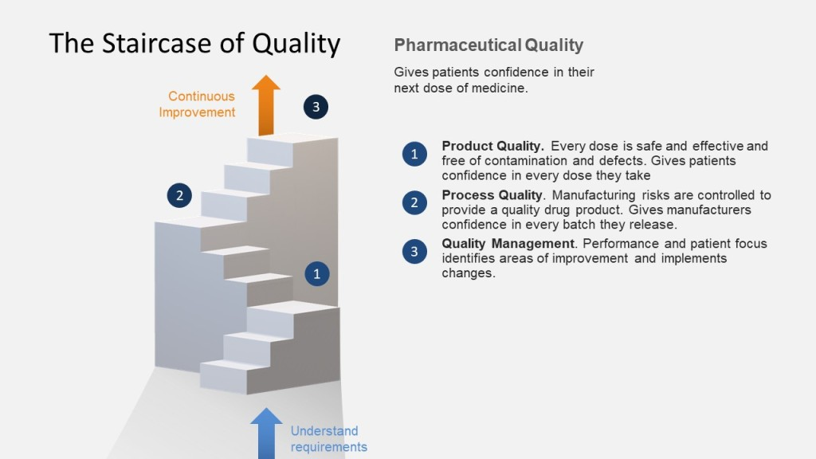

Slide 20
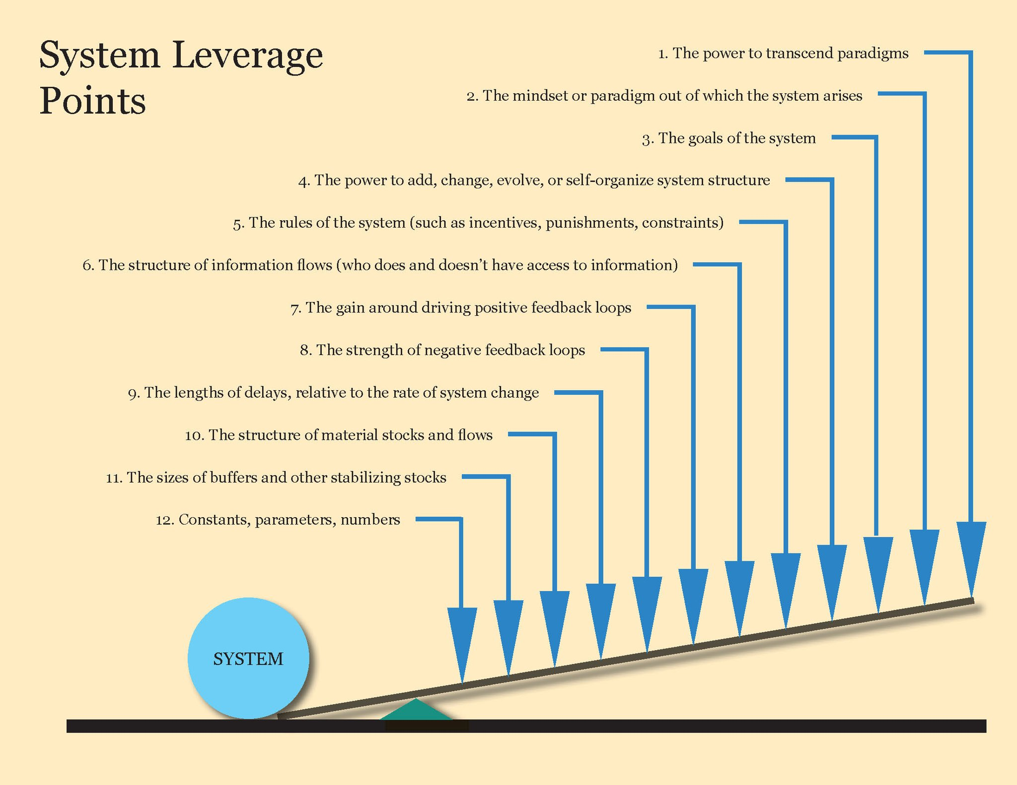
Notes:
Donella Meadows 12 System Leverage Points

Slide 21






The Five Elements of Quality Culture
Leadership Commitment
Technical Excellence
Communication and Collaboration
Continuous Improvement
Employee Ownership and Engagement

Slide 22



Quality Leadership
Leadership Commitment in Quality Culture
Criteria for Success of Leadership Commitment
Leadership Commitment
Measurement of Leadership Commitment
Suggestions for Improvement in Leadership Commitment
Effective Leadership Framework
Notes:
Leadership is required to promote an effective and sustainable Quality Culture at all levels of an organization. The role of leaders is to provide guidance within the company to define and enable beliefs and behaviors that promote operational excellence and product quality. Quality culture starts with leadership that understands and believes the implications of the Quality System's view and knows the necessity of successfully serving customers. The result of that understanding is a culture where a positive internal environment and the creation of satisfied customers go together. It is a culture that naturally emphasizes continuous improvement of processes and one that results in a healthy workplace, satisfied customers, and a growing, profitable company.
Behaviors are driven from the values defined by the organization as well as the attributes that an individual demonstrates each day. Since culture is often implied and felt rather than directly stated, leadership has the responsibility to define the values important to the organization as well as the expected behaviors. Leaders must then consistently and transparently demonstrate the behaviors that align with the organization’s values. This brings clarity to the workforce on how to embody the values. When people care deeply about the organization’s values, and they are behaving as expected, people can improve performance and they are motivated to work toward the company vision.
Positive leadership behavior is a set of actions, taken by individuals in a position of authority and influence, to motivate and cultivate others through mechanisms of empowerment, engagement, and collaborative assignment to meaningful work. Positive leadership behavior promotes happiness, well-being, and mindfulness as goals for organizations that are as important as profit, achievement, and winning in competitive situations, like markets and contract awards.
An effective Leadership framework sustains the commitment towards interpersonal effectiveness, management skills and change resiliency. In an organization with a culture of quality, product quality and operational excellence are owned by all employees. It is not just managers that should drive quality culture within an organization. Ideally Quality Improvement (QI) should be inherently built into the cyclical performance management plans for all employees so that it is embedded across all levels of the organization. This should also include provision of ongoing training opportunities, granting authority to make decisions, and eliminating fear of consequence or blame culture.
Senior management should lead the process for transformational change, dedicate financial and human resources to QI, communicate progress, hold staff accountable, address resistance to change, and exhibit visible support for QI. Middle managers and supervisors should ensure that all employees have the direct support needed and are being held accountable to QI values and behaviors.
Λεαδερσηιπ Χομμιτμεντ ιν Θυαλιτψ Χυλτυρε
Μεασυρεμεντσ οφ Λεαδερσηιπ Χομμιτμεντ
Χριτερια φορ Συχχεσσ οφ Λεαδερσηιπ Χομμιτμεντ
Συγγεστιονσ φορ Ιμπροϖεμεντ ιν Λεαδερσηιπ Χομμιτμεντ

Slide 23




Visionary
Vision embodies the desired optimal state of an organization to achieve world class quality culture based on a core set of values
Strategic Thinking
Visionary
Intentional and rational thought process focused on the analysis of critical factors and variables that will influence the long-term vision and success for a business to achieve their desired state. Leaders need to embrace and facilitate strategic conversations, which help them solve their key quality challenges.
Strategic
Thinking
Effective Enabler
Effective
Enabler
Bring visibility to the work
Ensures
Accountability
Ensures Accountability
Deliver on commitments, showing others they can be trusted to do what they say they will do
Notes:
Leadership Attributes
Leadership Attributes are the inner or personal qualities that constitute effective leadership. These are relatively stable and coherent integrations of personal characteristics that foster a consistent pattern of leadership performance across a variety of group and organizational situations. These characteristics reflect a range of stable individual differences, including personality, temperament, motives, cognitive abilities, and expertise. World class leaders must create a positive environment to nurture talented employees and recognize their polarized needs, ambitions, and values. They must possess the ability to create a sustainable organizational capacity while making efficient use of resources. Below, key attributes are discussed in more detail.
Visionary
Vision is the ability to concentrate on the most important aspects of business, such as what the organization aims to achieve. Vision embodies the desired optimal state of an organization to achieve world class quality culture based on a core set of values. The vision of leadership permeates the workplace and is manifested in the actions, beliefs, behaviors, and goals of the organization. This requires a vision that is clearly articulated, energetically shared, and passionately owned ensuring others will follow and share the vision and enables success by providing the necessary resources, removing barriers, and promoting collaboration.
Transparency involves gaining the trust of others by openly sharing information. Sharing visibility with the team will promote the vision in achieving the goal.
Creativity is being open to new ideas, possibilities, and perspectives, and understanding that there's no "right" way to do things. The creative leader is able to listen, observe, and be willing to change course when necessary. Innovation distinguishes between a leader and a follower.
Strategic Thinking
Strategic thinking, applied to Quality Culture, is an intentional and rational thought process focused on the analysis of critical factors and variables that will influence the long-term vision and success for a business to achieve their desired state. Leaders need to embrace and facilitate strategic conversations, which help them solve their key quality challenges.
With communication, strong leaders know the importance of and how to communicate with people at all levels of their organization. Communicating should feel genuine to others and leaders should demonstrate empathy, engage in active listening, and build meaningful working relationships with others in the team. In successful communication, messages are understandable, and the team is clear on what is expected and are motivated to achieve the vision.
Decisiveness is the ability of leaders to make timely decisions based on available information. People will often look to their leaders, not for perfection, but for someone able to make quick, considered, and well discerned decisions to allow them to focus on deployment within an agreed set of priorities. Leaders possess the ability to make the right decision at the right time with strong forethought. Once the decision is made, a good leader stands by the decision. When new information is introduced and warrants a change in strategy, it is clearly communicated.
Leading Change is a key behavior for strategic thinking. Leadership involves the knowledge that success comes with a willingness to change how things are done and to bring in new talent to inspire innovative and creative ideas to achieve maturity of the quality culture. Effective leaders know that they do not exist alone and need other people to help them achieve the organizational vision. Strong leadership can identify change agents in the organization that can be mentored and coached to help drive the desired changes.
Effective Enabler
Enablers bring visibility to all the work necessary to support efficient development and delivery of future business requirements to create the desired Quality Culture. They identify and initiate opportunities for key improvements, continuously challenge and find ways to improve systems, processes, and practices to ensure long term success. Additional considerations include:
Motivation through Empowerment is demonstrated by delegating authority and allocating more autonomy and responsibilities to people in a team, by enhancing the meaningfulness of work, fostering participation in decision making, and by expressing confidence in other people's decisions.
Delegation is critical to a leader's success because it allows them time to focus on more strategic planning to accomplish the vision of the organization. Delegation also allows the team members to grow and demonstrate their leadership capabilities.
Passionate leaders are successful because they believe that their work is important. Sharing that enthusiasm is motivating for all people involved and is a way to leverage greater success.
Empathy is when supportive leaders take into consideration other people’s points of view.
Authenticity is demonstrated by consistency and transparency in values, beliefs, and actions; integrating values and principles to create a purposeful vision and to contribute to the growth of others. Authentic leaders are self-aware enough to understand their strengths and weaknesses and how these translate to the workplace. Authenticity in leadership includes the capacity of a leader to be open, honest, and forthright and factual with their team.
Team building is important in an organization. Collaborative leaders understand that the organization achieves more when its people work together. Working across roles and functions brings energy, ideas, and new solutions to any task. Leadership welcomes the opinions of others in the team to support decision making which encourages a participative open culture. Discussions are open and frank, which leads to innovative new ideas being utilized to promote the quality culture. When managers act in a collaborative fashion, all staff come together to work as a team where information is shared organically, and all involved take responsibility.
Ensures Accountability
Accountability occurs when individuals reliably deliver on their commitments, showing others they can be trusted to do what they say they'll do. Leaders further demonstrate accountability by taking responsibility for the outcomes of their actions and decisions and successfully transforming effort into results.
Confidence in an effective leader is demonstrated when they ensure that others follow their plans. Assertiveness and confidence enable the leader to gain the respect of their followers/team.
Learning from failure is an excellent tool of knowledge building and understanding of self. It allows for survival, renewal, and reinvention of oneself and the organization. How a leader manages and learns from failure often defines one's character as a leader.

Slide 24




Communication and Collaboration in Quality Culture
Suggestions for Improvement
Openness and trust
Respect for others with an equity platform that embodies constructive feedback
Learning and continuous improvements
A shared quality culture vision
Improve Operations and Innovate
01
04
02
03
Criteria for Success
Measurements
A precondition of a successful organization is motivated co-workers who feel appreciated and respected. Leaders and co-workers are committed to developing a good working environment. Everyone sees their role in the whole and has a clear mandate to contribute to the organization’s development.
Management by Process and Facts
Knowledge Management
Notes:
Effective communication is essential to the success of an organization in the promotion of a quality culture and enables openness and trust at all levels. Communication is critical in ensuring that everyone involved in the process is aware of goals, expectations, and requirements. It can also help with identifying and resolving issues before they become major problems, increasing customer satisfaction, and establishing a mature quality culture.
Collaboration is fundamental to achieving and maintaining a shared vision; transformational leadership; constructive and productive communication; and demonstrated competency with key stakeholders. It ensures high standards of quality and performance using openness and trust; respect for others with an equity platform that embodies constructive feedback; learning and continuous improvements to achieve organizational objectives aligned with partner organizations; and a shared quality culture vision.
Effective communication and collaboration in quality culture leads to improved efficiency, reduced costs, enhanced reputation (i.e., regulatory, public, investors, etc.) and employee, customer, and stakeholder satisfaction.

Slide 25
The Culture of Quality
Quality of Culture requires use to transfer attitudes and behaviors
Hear Others Talk About Quality
Transfer Quality
Feel Quality all Around
Hear Quality
Feel
Quality
See
Quality
Transfer Quality
Culture of Quality
See Others Take Quality* Focused Actions
Cultural Environment
Cultural
Carriers

Slide 26
Organizational Culture
Quality Culture
All of a company's beliefs, values and attitudes, and how these influence the behavior of its employees
The opinions, beliefs, traditions and practices concerning quality
Behaviors
What you expect people to do
Personal Ethics
Characteristics which dominate your personality and strongly influence your thoughts, feelings, and behaviors
1
Personal Disposition
2
Characteristics which dominate your personality and strongly influence your thoughts, feelings, and behaviors
3
4
5
Notes:
The quality culture onion – reflecting the influences on quality culture, beginning with the predisposition to quality behaviours of the individual

Slide 27
Quality Culture
PRUDENTAL SUPERVISION
QUALITY
CULTURE
DRIVERS
OUTCOMES
ORGANISATIONAL
Training Strategy
Remuneration/KPIs
Quality Management
Leadership
Governance Structure (Including Attributes of Directors, Senior Exec)
ORGANISATIONAL
Quality Outcomes
Few Surprises
Shared Views and Beliefs Across the Organization
INDIVIDUAL EMPLOYEES
Promotion of Quality Behavior
Speaking up
Taking Responsibility
Low Gaming Behavior
Overconfidence
INDIVIDUAL EMPLOYEES
Demographics (Age, Gender, Tenure, Education, Income, Seniority, Role)
Attitude to Quality
Knowledge of Quality
Personal Risk Tolerance
Individuals’ Perception of Culture

Slide 28
What We Mean By Quality Culture
“How We Behave”
Leadership styles
Time Spent
Personalities
Team Norms
Behaviours
Quality
Culture
“What’s important
To our Business”
Beliefs
Decisions
“How We Make Choices”
Governance
Decision Rights and Accountabilities
Vision
Strategy
Business model
Values
Brand
Leadership
People programs
Enabling infrastructure

Slide 29
Four Components of Quality Culture
Valued
Proactive
Quality is valued within the organization
Quality issues and events are proactively identified and addressed
Four Components of
Quality culture
Avoidance
Manager
Quality issues and policy breaches and ignored, downplayed or excused
Immediate manager is an effective role model for desirable quality management behaviours

Slide 30
Process for Building and Maintaining a Quality Culture
Map discrepancies and priorities for change
Implement cultural change initiatives
Determine target quality culture
Assess impact on quality culture
Asses current quality culture
01
02
03
04
05
Notes:
Source file:-
https://pixabay.com/photos/startup-start-up-notebooks-creative-593338/

Slide 31
Understand how processes, policies and procedures influence people’s attitudes and behaviors
Assess the quality culture impact of leadership
Tendencies/ behaviors and management processes
360°
Perspective
Quality culture
Measure and understand the hidden, psychological aspects of Quality Culture

Slide 32
Co-Assess to Co-Create Solutions
Current Culture Review
Facilitator Initiates
“What words would you use to describe the current culture of quality?”
Participants Share
They define the positive (e.g. honest) and negative (e.g. siloed) characteristics of their culture of quality.
Facilitator Prompts
“Imagine it is 3 years from now, and we have an excellent culture of quality: what does that look like, and how did we get there?”
Future Visioning Exercise
Participants Envision
They brainstorm characteristics of a strong culture of quality and develop guiding principles.
Overcoming Barriers Discussion
Facilitator Challenges
“What are some barriers you will have to overcome to achieve an excellent culture of quality?”
Participants Reach Consensus
They share a common understanding of their barriers and a pathway to improve their culture of quality.

Slide 33
Quality Culture: Blocks ABC
ATTITUDE
BEHAVIOUR
CULTURE
Training & awareness values & beliefs ethics & probity, risk reporting
Attitudes driving repeated behaviours
The way we do things around here
Continuous improvement
Open discussions & understanding of risk
Freedom to challenge around here/ transparency
Directed at the required outcome
Good behaviour rewarded and repeated
Common understanding of roles/ownership

Slide 34
Extent of Quality Culture
Use of work
Programs that reflect
Regulatory requirements
Use of work programs that reflect quality culture and quality culture indicators
Assessment of quality culture framework
Assessment of company cultural integrity
Extent of Internal Audit Activities
pervasiveness
Maturity
Foundation
Development
Extent of Quality Culture

Slide 35
QUALITY CULTURE
  purpose
  Values
  Behavior's
  Activities involved
  Stakeholders involved
Culture
Process
Actions
Content
  Controls
  Key indicators
  Change programs
  Strategies
  Registers
  Reports
  Mapping
  Assessment

Slide 36
Build a Process Based, Networked Organization
Organic Internal Organization
Dynamic Collaboration within the value network
Agile Management
Focus on Customer Benefits
Daily Scrum
Sprint
Motivational Goal Systems
Flexible Communities
Decision Rights Management
Cooperation within the Networks

Slide 37
Redefine Collaboration
Social Collaboration
Willingness to change
Data-based learning
Confidence in Systems and Processes
Openness to innovation
Check
Act
Plan
Do
Collaboration
Willingness
to change
Democratic Leadership Style
Shaping change
Continuous Professional Development
Open Communication
Recognise the value of mistakes

Slide 38
Building Values that Drive Behaviours
Elements and Levers
Key Behaviour Indicators
GEMBA Walks
Call to Action
Building Values that Drive Behaviours
Feedback
Building an Action Plan

Slide 39
The Culture of Quality Index
The Culture of quality index is calculated by combining respondent ratings of the four core cultural elements, and indexing to 100¹.
Hear Others Talk About Quality
Transfer Quality
Hear Quality
Feel
Quality
See
Quality
Transfer Quality
Culture of Quality Index
See Others Take Quality* Focused Actions
Cultural Environment
Cultural
Carriers
Feel Quality all Around

Slide 40
We live in a VUCA World
Uncertainty
Volatility
Complexity
Ambiguity
Internal Changes
External threats and opportunities
Adapt in real-time to changing and simultaneously varying levels of risk without sacrificing the core purpose of Quality
Notes:
In the current world scenario, which is marked by high volatility, uncertainty, complexity, and ambiguity (VUCA), threats are increasingly unforeseen. As organizations, we are striving for this concept of Resilience.

Slide 41

Call to Culture
03
02
Broken down silos and glass ceilings to allow risk information to flow freely and prevent ‘risk blindness’
04
Diversified structural flexibility to respond to both adverse and beneficial changes
Rapid response capabilities to avoid incidents escalating into crises
01
05
The ability to anticipate problems before they build-up (includes risk management)
Learn from previous mistakes from themselves and others making the necessary changes
Notes:
The ability to anticipate problems before they build-up (includes risk management)
Diversified structural flexibility to respond to both adverse and beneficial changes
Broken down silos and glass ceilings to allow risk information to flow freely and prevent ‘risk blindness’
Rapid response capabilities to avoid incidents escalating into crises
Learn from previous mistakes from themselves and others making the necessary changes

Slide 42
Enable employees to make faster decisions without sacrificing quality by developing training to build quality-informed judgment and embedding quality guidance in employee workflows.
Leadership
Charge
Identify quality processes that may prevent operational resilience and reinvent them by starting from scratch, ruthlessly challenging the necessity of every step and requirement.
Ensure employees and new hires have the right skill sets to design, build and operate a responsive network environment.

Slide 43







Integrity
Excellence
displays honorable, truthful, and straightforward behavior
Strong leadership ensures employees own product quality and promote excellence in their organization
Trust
Respect for People
Dispersed model of responsibility focused on employee trust
Two way interaction
Leadership behaviors
Invest in people
Recognize and reward positive behaviors
Leadership Values
Humility
Joy
Team first mindset
Lessons are learned and embraced to provide improvement
Assess the workplace environment and how it impacts people’s experiences
Courage
Equity
Do the right thing in face of opposition
Transparency in decisions
Clear consequences and rewards
Notes:
The trustworthiness of a leader can be gauged by their personal characteristics of competence, compassion, and work ethic in terms of core values such as courage, empathy, equity, excellence, integrity, joy, respect for others and trust. Some of the Core Values that contribute to a strong quality culture are described below:
Trust
In a leadership context, trust means that employees expect their leaders to treat them with equity and respect and, consequently, are comfortable being open with their leaders. Trust in leadership takes time and starts with observing, being familiar and having belief in other people's competences and capabilities. Trust is a two-way interaction, and it can develop to a stage where informal interactions and body language are intuitively understood, and positive actions and reactions contribute to a strong quality culture. While an authoritarian style of leadership can be effective in given situations, it is now being recognized that high performing organizations can benefit greatly by following a more dispersed model of responsibility focused on employee trust.
Integrity
Integrity is a leader that displays honorable, truthful, and straightforward behavior. An organization with integrity at its core believes in a high-trust environment, honoring commitments, teamwork, and an open exchange of ideas.
Excellence
Organizational excellence can be about Respect for people is product quality, people, and customers. Strong leadership ensures employees own product quality and promote excellence in their organization. Leadership Excellence means being on a path towards what is better and more successful. This requires the leader to be committed to development and improvement.
Respect for People
Respect for people is foundational and central to effective leadership. This requires leaders to be truthful, open and thoughtful, and have the courage to do the right thing. Regardless of the size of the business, people are critical to an organization’s success and should be viewed as important resources for management investment. Organizations with a strong quality culture invest heavily in all their assets, including their people, by upgrading the skills and knowledge of people. Leaders institutionalize ways in which to recognize and reward positive behaviors they want to reinforce. In turn, employees in a positive quality environment become more engaged, productive, receptive to change and motivated to succeed.
Joy
Organizations with a strong quality culture understand it is essential to assess the workplace environments and how it impacts on people's experiences. To promote joy in the workplace leaders positively engage with employees and managers to consider the following factors and how they impact the work environment.
Workload
Workload Efficiency
Flexibility at work
Work life integration
Meaning in work
Equity
Across a diverse workforce, employes receives fair treatment, regardless of gender, race, ethnicity, or any other social or economic differentiator. Leaders should ensure there is transparency in decisions and all staff know what to expect with regards to consequences and rewards. When equity exists, the ideal scenario is that people have equal and fair access to opportunities within the organization as it aligns with the individual’s role, responsibilities, and capabilities.
Courage
Courage is when leaders and people do the right thing in the face of opposition. Everyone in the organization should have the opportunity and responsibility to speak up and to do the right thing. A courageous organization engenders trust with both employees and customers.
Humility
Humble leaders have a team first mindset and understand their role in the success of the team. Humility is demonstrated by a sense of humbleness, dignity, and an awareness of one’s own limitations whilst being open to other people’s perspectives which may be different. Humble leaders take accountability for the failures and successful outcomes of the team. They ensure that lessons are learned and embraced to provide improvement to the quality culture.

Slide 44
Define the Values
Value: A one or two-word title for each value
Definition: A two or three sentence description that clearly states what this value means in your organization
Desired Behaviors: “I statement” behaviors that simply state activities. The behaviors we choose reinforce the values’ definitions by describing exactly how you want members of the organization to interact.
  Is this observable behavior? Can we assess someone’s demonstration of this behavior by watching and/or listening to their interactions? By seeing results?
  Is this behavior measurable? Can we reliably “score” this behavior? Can we rank how individual models or demonstrates this behavior?

Slide 45
Speaking Out
Value: Speaking Out
Definition: Problems are reported and recorded honestly and transparently. Employees are not afraid to speak up, identify quality issues, or challenge the status quo for improved quality; they believe management will act on their suggestions.
Desired Behaviors:
  I hold myself accountable for raising problems and issues to my team promptly.
  I attack process and problems, not people.
  I work to anticipate and fend off the possibility of failures occurring.
  I approach admissions of errors and lack of knowledge/skill with support.

Slide 46
Activity
Value: A one or two-word title for each value
Definition: A two or three sentence description that clearly states what this value means in your organization
Desired Behaviors: “I statement” behaviors that simply state activities. The behaviors we choose reinforce the values’ definitions by describing exactly how you want members of the organization to interact.
  Is this observable behavior? Can we assess someone’s demonstration of this behavior by watching and/or listening to their interactions? By seeing results?
  Is this behavior measurable? Can we reliably “score” this behavior? Can we rank how individual models or demonstrates this behavior?

Slide 47
Exercise: Your Culture of Quality Elevator Pitch
Conversation Element | What Explain what we’re saying when we’re talking about “culture of quality.” | Why Substantiate the value of the message. | How it Works Demonstrate how the organization will improve. | How it Applies Explain how the audience will be involved. | Connection Explain the connection between culture of quality and other initiatives.
Employee Outcome | “I understand what you’re talking about.” | “I understand why a strong culture of quality is important for us.” | “I know what this will look and feel like.” | “I can see how this relates to my day-to-day work.” | “I understand the relationship between this and the other items I’m being asked to focus on.”
Your Elevator Pitch

Slide 48
Key Behaviour Indicators
Elements and Levers
Key Behaviour Indicators
GEMBA Walks
Call to Action
Building Values that Drive Behaviours
Feedback
Building an Action Plan

Slide 49
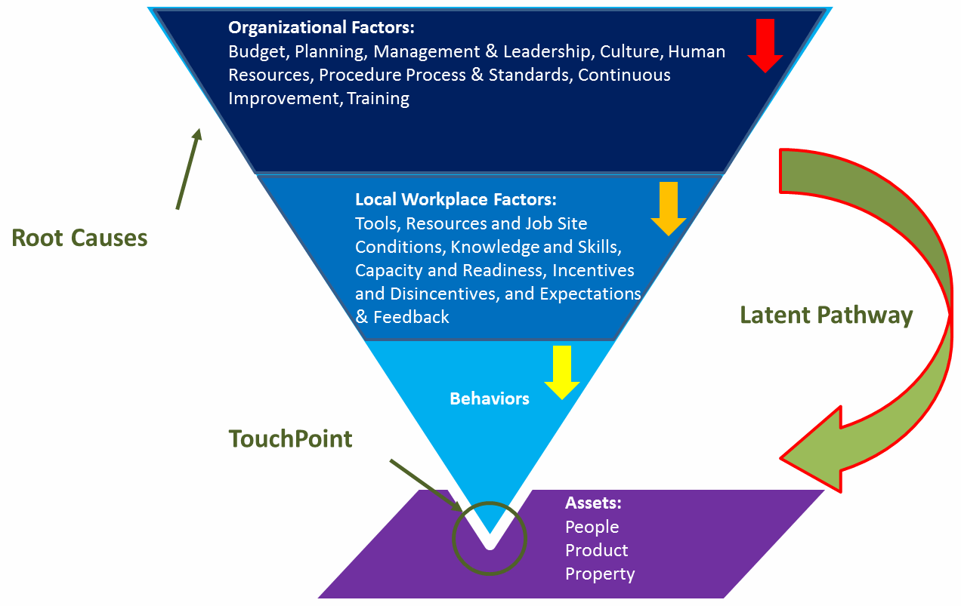
Building the Culture
Quality Culture refers to an organizational culture that intends to enhance quality permanently and is characterized by two distinct elements: on the one hand, a cultural/psychological element of shared values, beliefs, expectations and commitment towards quality and, on the other hand, a structural/managerial element with defined processes that enhance quality and aim at coordinating individual efforts.

Slide 50






Importance of Key Behavior Indicators
Leadership and Vision
Improve and Learn
Foster and Develop
Cultural Enablers
Mindset and Attitudes
Oversight and Reporting
Deliberate Presence
Leading Quality Indicators and Triggers
Monitor and Measure

Slide 51
Values to Results
Experience
Target Belief
Target Action
Target Results
Accountability
Participation in multiple successful quality improvement events (e.g. Kaizen).
Belief that I can and should directly improve quality in my area.
Active identification of quality improvements and acting upon them.
Continuous incremental improvement to processes and performance.
Ownership
Experiences with their leader empowering and supporting them to make decisions within their area.
Belief that I can and should make decisions and own quality in my area.
Decisions are made promptly by those closest and knowledgeable to issue.
Increased ownership, quicker decision making and problem solving.
Action Oriented
Participation in multiple facilitated risk assessment events.
Belief that I can and should identify and communicate risks to management.
Active communication of risks and mitigation actions and decisions.
Improved proactive communication and mitigation of risks as part of daily activity.
Speak up
Direct experiences with their leader encouraging and acknowledging them to speak up.
Belief that I can and should admit mistakes, raise issues, and recommend improvements.
Concerns and issues are raised immediately to supervisor.
Improved prevention and speed in addressing issues and driving improvements.

Slide 52



The ABCs of Behavior
Workplace, Self, Peers, Leader, Organization
Target
Motivators
Antecedents
Behaviors
Consequences
Events that precede behaviors. What people say and do (20%)
Motivate Behaviors (80%)
Enablers
Measure
Skills, Clarity of Purpose, Resources

Slide 53





I
M
P
AC
T
IDENTIFY
MEASURE
PINPOINT
ACTIVATE the CONSEQUENCES
TRANSFER
The desired quality or process improvement goal (the top-level goal)
Establish the existing Measure (KPI) used to conform and report achievement of the goal
Pinpoint the “desired” behaviors necessary to deliver the goal (behaviors that contribute successes and failures)
Activate the Consequences to motivate the delivery of the goal
(4:1 positive to negative actionable consequences)
Transfer the knowledge across the organization to sustain the performance improvement

Slide 54
I
IDENTIFY
Consistent delivery of clinical studies
M
Decrease the number of procedural error protocol deviations
MEASURE
Promote and coach for enhanced attention to detail where “quality is everyone’s job” through leadership and vision, as well as routine Gemba walks
Encourage a speak-up culture where concerns, issues or suggestions are shared in a timely manner in a neutral constructive forum.
P
PINPOINT
Organize team briefings on consequences
Review outcomes of study health
Senior leadership celebrate/acknowledge
Acknowledge and recognize improvements
Motivate the team through team awards
ACTIVATE the CONSEQUENCES
AC
T
Create learning teams
Lessons learned are documented and shared
Lunch-and-learn sessions
Create improvement case studies
TRANSFER

Slide 55
Leading Quality Indicators/
Leading Behavioral Indicators
Leading
Measure and report attendance at the multidisciplinary daily meetings
Number of employee/team improvement suggestions implemented
Number of good catches identified
Number of successful RCA exercises
Trended Lagging
% RFT clinical visits
% RFT Risk Based monitoring

Slide 56

ACTIVITY

Slide 57
Feedback
Elements and Levers
Key Behaviour Indicators
GEMBA Walks
Call to Action
Building Values that Drive Behaviours
Feedback
Building an Action Plan

Slide 58
Virtuous Experiential Learning Cycle
Experiences that expose to the desired behaviors
Helps build the new mindset
2
New Experiences
1
New Mindset and Attitudes
4
New Results
New Actions
3
Which obtains results
Which drives actions

Slide 59
Value of “Quality is Owned by Everyone
Value: Quality is owned by everyone
Desired Behavior: All employees see quality and compliance as their personal responsibility
Target Experience: Participation in a successful quality improvement
Participate in a quality improvement
Belief that I can and should improve quality in my area
Actively identifying quality improvements and acting upon them.
Continual improvement to processes and performance
2
New Experiences
1
New Mindset and Attitudes
4
New Results
New Actions
3

Slide 60

3 Models for Providing Effective Feedback
The
Feedback Sandwich
Situation, Behavior, Impact Feedback Tool
Pendleton’s Model of Feedback
Initiates with the reason behind feedback
Describe the specific behavior observed by manager
Define the impact of employee behavior to the company
Highlights positive behaviors
Discuss required skills to achieve expected results
Discuss what the employee could do something different
Initiates with positive feedback
Introduce negative feedback
Close with specified feedback that builds trust in employees
Components
To minimize the impact of negative feedback
On employee
To provide action-oriented feedback
To discuss strategies for improving employee improvement
Main Objective

Slide 61
Peer Learning Circles
Five or six participants bring current challenges to their peers, seeking to help each other.
Participants use listening, inquiry, and reflection to explore root causes, drivers, theories, and options. The group avoids advice-giving.
  When the group emphasizes asking good questions rather than making statements or offering solutions, thinking expands and deepens.
  The initial challenge often gets reframed and redefined.
Diverse perspectives produce fresh insights, challenge mindsets, and reveal new possibilities for taking action.
Group members hold each other accountable for following through on stated commitments.
Reflection supports development of a learning mindset and mindful leadership.
A remarkable level of trust grows among group members as they share challenges and help each other.

Slide 62
Standard Agenda for Peer Circles
Step | Action
Rules of Engagement | Group members introduce themselves, as needed, and establish ground rules (such as confidentiality).
Presentation | The coachee describes the challenge she would like to solve, ending with a focus question (rather than a statement) that is her challenge.
Silence, reflection, sharing | All group members, including the coachee, write down questions. Questions are open-ended and framed as “I” statements. Participants do not give recommendations or advice or make statements disguised as questions.
Offers, requests, next steps | Group members offer ideas or assistance (called offers) for the coachee’s consideration.
Feedback | The coachee shares how the peer coaching helped her.
Takeaways | Participants silently reflect on and write about the learning they gained from the process, such as insights, awareness, resonance, questions, or any follow-on actions they would like to take. They may choose to share this with the group.

Slide 63
Peer Learning Circles will Help to
Create organizational change and improved outcomes through a focus on best practice.
Inspire a learning organization committed to improved practices, functioning, and outcomes.
Address challenges or practice issues relevant to and actionable by the Learning Circle members.
Connect practice change to the Quality’s mission, values, and practice.
Employ interventions and activities based upon evidenced-based approaches.
Empower circle members to improve practice for more positive organizational climate.
Embody a culturally responsive approach.
Use comprehensive, incremental interventions for long-term sustainability.
Expect full, open, and unbiased participation that encourages communication by all members of the circle.
Empower circle members to engage in collaborative, balanced, and supportive behavior.
Emphasize ongoing evaluation to improve effectiveness and achieve desired outcomes.

Slide 64
The Culture of Quality
The Culture of quality is made of the four core cultural elements.
Transfer
Quality to Poors
Hear Others Talk About Quality
See Others Take Quality* Focused Actions
Feel Quality all Around
Cultural Environment
Hear Quality
Feel Quality
See Quality
Cultural
Carriers
Transfer Quality
Culture of Quality

Slide 65
Storytelling
Goal, Strategy and Process
Stories allow us to clearly articulate goals, strategies and processes and share understanding about why they exist
Engagement
Stories improve communication that creates space for engagement, shared decision making and creativity among co-workers
Proactive
Stories develop a proactive leadership that is not dictated by problems, but is rather driven by vision and goals
Nurture Culture
Create a Culture of Leading by good example

Slide 66
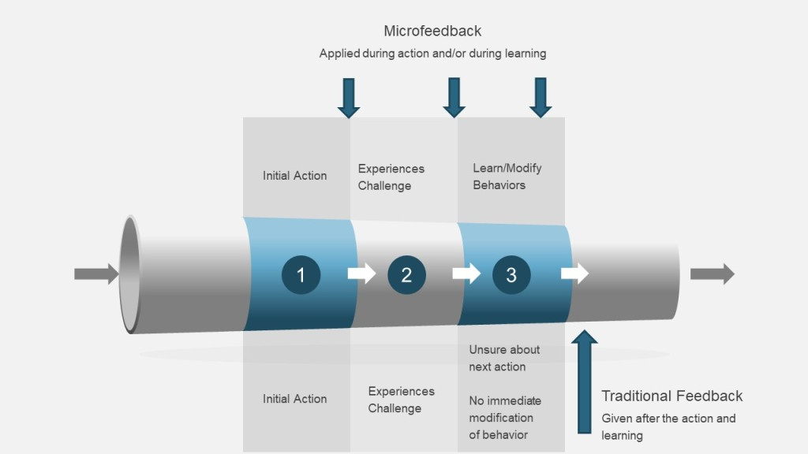
Notes:
Previously I’ve talked about defining the values and behavior associated with quality culture. Once you’ve established these behaviors, a key way to make them happen is through microfeedback, a skill each quality professional, supervisor, and leader in your organization should be trained on.
We are all familiar with the traditional feedback loop: you receive feedback, reflect on it, make a plan, and then take action. This means feedback is given after a series of actions have taken place. Feedback addresses a few key observations for future improvements. In a situation when actions and sequences are quite complicated and interdependent, feedback can fail to provide useful insights to improve performance. Micro-feedback potentially can be leveraged to prevent critical mistakes and mitigate risks, which makes it a great way to build culture and drive performance.
Micro-feedback is a specific and just-in-time dose of information or insights that can reduce gaps between the desired behavioral goals and reality. Think of it as a microscope used to evaluate an individuals comprehension and behavior and prescribe micro-interventions to adjust performance and prevent mistakes.

Slide 67
Where and When Micro-Feedback Happens
Task–based
Micro-feedback
Focuses corrective or suggestive insights on the content of a task. To provide higher impact focus micro-feedback on the correct actions rather than incorrect performance. For example “Report this issue as an incident…”.
Task
Based
Self-regulation-based micro-feedback
Focuses on giving suggestive or directive insights helping individuals to better manage and regulate their own learning. For example, “Pause once you have completed the task and ask yourself a set of questions following the 5W2H formula.”
Process-based micro-feedback
Process
Based
Self-Regulation
Based
Focuses on the learning processes and works best to foster critical thinking in a complex environment. For example, “This issue can be further processed based on the decision tree strategies we talked about earlier.”

Slide 68
ACTIVITY

Slide 69
7 Step Horizontal Flow Diagram
Elements and Levers
Key Behaviour Indicators
GEMBA Walks
Call to Action
Building Values that Drive Behaviours
Feedback
Building an Action Plan
Notes:
Gemba (also written as genba) is a Japanese word meaning “the actual place.” In lean practices, the gemba refers to “the place where value is created,” such as the shop floor in manufacturing.
A popular approach in companies who implement lean principles is called “Gemba walks,” which denote the action of going to see the actual process, understand the work, ask questions, and learning from those who do the work (showing respect to them). It is an opportunity for management and support staff to break away from their day-to-day tasks to walk the floor of their workplace to identify wasteful activities. The objective is to understand the value stream and its problems, rather than review results or make superficial comments from their office or conference room.

Slide 70
Who we interact with – valuing the connection and contributions of all stakeholders.
How we interact – the quality and quantity.
Interactivity
Inclusiveness
Deliberate
Presence
Concern
Why our interactions resonate – embracing a holistic view.
Notes:
Gemba is a principle from the lean methodology that says “go and see” something happening for real – you need to go and see how the process really works. This principle rightly belongs as one of the center points of quality thinking. This may be fighting words but I think it is the strongest of the principles from Lean because of the straightforward “no duh” of the concept. Any quality idea that feels so straightforward and radical at the same time is powerful.
You can think of a gemba through the PDCA lifecycle -You plan, you do it, you decide on the learnings, you follow through.

Slide 71








Leadership Behaviors to Enable a Problem-Solving Culture
What Works Well
What to Avoid
Involve a privileged few in conversations, stick to the “usual suspects”. Avoid having only a group of “experts” solve problems
See the situation (Gemba Walks)
Proactively seek problems and make them visible
Courtesy visits – Gemba Walks are not check the box drop-ins
Challenge the status quo and encourage your team to do so
Avoid the issues and then do firefighting when you have no other option
Be empathetic, listen carefully and focus on facts
Discuss symptoms, focus on the who
Actively seek for answers with the team and ask “why”
Focus on perfect but lengthy and costly solutions
Foster a “we belong” mentality but also encourage rotation in and out
Exclusively focus on efficiency
Hold back successes
Take time to step back from the issue
Coach by appointment or only when something is wrong
Decide fast but back up decisions with facts
Share feedback on an on-gong basis
Consistent priorities with metrics/targets meaningful to your team

Slide 72

This is all about building a shared understanding of problems we all face together by:
Observation of specific issues where things don’t go as intended, listening to the people who do the work.
Discussion of what those issues mean both in the details of operations but also on a wider strategic level.
Commitment to problem solving in order to investigate further – not to fix the issue but to have the time to delve deeper. The assumption is that if people understand better what they do, they perform better at every aspects of their job
Notes:
Gemba walks demonstrate visible commitment from the leadership to all members of the organization. They allow leadership to spread clear messages using open and honest dialogue and get a real indication of the progress of behavioral change at all levels. They empower employees because their contributions to site results are recognized and their ideas for continuous improvements heard.

Slide 73

Define your goal
Identify suitable time
Plan the logistics
Answer the where and when
Plan Effectively
What is it that you want to do a Gemba walk for? What do you hope to find out? What would make this activity a success?
Set a scope
Find right location
Set a theme
Map what you will see
Value Added Location
Observation
Find additional viewpoints
Build an agenda
Get support
Share the agenda
What did you learn?
Explain what you are doing
Review Challenges with a critical eye
Use your agenda
Ask open questions
Take Action
Teaming
Ask closed questions
After the Gemba Walk
Take action on what you learned.
Doing the Gemba Walk
Execute the agenda and keep the eye on the prize
Hold yourself accountable
Capture reality with notes
Coach

Slide 74
Plan Effectively
Define your goal | What is it that you want to do a gemba walk for? What do you hope to find out? What would make this activity a success? A successful walk stresses discovery.
Set a scope | Which areas will you observe? A specific process? Team? This will allow you to zoom into more detail and get the most out of the activity.
Set a theme | What challenges or topics will you focus on? Specific and targeted gemba walks are the most effective. For example, having a emba focusing on Data Integrity, or area clearance or error reduction. Picking the right challenge is critical. Workplaces are complex and confusing, a gemba walk can help find concrete problems and drive improvement linked to strategy.
Find additional viewpoints | Who else can help you? Who could add a “fresh pair of eyes” to see the big questions that are left un-asked. Finding additional people to support will result in a richer output and can get buy in from your stakeholders.
Get support | Bring visibility and sponsorship for your gemba. Ensure all stakeholders are aware and on board.

Slide 75
Plan the Logistics
Identify Suitable Time | Find a suitable time from the process’ perspective. Be sure to also consider times of day, days of the week and any other time-based variations that occur in the process.
Find right location | Where should you see the process? Also, do you need to consider visiting multiple sites or areas?
Map what you’ll see | Define the process steps that you expect to see.
Build an agenda | What parts of the process will you see in what order? Are there any time sensitive processes to observe?
Share that agenda | Sharing your agenda to get help from the operational owner and other subject matter experts.

Slide 76
On the Gemba Walk
Explain what you are doing | Put people at ease when you’re observing the process. When you are on the walk you need to challenge in a productive yet safe manner to create a place where everyone feels they’ve learned something useful and problems can be resolved. It pays to communicate both the purpose and overall approach by explaining the why, the who, and the when.
Use your agenda | Keep some flexibility but also make sure to cover everything.
Ask open questions | Open discussion and explore the process challenges.
Ask closed questions | Use this to check your understanding of the process.
Capture reality with notes | Take notes as soon as possible to make sure you recall the reality of the situation.
Coach | As a coach, your objective is not to obtain results – that’s the person you’re coaching’s role – but to keep them striving to improve. Take a step back and focus on dismantling barriers.
What did you learn | What did you expect to see but didn’t? Also, what did you not expect to happen? Then ask questions, coach, learn aspect can be summarized as: Visualize the ideal performance with your inner eye Spot the specific difficulty the person is having (they’ll tell you – just listen) Explain that (though sometimes they won’t want to hear it) Spell out a simple exercise to practice overcoming the difficulty.

Slide 77
Gemba Walk
What did you learn? | Were challenges widespread or just one offs? Review challenges with a critical eye. The best way I’ve heard this explained is “helicopter” thinking – start on a very detailed operational point and ascend to the big picture and then return to the ground.
Resolve challenges with a critical eye | Define next steps and agree which are highest priority. It is a good outcome when what is observed on the gemba walk leads to a project that can transform the organization.
Take action | Follow-through on the agreed upon actions. Make them visible. To avoid being seen only as a critic you need to contribute firsthand.
Hold yourself to account | Share your recommendations with others. Engage in knowledge management and ensure actions are complete and effective.

Slide 78
GEMBA Walks as Standard Work
Who | Best Practice Frequency | Minimum Recommended Frequency
First line supervisors | Each shift, multiple times | Each shift
Team leaders in individual units | Daily covering different shifts | 2 per week
Unit/Department heads | 1 per day | 1 per week
Leadership team | 1 per day | 1 per month
Internal customers and support (e.g. purchasing, finance, HR) | 1 per month | 1 per quarter

Slide 79
ACTIVITY

Slide 80
Building a Quality Action Plan
Elements and Levers
Key Behaviour Indicators
GEMBA Walks
Call to Action
Building Values that Drive Behaviours
Feedback
Building an Action Plan

Slide 81
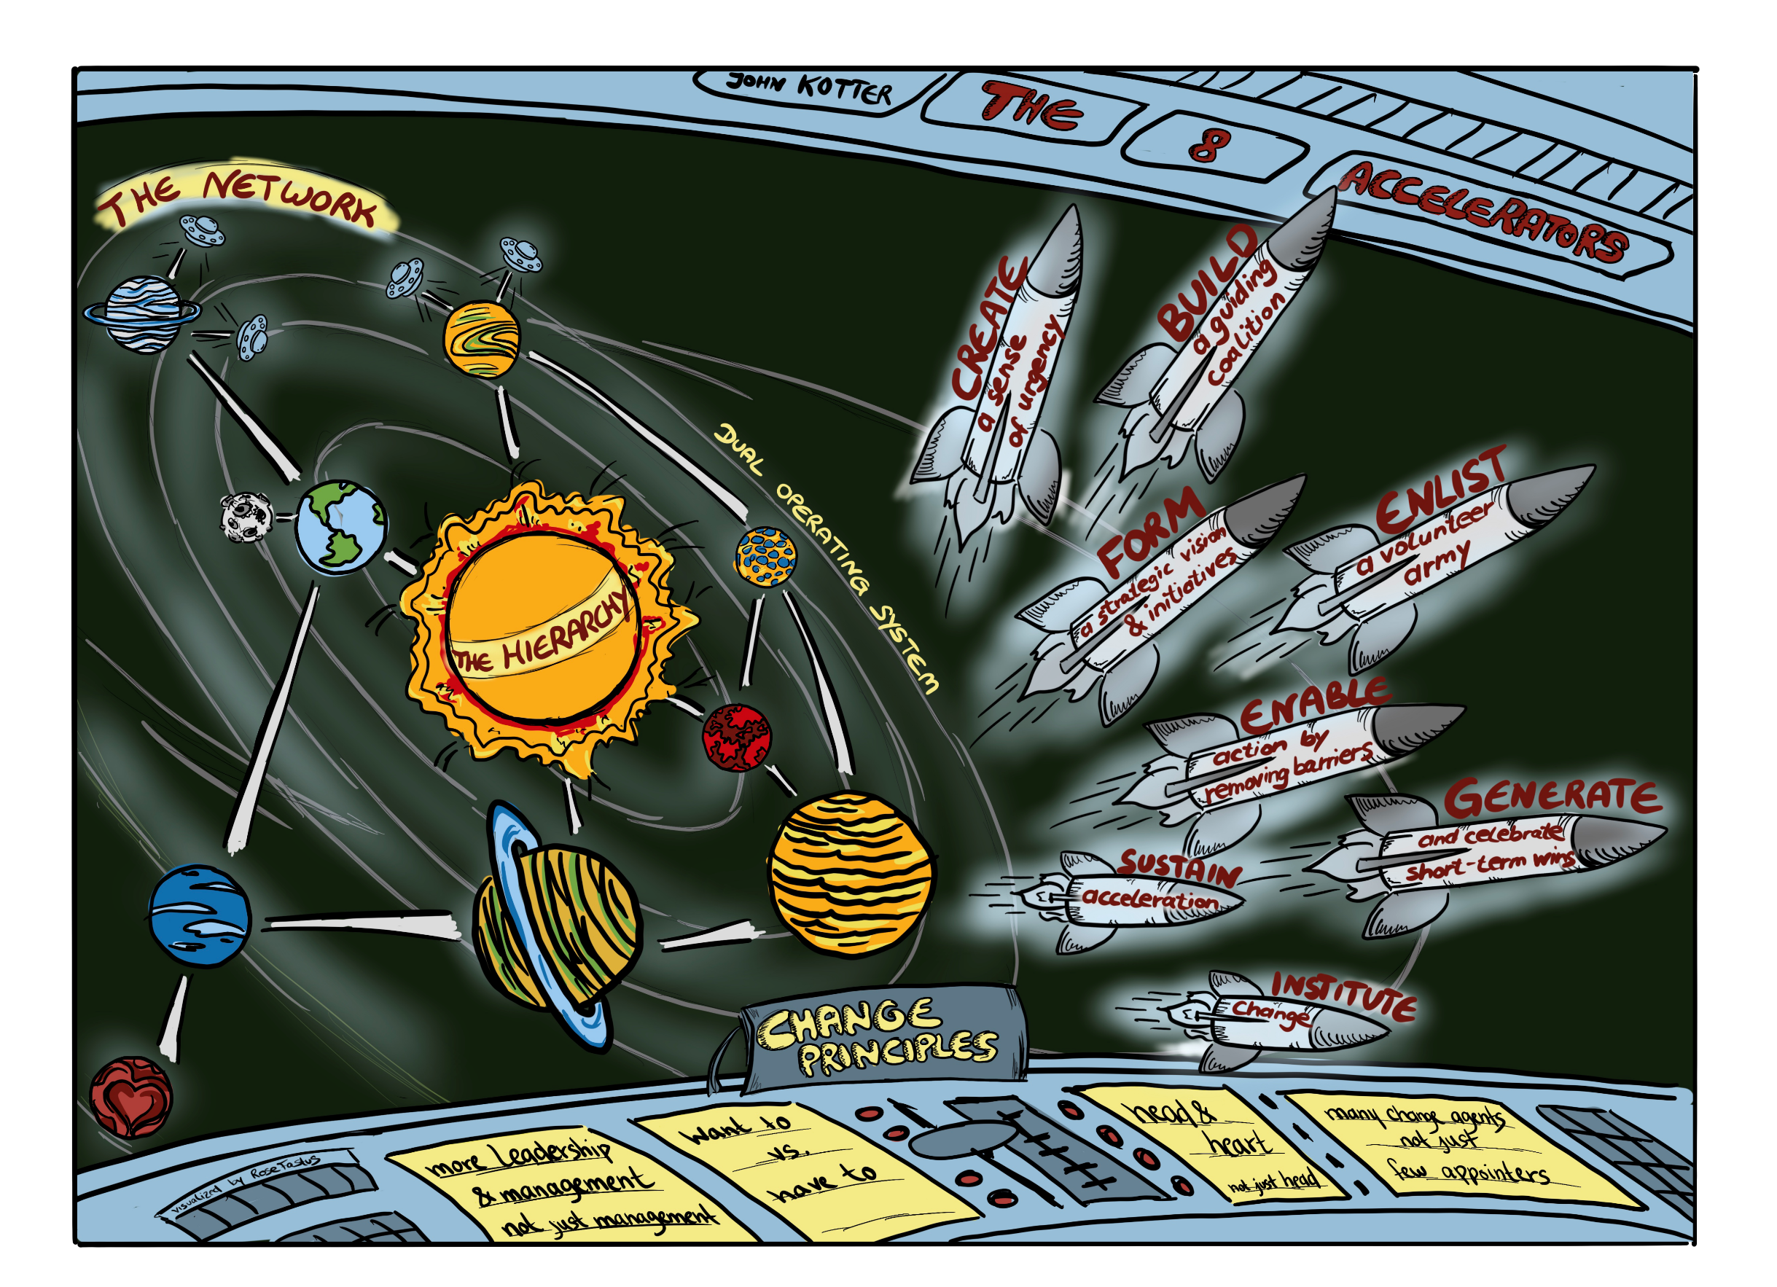

Slide 82
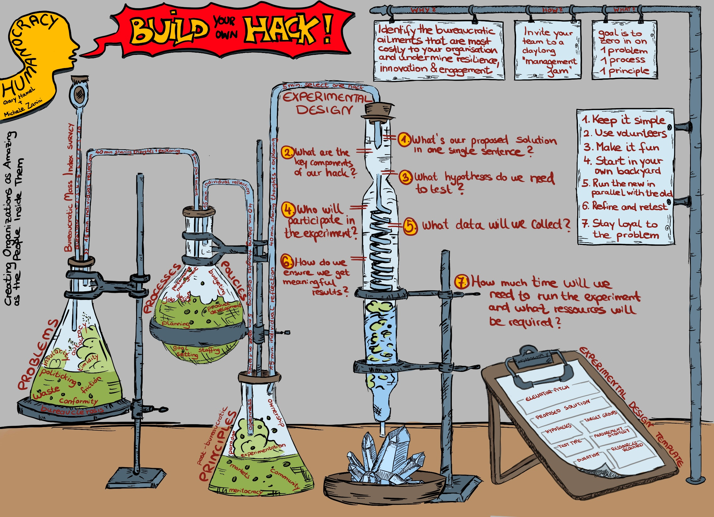

Slide 83
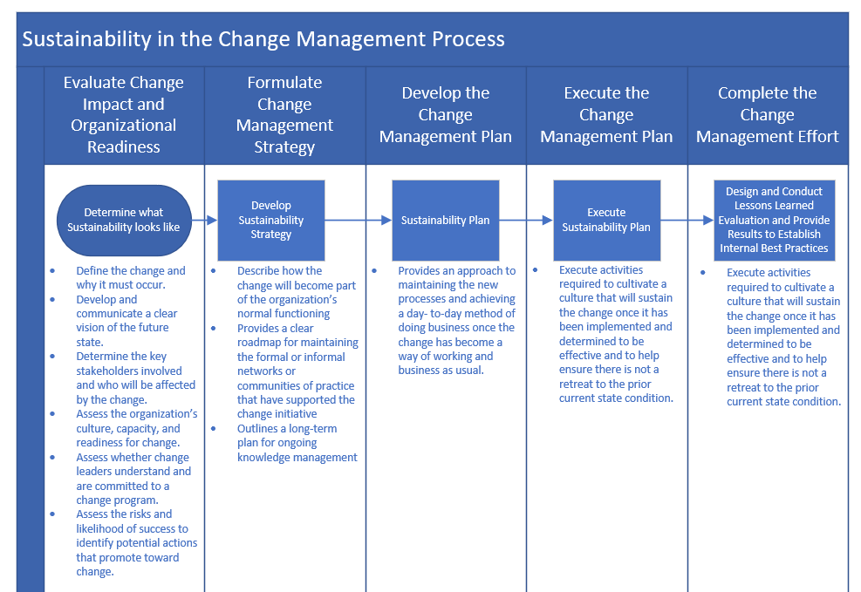

Slide 84
Points of Adoption
Adopt
Are people doing, thinking and acting in a wat that will help the change stick?
Does it look like the change is sticking and benefits will be realized?
What risks of sustainability exist – does accountability exist?
Are the leaders talking and acting in a way that will help the change stick?
How are we going towards our stated change and business outcomes?
What effect is the measurement and reporting having on our ability to openly discuss teething troubles and ideas for improvements?
Transition
Success
Sustain
Change
Embed
Adapt
Accountable
Where is the critical mass? Have we reached our tipping point yet?
Are the activities planned still the right ones?
Who might be likely to unstick it?
Are they having the effect planned?
How might it come unstuck?
Are they having the effect needed? What will get in the way of that effect lasting?
Sticky
Notes:
The success of any change is at its highest risk of failure at the point of adoption. This is because it is new and fragile, full of uncertainties and unknowns, in limbo between the people who built it and the people who will own it – and thus implementing a change can be full of surprises.

Slide 85
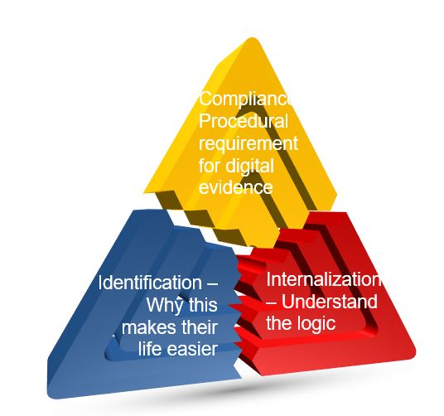
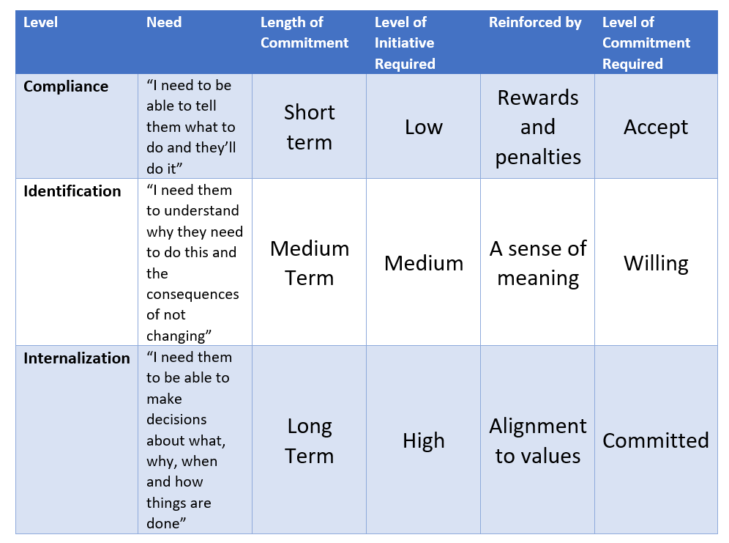
Levels of Adoption

Slide 86
Change Fit
Management
Change
The support, sponsorship and way management gets don
The future state
Motivation
Culture
Engagement and desire to get the change done
The company culture, values and behaviors

Slide 87
How should organizational achievements reinforcing the change be commemorated?
Set Communications Goals and Objectives
Ask the Right Questions.
08
01
03
02
Implement,
evaluate, &
modify plan
Identify Intended Audience
01
02
08
03
07
07
04
04
06
05
Develop & Pre-Test Materials
Develop and Pretest Messages
06
05
Develop Action Plan
Select channels, activities, materials, & partnerships
Notes:
How should organizational achievements reinforcing the change be commemorated?
Communication: Mechanisms for persuasive communication and ongoing socialization of the change, rites of parting (saying goodbye to the old ways of doing things), and rites of enhancement (acknowledgment of quick wins and continued adoption)
Leverage key messages developed during the project to support ongoing communications on any updates made after the change. Show end users the progress that’s been measured and tie it back to the goals they heard so much about before the change. Answer FAQs so end users are aware of any issues or concerns. Most of all, share the successes to gain more credibility and maintain the momentum.
Start by asking the right questions—the answers will provide you with a strong reality check and will include both the hard truths and the intangibles surrounding your change. Let this list provide a point of departure for your collective thinking:
Have you identified the functions you want to sustain?
Are you effectively serving the variety of cultures in your organization?
Are they “champions” yet?
Whom else do you need on board to sustain your initiative?

Slide 88
Organizational Performance | Results and Outcome | Benefit realization Objectives met KPIs Performance Improvement
Did the Initiative deliver what was expected
Individual Performance | Adoption and Usage Behaviors and Results | Understanding Participation Engagement Usage Compliance Profiency
How effectively did impacted individuals adopt and use the change?
Change Management Performance | Effective Change Management | Activity effectiveness Sustainment activities Feedback
How well did we do change management?
What results should be observed and measured on a regular basis?
What metrics should be used for measuring behaviors and results?
What mechanisms should be used for reporting results?
Notes:
What results should be observed and measured on a regular basis?
What metrics should be used for measuring behaviors and results?
What mechanisms should be used for reporting results?

Slide 89
Prepare for Employee Objections
Example Scenario: Disagreement on Project Focus
1
What objections might we face?
A meeting participant dives into a personal issue rather than focusing on the issue at hand.
2
How do we overcome the objection?
Focus on Agreement
Acknowledge comment and connect back to bigger issue and the larger pay-off associated with solving it. .
3
What is our ideal outcome?
All participants agree on the issue to be addressed, and are ready to begin organizing their project plan.
Object Mitigation Techniques (Samples)
Preventions: Use before or during meetings to keep participants focused.
Start-up Agreements: Build agreement on the start on agenda, outcome, roles, decision-making and ground rules.
Focus on Agreement: Avoid counterproductive personalized debate by focusing on points of agreement, not disagreement.
Exercise: Engage in a role-play exercise to practice their objection handling abilities.

Slide 90



Exercise: Actions to Start, Stop, Keep Doing
START DOING
STOP DOING
KEEP DOING
Reinforcing key quality messages with co-workers | Overlooking quality violations | Prioritizing quality in your day to day work
Driving participation in quality improvement projects | Considering quality a checkbox requirement | Helping others
Providing inputs to improve culture of quality | Skipping steps to keep up with production
Challenging directives if that will lead to better quality outcomes

Slide 91
ACTIVITY

Slide 92
Call to Action
Elements and Levers
Key Behaviour Indicators
GEMBA Walks
Call to Action
Building Values that Drive Behaviours
Feedback
Building an Action Plan

Slide 93
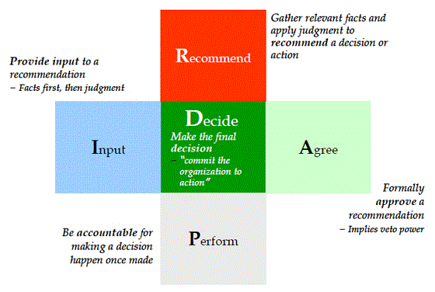
RAPID Framework

Slide 94
Decision Making Levels
Process Decision Making
Existing
Modified
New
As defined in SOP
As defined in SOP utilizing appropriate tools
Consult with Process Owner
Discrete
Scale of Decision
Governance Model
Governance Model
RAPID
Defined
Governance
Consult with Process Owner
RAPID
RAPID
System Level

Slide 95
Quality Ambassadors
Accelerator | Actions
Create a strong sense of urgency around a big opportunity | Demonstrate the organizational value of Ambassadors by performing a needs analysis to assess the current state of employee engagement with quality.
Build and evolve a guiding coalition | Bring together key stakeholders from across the organization who will provide input in the program’s design and support its implementation.
Form a change vision and strategic initiatives | Identify the key objectives for implementing a Quality Ambassador program and outline the lines of effort required to successfully design and pilot it.
Enlist a volunteer army | Reach out and engage informal leaders at all levels of the organization. Find your current informal Ambassadors and draw them in.
Enable action by removing barriers | Be vigilant for factors that impede progress. Work with your Ambassadors and senior leaders to give teams the freedom and support to succeed.
Generate and celebrate short-term wins | Pilot the program. Create success stories by looking at the successful outcomes of teams that have Quality Ambassadors and by listening to team members and their customers for evidence that quality culture is improving. Your goal will be to create an environment where teams that do not have Quality Ambassadors are asking how they can participate.
Sustain acceleration | Scale the impact of your program by implementing it more broadly within the organization.

Slide 96
What activities should Quality Ambassadors focus on? | Example: Reinforce key quality messages with co-workers. Drive participation in quality improvement projects. Provide inputs to improve culture of quality. Provide inputs to improve and maintain data integroty
What will Quality Ambassadors need from their managers? | Example: Approval to participate, must be renewed annually
What will Quality Ambassadors receive from the Quality team? | Example: Training on ways to improve employee engagement with quality. Support for any questions/objections that ariseTraining on data integrity
What are Quality Ambassadors’ unique responsibilities? | Example: Acting as the point of contact for all quality-related queries. Reporting feedback from their teams to the Quality leadership. Conveying to employees the personal impact of quality on their effectiveness. Mitigating employee objections about pursuing quality improvement projects. Tackling obstacles to rolling out quality initiatives
What responsibilities do Quality Ambassadors share with other employees? | Example: Constantly prioritize quality in their day-to-day work
Expected time commitment | Example: 8-10 hours/month, plus 6 hours of training at launch

Slide 97
Assess Quality Culture as Part of the Program
Compliance Demand
Regulations & Standards
Compliance Obligations
Change Management
Legal
Objectives
Program
Governs
Quality Program
03
Change Directives
Validates
System
Manages
Verifies
Process
02
01
Outcomes
04
Audit Function
Pre Audit
Internal Audit
External Audit
Findings
01 - Criteria
02 – Drive Change
03 – Reassess Course
04 Evaluate Organization

Slide 98
What We Covered
Elements and Levers
Key Behaviour Indicators
GEMBA Walks
Call to Action
Building Values that Drive Behaviours
Feedback
Building an Action Plan

Slide 99
Thank You

