Slide 1
ASTM E2500, Validation and Risk Management
Jeremiah Genest, Senior Director Quality Technical and Risk
Just Evotec Biologics

Slide 2
Objectives
Challenges for Validation
Purpose
The ASTM E2500 Approach
Living Risk Assessments
The Validation Master Plan
Building Risk Management into the
Validation Plan
Implementation Strategies

Slide 3



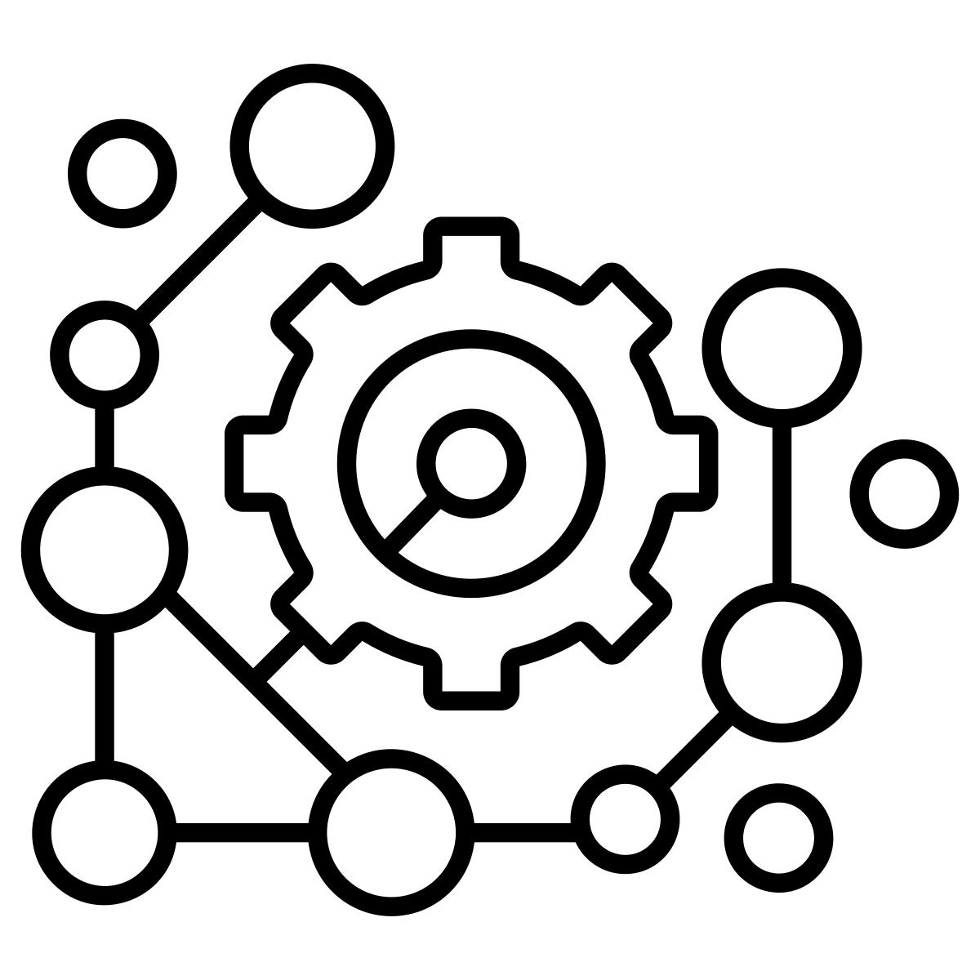

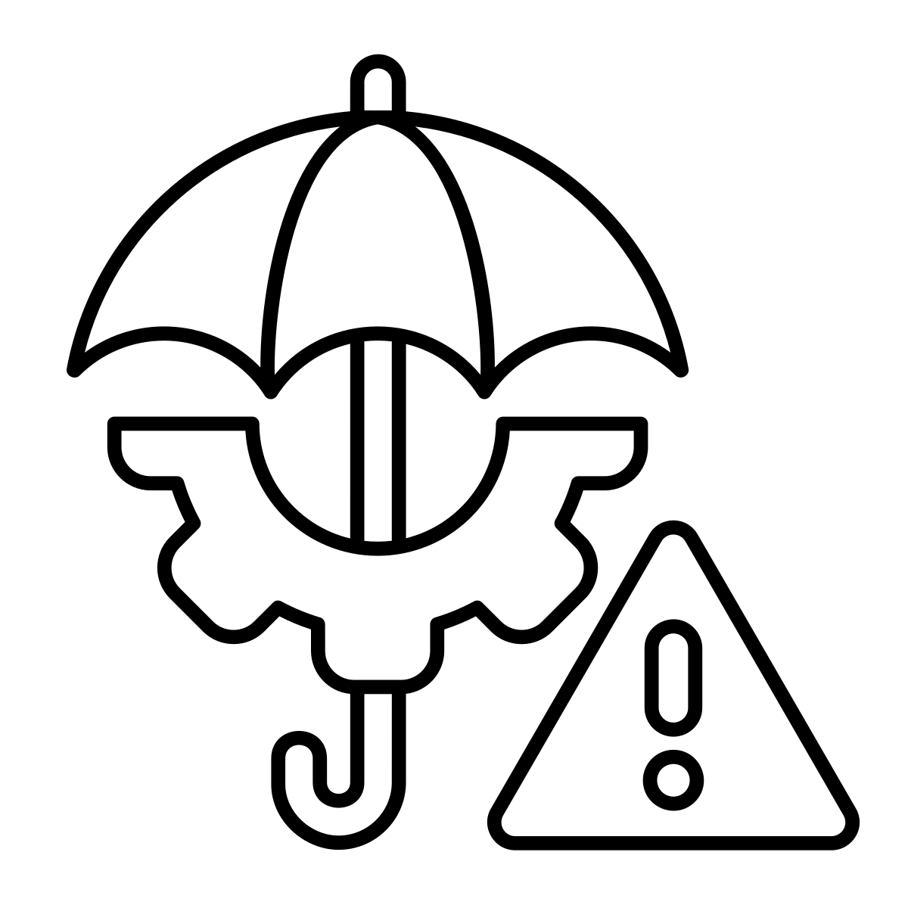

Seven Challenges to Validation
Rapid Technological Advancements
The biotech industry is experiencing rapid advancements in technologies such as AI, machine learning, and automation.
Data Management and Integration
Regulatory Compliance
With the increasing use of digital tools and platforms, managing and integrating vast amounts of data has become a challenge.
The regulatory bodies are continuing to evolve.
Collaboration and Knowledge Sharing
Complexity of New Therapies
Validation processes often require collaboration among various stakeholders, including validation teams, developers, and regulatory bodies.
Ensuring sterility and product quality at each stage of the process is crucial but challenging
Risk Management
Resource Constraints
Adopting a risk-based approach to validation is essential but challenging.
Companies continue to strive to do more with less
Notes:
## Risk-Based Approach
Implementing a risk-based approach is crucial for effective risk management. This involves:
- Identifying and prioritizing critical process parameters and quality attributes
- Focusing validation efforts on areas with the highest impact on product quality and patient safety
- Using risk assessment methodologies to concentrate efforts on high-risk areas
## Quality Risk Management (QRM)
Integrating QRM into processes helps ensure quality and compliance:
- Following ICH Q9 guidelines for a systematic approach to quality risk management
- Applying QRM throughout the product lifecycle, from development to manufacturing
- Using QRM to define validation strategies and scope proactively
## Data Management and Analysis
Effective data handling is essential for risk management:
- Implementing advanced data management and analytics tools
- Ensuring proper collection, analysis, and management of validation data
- Utilizing digital tools and platforms for more efficient data processing
## Documentation and Procedures
Clear documentation is crucial for consistent risk management:
- Developing comprehensive documentation and standardized procedures
- Creating a Validation Master Plan to outline scope, objectives, and responsibilities
- Ensuring clear documentation of risk assessments and mitigation strategies
## Cross-Functional Collaboration
Effective teamwork is key to managing risks:
- Forming cross-functional teams for risk assessment and management
- Encouraging interdepartmental communication and collaboration
- Involving various stakeholders in the risk management process
## Continuous Monitoring and Review
Risk management should be an ongoing process:
- Establishing systems for continuous monitoring of processes post-validation
- Conducting periodic reviews and audits to identify deviations
- Regularly reassessing risks throughout the product lifecycle
## Training and Education
Keeping teams up-to-date is crucial for effective risk management:
- Investing in regular training for staff on current regulations and standards
- Educating teams on risk assessment techniques and quality management principles
## Leveraging Technology
Using technology can enhance risk management efforts:
- Implementing specialized validation software solutions
- Automating processes where possible to reduce human error
- Utilizing digital tools for risk assessment and management
By implementing these strategies, biotech and pharmaceutical companies can more effectively manage risks in their validation processes, and overall operations, leading to improved compliance, quality, and efficiency.

Slide 4

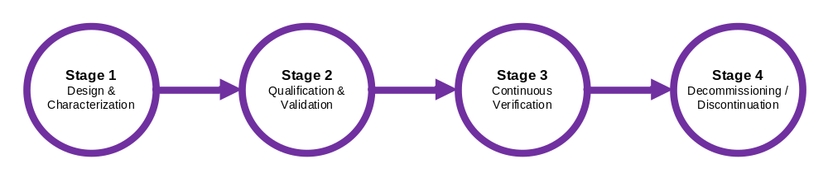
FDA Guidance
Process Validation: General Principles and Practices (fda.gov)
Establishing the Quality Target Product Profile (QTPP), Critical Quality Attributes (CQA), Critical Process Parameters (CPP), and Critical Material Attributes (CMA)
Performing quality risk management
Defining the manufacturing process
Conducting process characterization studies
Appropriate design of the manufacturing facility
Proper selection and qualification of utility systems and equipment
Execution of PPQ protocols to demonstrate process robustness
Monitoring and collecting data on process performance
Statistical analysis of process data
Continuous improvement efforts to maintain or enhance process control and reduce variability
Not actually in the guidance
This stage involves the systematic removal of equipment or facilities from active status, which may precede storage, repurposing, or demolition/disposal. The process should be managed to ensure business continuity and GxP compliance up to, during, and post-closure.

Slide 5

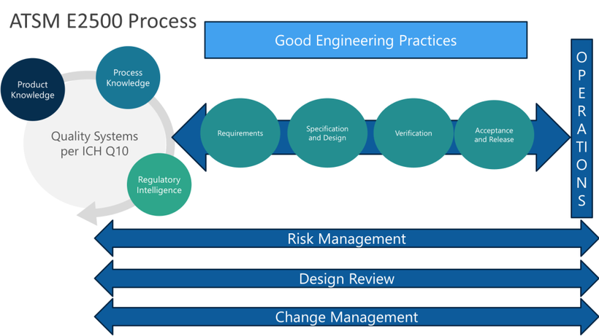
ASTM E2500 : APPROACH TO VALIDATION
By Jeremiah Genest
CROSS-FUNCTIONAL PROCESSES
INTRODUCTION
ASTM E2500 is a standard guide designed for the specification, design, and verification of pharmaceutical and biopharmaceutical manufacturing systems and equipment. Its primary goal is to ensure that these systems meet international regulatory expectations and are fit for their intended use. By focusing on a risk- and science-based methodology, ASTM E2500 aims to enhance product quality and patient safety.
ASTM E2500 emphasizes several cross-functional processes to ensure comprehensive validation.
  Good Engineering Practices (GEP) are integrated throughout the entire project to adhere to industry standards.
  Quality Risk Management involves ongoing assessment and management of risks to product quality and patient safety.
  Design Review is a continuous process ensuring that the system design meets requirements and addresses identified risks. Lastly,
  Change Management is implemented as a structured process for evaluating and documenting system changes to avoid test duplication and ensure proper documentation.
KEY PRINCIPLES
The ASTM E2500 approach integrates several critical principles.
  Risk Management by incorporating guidelines from ICH Q8, Q9, and Q10 to identify and mitigate risks to product quality and patient safety throughout the lifecycle of the manufacturing system.
  Good Engineering Practices (GEP), ensuring that systems are correctly designed, installed, and operated.
  Flexibility and Efficiency by tailoring verification activities to each project's specific context, allowing for a more adaptable and efficient process.
COMPARISON: ASTM E2500 VS. TRADITIONAL APPROACHES
Compared to traditional validation methods, ASTM E2500 offers a more flexible and risk-based approach. Traditional methods follow a prescriptive sequence of tests, such as FAT, SAT, IQ, OQ, and PQ, which can be rigid and less adaptable to specific project needs. In contrast, ASTM E2500 encompasses a broader definition of Verification that integrates all testing activities, allowing for a more rational and tailored approach. The role of Subject Matter Experts (SMEs) is also more continuous and integral in ASTM E2500, compared to traditional approaches where SMEs are involved primarily during specific phases. Additionally, ASTM E2500's focus on Documentation is centered on risk management and flexibility, contrasting with the more extensive and prescriptive documentation required in traditional methods.
FOUR MAIN STEPS
APPLICATIONS & BENEFITS
STEP #1
  Applicability: The ASTM E2500 approach can be applied to new and existing manufacturing systems, including laboratory, information, and medical device manufacturing systems.
  Lifecycle Coverage: It applies throughout the manufacturing system’s lifecycle, from concept to retirement.
  Regulatory Compliance: The approach is designed to conform with FDA, EU, and other international regulations, ensuring that systems are qualified and meet all regulatory expectations.
  Efficiency and Cost Management: By focusing on critical aspects and leveraging risk management tools, the ASTM E2500 approach can streamline project execution, reduce time to market, and optimize resource utilization.
The ASTM E2500 approach provides a structured, risk-based framework for specifying, designing, and verifying pharmaceutical and biopharmaceutical manufacturing systems. It emphasizes flexibility, efficiency, and regulatory compliance, making it a valuable tool for ensuring product quality and patient safety.
Requirements: where Subject Matter Experts (SMEs) define system needs and critical aspects and develop a verification strategy.
STEP #2
Specification & Design: which involves creating detailed specifications and designing the system to meet the established requirements, complemented by rigorous design reviews and risk assessments.
STEP #3
CHALLENGES & FUTURE CONSIDERATIONS
CONCLUSION
Verification: involves confirming that the system meets all specified requirements through a streamlined process that replaces traditional FAT/SAT/IQ/OQ/PQ sequences.
Despite its advantages, the ASTM E2500 approach faces challenges in implementation, often feeling aspirational due to varying levels of alignment across organizations. Future updates, such as those anticipated for Annex 15 and the ISPE Baseline® Guide Volume 5, are expected to address some of these difficulties and improve alignment with European regulations. The ongoing evolution of related guidelines and standards, including GAMP5 and USP <1058>, will continue to shape the validation landscape.
The ASTM E2500 approach offers a structured, risk-based framework for the specification, design, and verification of pharmaceutical and biopharmaceutical manufacturing systems. While it provides flexibility and efficiency, achieving the right balance among various standards and regulations remains a challenge. Continuous improvement in validation practices increased SME involvement, and effective change management will be crucial for advancing the approach and meeting future regulatory and industry demands.
STEP #4
Acceptance & Release: involves finalizing verification, reviewing all activities and documentation, and releasing the system for operational use.
Notes:
ASTM E2500 was first published in June 2007. Since then, it has undergone several revisions:
1. First publication: June 2007
2. Reapproved: 2012 (without significant changes)
3. Revised: 2013 (ASTM E2500-13)
4. Current version: ASTM E2500-20 (released in 2020)
The standard is currently undergoing another revision process, as indicated by the work item WK88043. This revision aims to update E2500-20 to include:
- Best industry standards
- Most recent regulatory guidance
- Current updates to ICH Q9R1
- EMA Annex 1 and 15
- Best practices from PDA TR 54-5 on Quality Risk Management
The upcoming revision is described as a "major overhaul" of E2500, seeking wide consensus from industry experts. This continuous revision process demonstrates the standard's evolution to keep pace with industry developments and regulatory changes in pharmaceutical and biopharmaceutical manufacturing.

Slide 6
ATSM E2500 Process
OPERATIONS
Good Engineering Practices
Process Knowledge
Product Knowledge
Quality Systems per ICH Q10
Requirements
Specification and Design
Verification
Acceptance and Release
Regulatory Intelligence
Risk Management
Design Review
Change Management

Slide 7
What does ASTM E2500 mean by Critical Aspects
Quality Target Product Profile (QTPP)
Prospective summary of desired quality characteristics
Forms the basis for product design and development
Includes intended use, route of administration, dosage form, etc.
Critical Quality Attributes (CQAs)
Derived from QTPP
Physical, chemical, biological, or microbiological properties
Must be within appropriate limits to ensure product quality
Critical Process Parameters (CPPs)
Process inputs that significantly impact CQAs
Identified through risk assessment and experimentation
Variability must be monitored and controlled
QTPP informs selection of CQAs
CQAs guide identification of CPPs
CPPs are adjusted to ensure CQAs remain within acceptable range
Control space represents area where CPPs can be varied while maintaining CQAs
Notes:
According to ASTM E2500, Critical Aspects are the key features, functions, and characteristics that manufacturing systems and equipment must possess to adequately control process risks and protect patient safety
## Determination of Critical Aspects
Critical Aspects are determined through a risk-based and science-based approach:
**Risk Assessment**: A product-focused risk analysis is conducted early in the process to identify critical parameters related to product quality and patient safety. This includes Critical Quality Attributes (CQAs) and Critical Process Parameters (CPPs)
**Scientific Knowledge**: The evaluation of quality risks should be based on scientific understanding of the product and process
**Subject Matter Expert Input**: SMEs play a crucial role in identifying critical aspects from the start of a project. They contribute their expertise in defining needs and reviewing system designs
**Product and Process Information**: Examples of information considered include:
- Critical Quality Attributes (CQAs)
- Critical Process Parameters (CPPs)
- Process control strategy information
- Prior production experience
## Key Characteristics of Critical Aspects
Critical Aspects typically include:
- Functions, features, and abilities necessary for the manufacturing process
- Performance characteristics essential for ensuring consistent product quality
- Aspects directly linked to patient safety
## Importance in Verification Process
The identification of Critical Aspects guides the verification strategy:
- It allows for a more focused and efficient verification process
- Verification activities can be tailored to address the most critical elements of the system
- It supports the "right test, right time" principle, optimizing resource allocation
By concentrating on Critical Aspects, ASTM E2500 aims to streamline the qualification process while maintaining a strong focus on product quality and patient safety. This approach aligns with modern regulatory expectations and supports a more flexible, risk-based validation paradigm.

Slide 8
Risk Management is a Living Process
Continuous throughout system/process lifecycle
Implementation of new product/system/process
Systematic (all-encompassing scope)
Entire existing product/process/system
High risk situations
Reviewed annually
Assessed using Formal or Intermediate tools
E.g. Facility and Process, Utilities, software, risk strategy to support, microbial and viral control
Assessment
Intermediate
Point in time
Created to fulfill a specific purpose
Changes to existing system
Narrow scope
Well understood process/system
Assessed using Less Formal, Intermediate, and Formal tools
E.g. Deviations, Change Controls, CAPAs
LIVING
Assessment
AD HOC
Less Formal Tools
Formal Tools

Slide 9
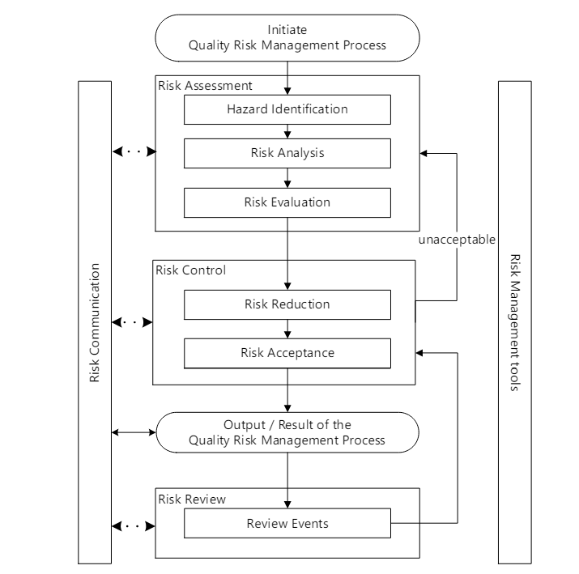
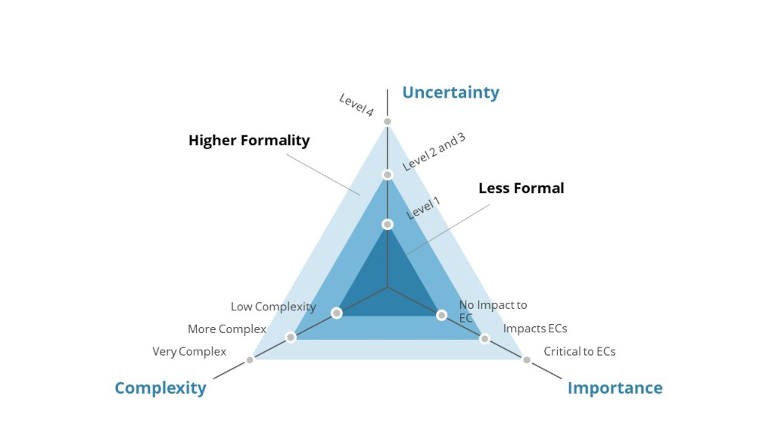
ICH Q9(R1) Risk Management
Understanding Formality

Slide 10
Factors Impacting Formality
Uncertainty
Importance
High
Low
Complexity
High
Low
High
Low
Cross- functional Team
Cross-functional team of SMEs assembled
Team assembled of several experts
Fewer SMEs are involved
QRM Tools Used
Quality Risk Management tools are used.
The use of tools may be limited
Quality Risk Management tools may not be needed
QRM Process
All steps of the QRM process are explicitly performed.
Some QRM steps are explicitly performed.
QRM is performed as part of routine activities within the PQS.
Potential Need for Facilitation
Use of experienced facilitator is integral
Facilitation may be beneficial
A facilitator may not be needed
.
High
Applied formality
Low

Slide 11
Key Terms & Concepts
There can sometimes be confusion between concepts/terms related to QRM and its tools, and because certain terms are tool-specific, they need to be used in the appropriate context
‘Hazard’ is a concept from ICH Q9(R1), while “Failure Mode” is a tool-specific term often used during QRM activities.
The QRM process in ICH Q9(R1) refers to Hazard Identification as the first step of the Risk Assessment process.
Hazards and failure modes are different from each other:
  A hazard is a potential source of harm to the patient.
  A failure mode is the specific way a failure occurs.
  Like hazards, failure modes can lead to patient harm if the associated failures occur that impact product quality.
While some risk assessment tools refer to hazards (e.g., HACCP - Hazard Analysis and Critical Control Points, HAZOP - Hazard Operability Analysis, PHA - Preliminary Hazard Assessment), others do not – other tools refer to failure modes (e.g., FMEA - Failure Mode and Effect Analysis, FMECA - Failure Mode, Effects and Criticality Analysis), while some other tools refer to faults (e.g., FTA - Fault tree analysis).
In this way, the ICH Q9(R1) concept of a “hazard” and the tool-specific term “failure mode” are inter-connected.
ICH Q9(R1) Concepts
Tool-specific Terminologies
Hazard
Hazardous Situation
Potential source of harm
(to patient health, product quality or product availability)
PHA terminology: event or circumstance causing exposure to the hazard
Harm
Failure Mode
Damage to health, including damage from a loss of product quality or availability
FMEA terminology: the ways or modes in which a product, process or system might fail
Risk
Fault
Probability of occurrence of harm and severity of harm
(R = P x S)
FTA terminology: the ways or modes in which a product, process or system might fail

Slide 12
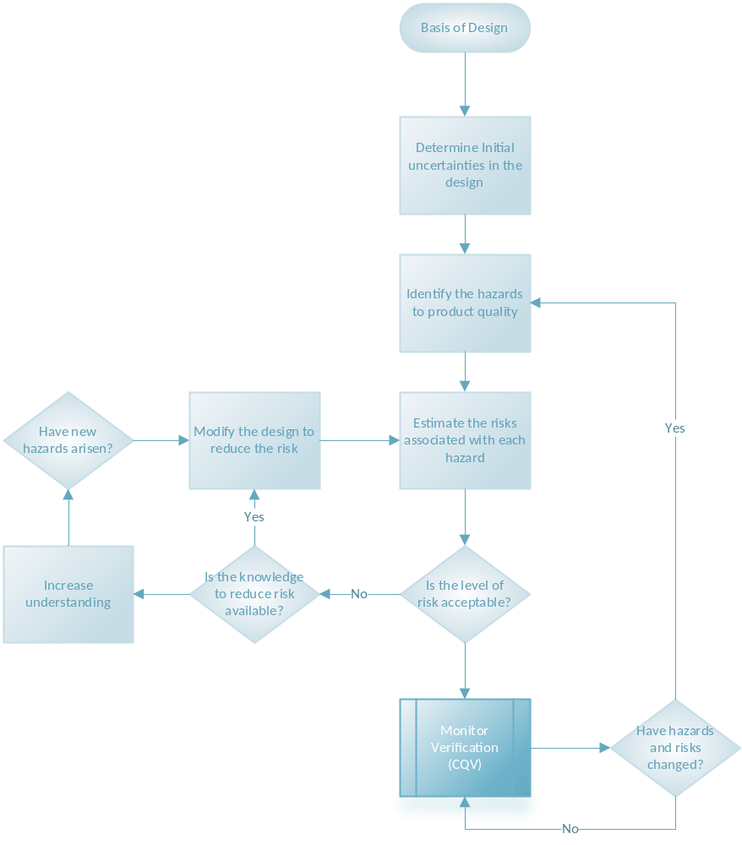
Facility design and manufacturing processes are complex, multi-stage operations.
Three primary components of risk assessment:
An understanding of the uncertainties in the design (which includes materials, processing, equipment, personnel, environment, detection systems, feedback control)
An identification of the hazards and failure mechanisms
An estimation of the risks associated with each hazard and failure
Notes:
Facility design and manufacturing processes are indeed complex, multi-stage operations that require careful risk assessment and management. Expanding on this concept using the ICH Q9(R1) and ASTM E2500 approaches, we can develop a comprehensive framework for risk management in pharmaceutical and biopharmaceutical facilities.
## Risk Management Framework
### Understanding Uncertainties
The first step in risk assessment is to thoroughly understand the uncertainties inherent in the design and manufacturing process:
**Materials**:
- Variability in raw material quality
- Potential for contamination
- Stability concerns
**Processing**:
- Equipment performance variability
- Process parameter fluctuations
- Scale-up challenges
**Equipment**:
- Reliability and maintenance issues
- Calibration and qualification requirements
- Compatibility with different products
**Personnel**:
- Training and competency levels
- Human error potential
- Adherence to procedures
**Environment**:
- Temperature and humidity control
- Cleanroom classification maintenance
- Utility systems reliability
**Detection Systems**:
- Sensitivity and specificity of analytical methods
- Instrument calibration and maintenance
- Sampling strategies
**Feedback Control**:
- Process analytical technology (PAT) implementation
- Real-time release testing capabilities
- Control strategy effectiveness
### Hazard Identification
Following the ICH Q9(R1) guidance, hazard identification should be a systematic process that considers all potential sources of harm[1]:
- Contamination (microbial, chemical, particulate)
- Cross-contamination between products
- Mix-ups and labeling errors
- Equipment failures
- Utility system failures (e.g., HVAC, water, compressed gases)
- Deviations from established procedures
- Cybersecurity threats
### Risk Estimation
Risk estimation involves assessing the likelihood and severity of each identified hazard[1]. This can be done using various tools such as:
- Failure Mode and Effects Analysis (FMEA)
- Fault Tree Analysis (FTA)
- Hazard Analysis and Critical Control Points (HACCP)
## ASTM E2500 Integration
The ASTM E2500 standard provides a science and risk-based approach to commissioning and qualifying regulated manufacturing systems[2]. Key aspects include:
**Critical Thinking**:
- Encourage a holistic view of the facility and processes
- Focus on critical aspects that directly impact product quality and patient safety
**Subject Matter Expert (SME) Involvement**:
- Leverage expertise across disciplines (engineering, quality, manufacturing, regulatory)
- Promote cross-functional collaboration in risk assessments
**Good Engineering Practice**:
- Apply industry standards and best practices in facility and equipment design
- Implement robust change management procedures
**Verification**:
- Develop a verification strategy based on identified risks
- Focus on critical aspects rather than exhaustive testing of all parameters
## Risk Control and Communication
Based on the risk assessment, implement appropriate control measures:
**Design Controls**:
- Implement inherently safe designs (e.g., closed systems, single-use technologies)
- Incorporate redundancy in critical systems
**Procedural Controls**:
- Develop and implement Standard Operating Procedures (SOPs)
- Establish training programs for personnel
**Technical Controls**:
- Implement in-process controls and real-time monitoring
- Utilize automation to reduce human error potential
**Organizational Controls**:
- Establish clear roles and responsibilities
- Implement a quality management system
## Continuous Improvement
Risk management is an ongoing process. Regularly review and update risk assessments based on:
- New data from manufacturing experience
- Technological advancements
- Changes in regulatory requirements
- Feedback from quality systems (e.g., deviations, complaints, audits)
By integrating the ICH Q9(R1) and ASTM E2500 approaches, organizations can develop a robust risk management strategy that enhances product quality, patient safety, and regulatory compliance while optimizing facility design and manufacturing processes.

Slide 13
Risk Management Tools
 | Bow-Tie | PHA (Preliminary Hazard Analysis) | FMEA (Failure Mode and Effects Analysis) | HACCP (Hazard Analysis and Critical Control Points)
Primary Focus | Visualizing risk pathways | Early hazard identification | Potential failure modes | Systematically identify, evaluate, and control hazards that could compromise product safety
Timing in Process | Any stage | Early development | Any stage, often design | Throughout production
Approach | Combines causes and consequences | Top-down | Bottom-up | Systematic prevention
Complexity | Moderate | Low to moderate | High | Moderate
Visual Representation | Central event with causes and consequences | Tabular format | Tabular format | Flow diagram with CCPs
Risk Quantification | Can include, not required | Basic risk estimation | Risk Priority Number (RPN) | Not typically quantified
Regulatory Alignment | Less common in pharma | Aligns with ISO 14971 | Widely accepted in pharma | Annex 1
Critical Points | Identifies barriers | Identifies Hazards | Identifies critical failure modes | Identifies Critical Control Points (CCPs)
Scope | Specific hazardous event | System-level hazards | Component or process-level failures | Process-specific hazards
Team Requirements | Cross-functional | Less detailed knowledge needed | Detailed system knowledge | Food safety expertise
Ongoing Management | Can be used for monitoring | Often updated periodically | Regularly updated | Continuous monitoring of CCPs
Output | Visual risk scenario | List of hazards and initial risk levels | Prioritized list of failure modes | HACCP plan with CCPs
Typical Use in Pharma | Risk communication | Early risk identification | Detailed risk analysis | Product Safety/Contamination Control

Slide 14
Risk Assessment: Building Scope and SMEs
Verification (CQV) methodology
Drug(s), Intermediates and excipients
Asset Lifecycle
Design and function of the drug product
HR Practices, including recruitment and training
Scientific/technical issues of process design
Design and function of process equipment
Laboratory capabilities and practices
Design and function of process controls
Quality Management System
Operating practices
Design and function of the facility

Slide 15
Map of the process flow (chemical/ physical/ biological)
Quality Management System
Thermodynamics, physical/chemical/biological behavior of critical process stages
HR Practices
Physical/chemical/biological risks of potentially harmful product (main, by-, waste)
Supplier Management
Purchasing policies and procedures
Inputs to
the Risk
Assessment
Physical/chemical/biological variability of all raw and process material
Data handling
IT infrastructure
Intended equipment (measuring, processing moving, containment, etc)
Process flow as an equipment map
Facility design, including environmental controls
Intended Utilities

Slide 16
BOWTIE ANALYSIS
Communicating and Aligning
PREVENTION
RECOVERY
Threat
Consequence
Hazardous Event
Threat
Consequence
Threat
Loss of Control
Consequence
Control Measures
Recovery Measures
Potential Causes
Potential Outcome

Slide 17
Preliminary Hazard Analysis
C
D
B
F
A
G
Hazardous Situations
Impact
Sequence of Events
Severity and Occurrence of the Impact
Identify Hazards
Risk Control Measures
Evaluate the Hazards
Current
Design
Improvements in Design
What are the hazards in the design
Provisions, Alternatives, and mitigation measures to reduce associated risk

Slide 18
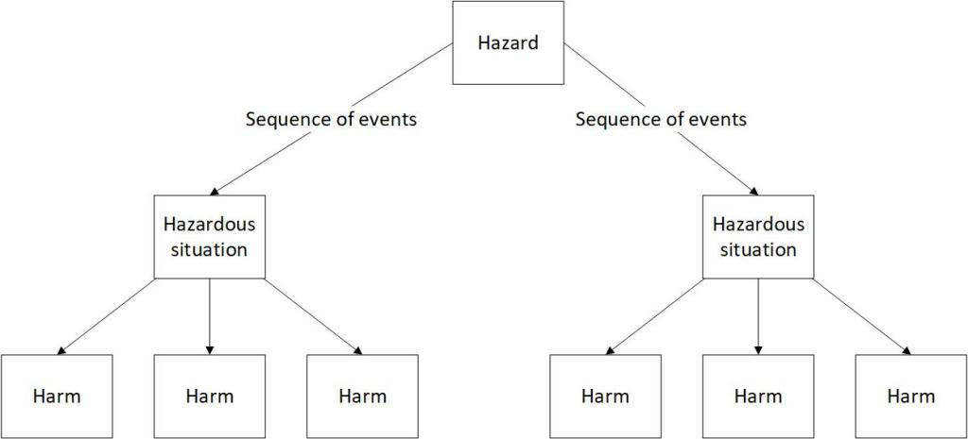
From Hazard to Harms

Slide 19
Performing the Hazard Level
Several Risk Assessments for a product include failure modes that lead to the same product impact (here: biological contamination of the product). In this example, the separate hazard analysis allows for consistent risk ratings across multiple FMEAs and aligned risk prioritization across the drug product and/or platform
Hazard Analysis
Critical Quality Attribute | Hazard | Sequence of Events | Hazardous Situation | Harm | Severity
Sterility | Biological contamination of the product | Drug product is contaminated during manufacture and user injects into blood stream | Exposure to bacteria or fungi | Severe illness or death | Catastrophic
FMEA relating to manufacturing
Requirement | Failure Mode | Potential Failure Effect | Potential Product impact | Severity | Potential Cause | Prevention Control | Detection Control | Occurrence | Detection | Risk
Correct stopper position in filled syringe | Stopper not positioned correctly | Container closure integrity impaired | Biological contamination of the product | Catastrophic | Servo motor lost position | 100% automatic equipment homing | Automatic visual inspection | Remote | High | Low
FMEA relating to distribution
Correct stopper position in filled syringe | Stopper movement | Container closure integrity impaired | Biological contamination of the product | Catastrophic | Shaking and vibration during air transport | Protective shipping containers | Automatic visual inspection at receipt | Remote | High | Low

Slide 20






PHA Before Facility Design Review
Assemble Team
Define the Scope
Identify Potential Hazards
Categorize Hazards
Prioritize Hazards
Document
Severity and Occurrence
Findings Inform Design
Internal and External
Focus on potential Hazards
Consdier interactions
Hazards to Harms
Multidisciplinary
Product Quality
Evaluate Design
Severity
Risk Matrix
Inform
Process engineers
Operations personnel
Safety specialists
Quality assurance representatives
Maintenance personnel
Instrumentation/controls experts
ASTME2500 SME
The scope should be clearly defined early in the project lifecycle, typically during the Front-End Loading (FEL) stages. A conceptual or preliminary PHA is usually conducted during FEL-2 (Concept phase or Feasibility Study phase).
Categorize identified hazards based on their potential impact on:
Product quality
Patient safety
Regulatory compliance
Operational efficiency
Identify potential hazards using techniques such as:
Brainstorming sessions
Review of historical data
Examination of similar facilities or processes
Risk Ranking Matrix
Clear risk levels
Evaluate current designed controls
Document rationale
Use a structured format
Be Specific and detailed
Include supporting data
Document assumptions
Cross reference design elements
Ensure traceability.

Slide 21
Transition to FMEA Before Verification
PHA as Input
Process Flow
Identify Failure Modes
Calculate Risk
Prioritize Hazards
Document
Findings Inform Verification
PHA results as input for the FMEA
Facility and its Systems
Design for testability
Structured approach
Hazards to Harms
Critical Aspects
Understanding
FMEA
Prioritize
Mitigations
Living
Map PHA hazards to FMEA failure modes:
.
Use PHA causes as FMEA failure causes: The causes identified in the PHA can often be directly translated into potential causes of failure in the FMEA.
Ensure logical flow
Include all major equipment and connections
Incorporate control systems and instrumentation
Show inputs and outputs
For each process step or system component:
Identify potential failure modes
Determine potential effects of each failure
Assess severity, occurrence, and detectability
Prioritize failure modes based on RPN scores and critical impact on product quality and patient safety.
Consider the entire lifecycle
Align to QbD principles
Robust change management
Ensure traceability
Iterative updates
Integration with verification activities
Real-time risk evaluation
Dynamic mitigation strategies
Notes:
Here are some best practices for developing risk mitigation strategies for use in verification under ASTM E2500:Focus on critical aspects: Prioritize mitigation strategies for failure modes that pose the highest risk to product quality and patient safety, as identified in the risk assessment.
Use a multi-layered approach: Implement multiple layers of control, including design features, automation, procedural controls, and training, to address critical risks.
Leverage Good Engineering Practices (GEP): Incorporate industry-standard engineering practices and controls as a foundation for risk mitigation.
Design for testability: Ensure that mitigation strategies can be effectively verified through testing or other means of demonstration.
Consider the entire lifecycle: Develop strategies that address risks throughout the system's lifecycle, from design to decommissioning.
Align with Quality by Design (QbD) principles: Integrate risk mitigation into the design process to build quality into the system from the start.
Utilize automation and process analytical technology (PAT): Where appropriate, implement automated controls and real-time monitoring to reduce human error and enhance process control.
Implement a robust change management process: Ensure that any changes to the system are evaluated for their impact on risk and mitigation strategies.
Develop clear acceptance criteria: Establish specific, measurable criteria for verifying the effectiveness of risk mitigation strategies.
Leverage supplier expertise: Collaborate with equipment suppliers to implement risk mitigation strategies that leverage their specialized knowledge.
Document rationale: Clearly document the reasoning behind each mitigation strategy to facilitate future reviews and updates.
Ensure traceability: Maintain clear links between identified risks, mitigation strategies, and verification activities.
Apply a risk-based approach to verification: Tailor the extent and rigor of verification activities to the level of risk associated with each aspect of the system.
Incorporate lessons learned: Use knowledge gained from previous projects and industry experiences to inform and improve risk mitigation strategies.
Conduct periodic reviews: Regularly assess the effectiveness of implemented mitigation strategies and update them as needed based on new information or changing conditions.
By following these practices, you can develop robust risk mitigation strategies that align with ASTM E2500 principles and effectively address critical risks in pharmaceutical and biopharmaceutical manufacturing systems.
A living risk assessment approach to FMEA during verification that follows ASTM E2500 principles involves continuously updating and refining the risk assessment throughout the verification process. Here are some key aspects of this approach:Iterative updates: Regularly review and update the FMEA as new information becomes available during verification activities. This ensures the risk assessment remains current and relevant.
Integration with verification activities: Align FMEA updates with verification test results, using outcomes to refine risk estimates and mitigation strategies.
Focus on critical aspects: Prioritize updates and verification activities for high-risk failure modes identified in the initial FMEA, following the risk-based approach of ASTM E2500.
Real-time risk evaluation: Continuously reassess risk levels (severity, occurrence, and detection) based on verification results and any design or process changes.
Dynamic mitigation strategies: Adjust risk mitigation strategies in response to verification findings, implementing new controls or modifying existing ones as needed.
Traceability: Maintain clear links between FMEA items, verification activities, and any resulting changes or actions.
Cross-functional involvement: Engage a multidisciplinary team in the ongoing FMEA process, including subject matter experts from various disciplines.
Documentation of rationale: Clearly document the reasoning behind risk assessment updates and mitigation decisions to facilitate future reviews and regulatory compliance.
Leverage data: Incorporate data from verification activities, such as testing results or simulations, to refine risk estimates and improve the accuracy of the FMEA.
Continuous improvement: Use insights gained during verification to identify opportunities for design or process improvements that can further reduce risks.
Alignment with quality systems: Ensure the living FMEA process integrates seamlessly with broader quality management systems and ASTM E2500 principles.
Flexibility: Allow for adjustments to the verification plan based on FMEA updates, focusing resources on areas of highest risk or uncertainty.
By adopting this living risk assessment approach, you can ensure that your FMEA remains a valuable tool throughout the verification process, aligning with ASTM E2500's emphasis on risk-based decision-making and continuous improvement in pharmaceutical and biopharmaceutical manufacturing systems.

Slide 22




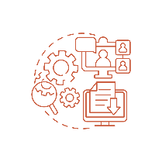


HACCP and Layers of Control Analysis for Acceptance and Release
Define layers of control
Quantify risk reduction
Document and review
Continuous Improvement
Identify potential contamination hazards
Assess effectiveness of each layer
Identify gaps and improvements
Implement a holistic contamination control strategy

Slide 23

Risk & Barriers
Risk Assessment
Technical Challenges
Validation Management Plan

Slide 24

Planning is Essential
The Validation Master Plan (VMP) applies
The VMP provides a strategic and comprehensive outline for validation activities across an organization, ensuring compliance and coherence.
The VP, derived from the VMP, focuses on specific validation projects, detailing the procedures, responsibilities, and requirements needed to achieve compliance for those specific systems or projects.

Slide 25
Validation Master Plan (VMP)
Key characteristics
of a VMP
include
A Validation Master Plan is a high-level document that outlines the overall validation strategy for an entire site or organization. It is comprehensive and covers all aspects of validation activities across various departments and systems within the organization. The VMP is designed to ensure that all components of the validation process are appropriately planned, executed, and maintained to meet regulatory compliance requirements.
Compliance and Review:
It includes compliance requirements and specifies the frequency of reviews and updates to ensure the plan remains current.
Scope and Purpose:
It defines the scope and objectives of all validation activities within the organization.
Responsibilities:
It details the organizational structure and responsibilities for validation activities.
Strategy and Approach:
It outlines the validation strategy and approach, including the integration of Good Manufacturing Practices (GMP).
Documentation:
It references all applicable protocols, reports, and related documents.
A Sub Validation Master Plan (sVMP) is a deep dive into a specific area or validation, for example the analytical method lifecycle.

Slide 26

Validation Master Plan (VMP) Contd..
The purpose of a Validation Master Plan (VMP) is multifaceted, primarily serving as a comprehensive document that outlines the strategy for validation activities within an organization. It is designed to ensure that all validation processes are conducted correctly and are in compliance with regulatory standards.
Organizational Alignment
Documentation of Compliance Requirements
The VMP enables stakeholders within the organization to unify around the details of the validation strategy, eliminating ambiguity and justifying validation activities both internally and externally[3].
The VMP documents the compliance requirements for the site, ensuring that all validation activities meet the necessary regulatory standards[1].
Regulatory Audit Support
Strategic Planning
It provides essential documentation that regulators require during an audit, demonstrating the organization's control over quality and compliance with GMP[2].
It acts as a roadmap for validation, detailing what, how, and when validation activities will be executed. This includes the lifecycle of the manufacturing validation process and integrates Good Manufacturing Practices (GMP)[2].
Educational Tool
Here are the
Key Purposes
of a VMP
Resource Planning
The VMP informs and educates senior management and other stakeholders about the importance of validation in terms of its impact on product quality, thereby fostering an understanding and support for validation activities[3].
The VMP identifies anticipated resource needs and provides key input into scheduling project timelines, which is crucial for efficient validation execution[3].
Risk Mitigation
Control and Direction
By outlining the validation approach and specific validation activities, the VMP helps in mitigating risks associated with product manufacturing or to consumers[2].
It controls and defines different parts of the production process to ensure consistency over time and directs validation strategies for instruments and systems[2].
In summary, the Validation Master Plan is crucial for ensuring that all aspects of validation are planned, executed, and documented in accordance with regulatory requirements and organizational goals. It serves not only as a compliance tool but also as a strategic guide for managing and conducting validation activities effectively[1][2][3].

Slide 27
Validation Plan (VP)
A Validation Plan, on the other hand, is more specific and detailed compared to a VMP. It is typically written for a particular validation project or system. The VP focuses on the specific validation activities for individual pieces of equipment, systems, or processes and is derived from the broader directives set out in the VMP.
Detailed Scope and Objectives: It provides detailed descriptions of what is to be validated, the specific tasks to be performed, and the expected outcomes.
Key characteristics of a VP
include:
Project-Specific Details: It includes timelines, specific procedures, and responsibilities for the particular validation project.
Risk Assessments and Requirements: It details the risk assessments, quality parameters, and regulatory requirements specific to the system or project being validated.
Differences and Relationship
Level of Detail:
Purpose and Use:
Scope:
The VMP is a high-level document that provides an overarching framework and strategy for validation activities across an organization. In contrast, a VP is a detailed, project-specific document that outlines the execution of validation activities for specific systems or projects.
The VMP sets the stage for all validation efforts within an organization and ensures consistency and compliance with industry standards. The VP, derived from the VMP, focuses on specific validation tasks and how they are to be accomplished.
While the VMP covers the entire validation program of an organization, a VP is limited to a particular project or system.

Slide 28
Validation Plan (VP)
A Validation Plan, on the other hand, is more specific and detailed compared to a VMP. It is typically written for a particular validation project or system. The VP focuses on the specific validation activities for individual pieces of equipment, systems, or processes and is derived from the broader directives set out in the VMP.
Key characteristics of a VP include
Detailed Scope and Objectives
Project-Specific
Details
Risk Assessments and Requirements
It provides detailed descriptions of what is to be validated, the specific tasks to be performed, and the expected outcomes.
It includes timelines, specific procedures, and responsibilities for the particular validation project.
It details the risk assessments, quality parameters, and regulatory requirements specific to the system or project being validated.
Differences
and Relationship
Level of Detail
The VMP is a high-level document that provides an overarching framework and strategy for validation activities across an organization. In contrast, a VP is a detailed, project-specific document that outlines the execution of validation activities for specific systems or projects.
Purpose and Use
The VMP sets the stage for all validation efforts within an organization and ensures consistency and compliance with industry standards. The VP, derived from the VMP, focuses on specific validation tasks and how they are to be accomplished.
Scope
While the VMP covers the entire validation program of an organization, a VP is limited to a particular project or system.

Slide 29
Risk-Based Verification Strategy
Emphasize a science and risk-based approach throughout the analysis process
Ensure SMEs are involved in all stages of the risk assessment and verification planning
Focus on critical aspects that affect product quality and patient safety
Use the FMEA results to inform the Verification Plan, concentrating on testing critical aspects
Develop a Verification Test Matrix (VTM) that identifies critical testing based on risk levels and SME input
Create Verification Test Protocols (VTPs) for critical aspects, with acceptance criteria derived from system design documents
Leverage vendor documentation and testing where appropriate to avoid redundant testing
Ensure the Quality Unit approves acceptance criteria for critical aspects
Document the entire process, including risk assessments, design reviews, and verification activities
Prepare a comprehensive System Verification Report that concludes with a statement of fitness for intended us

Slide 30

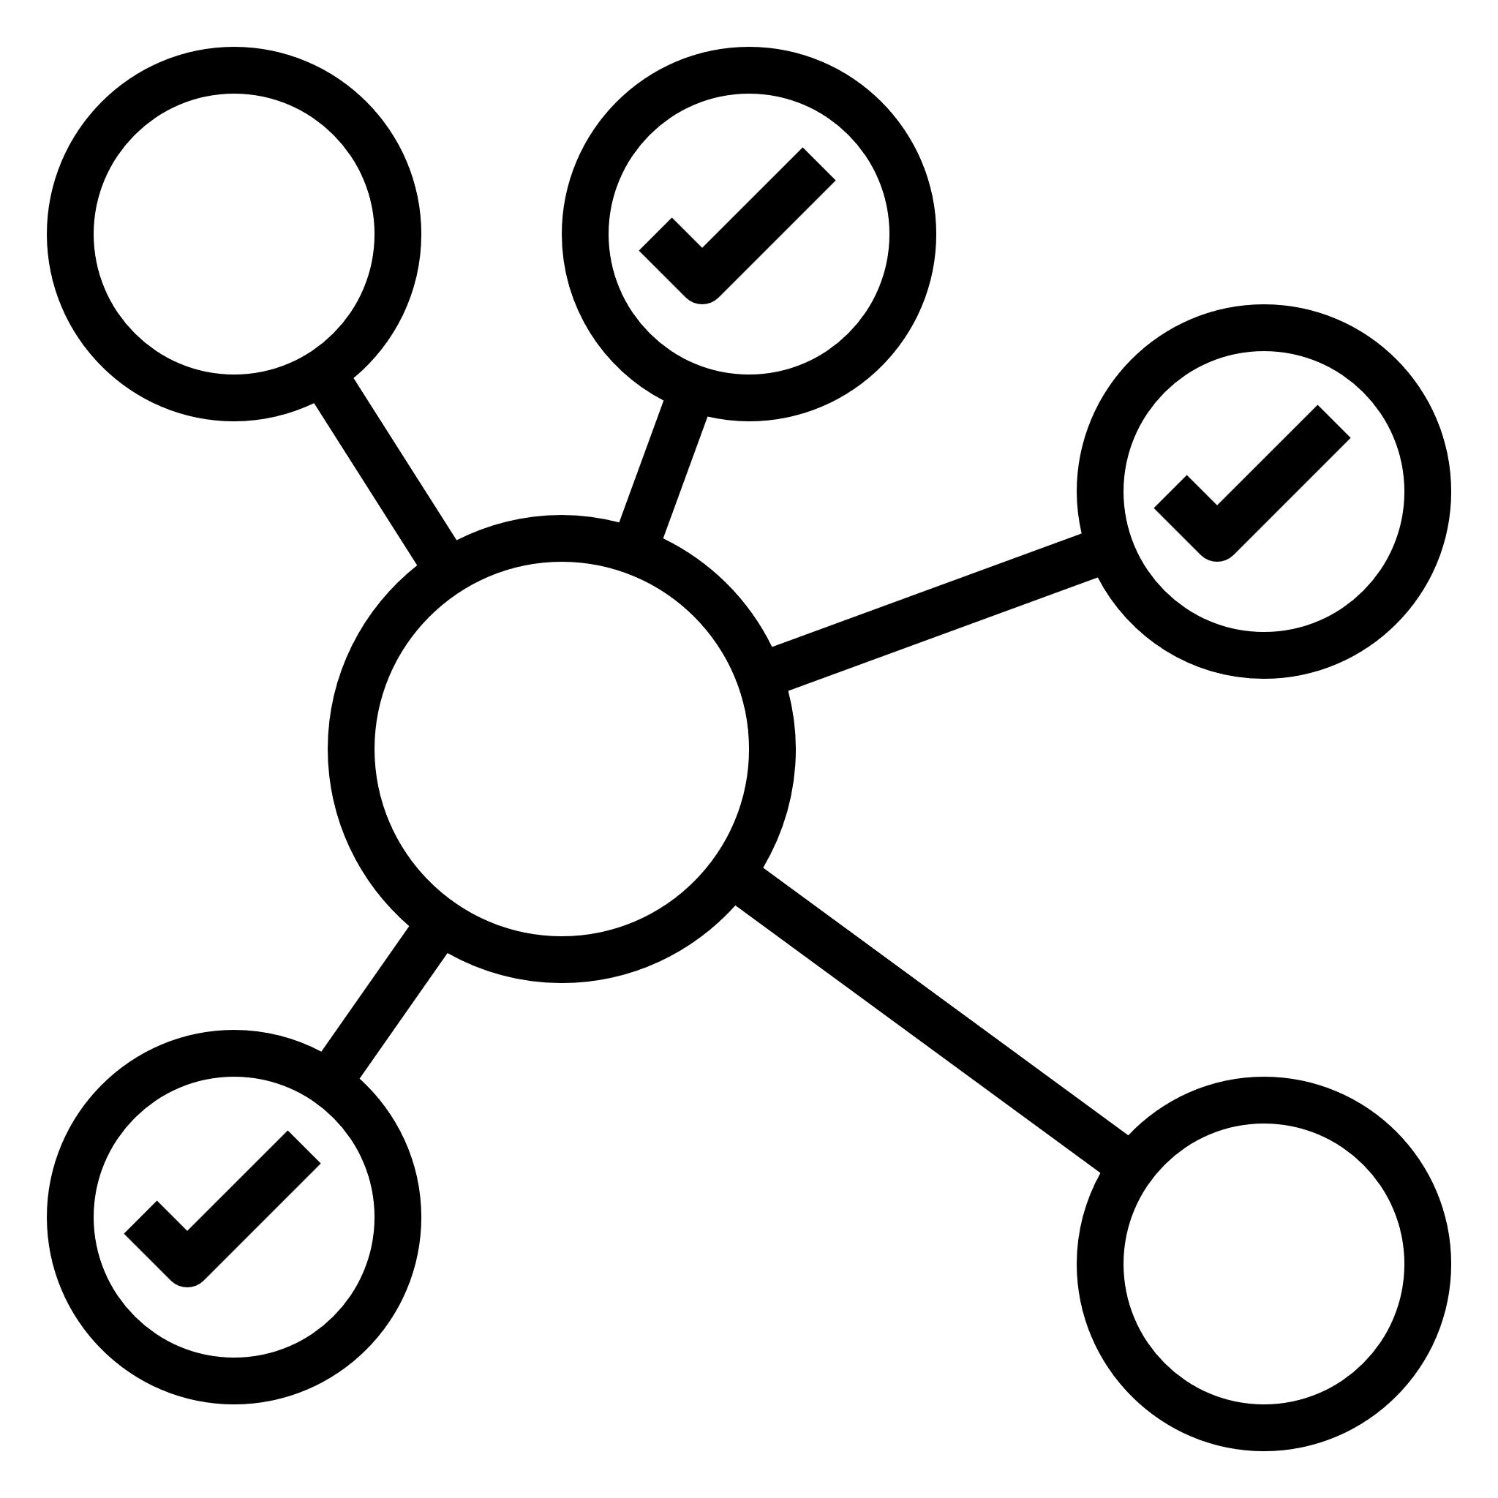

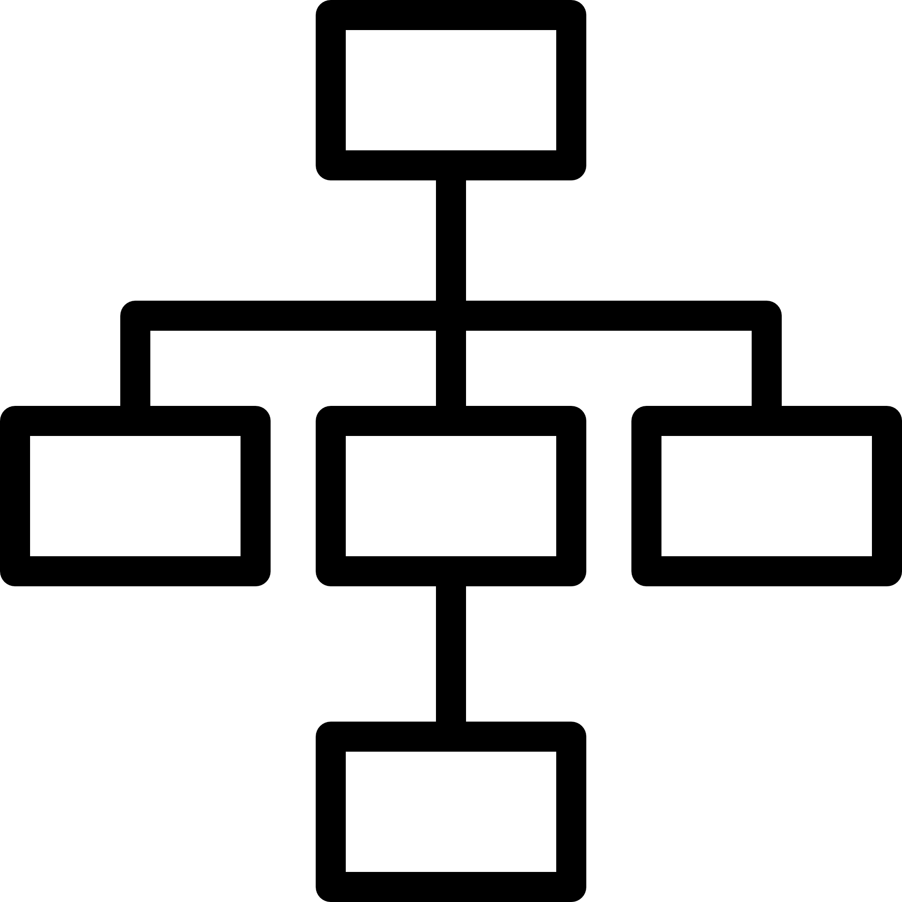

L5: Optimizing
L4: Predictible
L3:
Standardized
There’s a culture of continuous improvement in validation processes, aligned with the latest industry best practices and regulatory expectations.
Innovation in validation approaches is encouraged, always maintaining alignment with ASTM E2500 principles.
The organization actively contributes to developing industry standards and best practices in validation.
Validation activities are seamless integrated with other quality management systems, supporting a holistic approach to product quality and patient safety.
Advanced technologies (e.g., artificial intelligence, machine learning) may be leveraged to enhance risk assessment and validation strategies.
Key Performance Indicators (KPIs) for validation activities are established and regularly monitored.
Data-driven decision-making is used to continually improve the efficiency and effectiveness of validation processes.
Advanced risk management techniques are employed to predict and mitigate potential issues before they occur.
There’s a strong focus on leveraging supplier documentation and expertise to streamline validation efforts.
Engineering procedures for quality activities (e.g., vendor technical assessments and installation verification) are formalized and consistently applied.
L2:
MANAGED
Validation processes are standardized across the organization and align with ASTM E2500 principles.
Risk-based approaches are consistently used to determine the scope and extent of validation activities.
SMEs are systematically involved in the design review and verification processes.
The concept of “verification” replaces traditional IQ/OQ/PQ, focusing on critical aspects that impact product quality and patient safety.
Quality risk management tools (e.g., impact assessments, risk management) are routinely used to identify critical quality attributes and process parameters.
L1: INITIAL
Basic validation processes are established but may not fully align with ASTM E2500 guidelines.
Some risk assessment tools are used, but not consistently across all projects.
Subject Matter Experts (SMEs) are involved, but their roles are unclear.
There’s increased awareness of the need for scientific justification in validation activities.
Validation activities are performed inconsistently across different projects or departments.
There’s limited understanding of ASTM E2500 principles.
Risk assessment and scientific rationale for validation activities are not systematically applied.
Documentation is inconsistent and often incomplete

